Slide 1
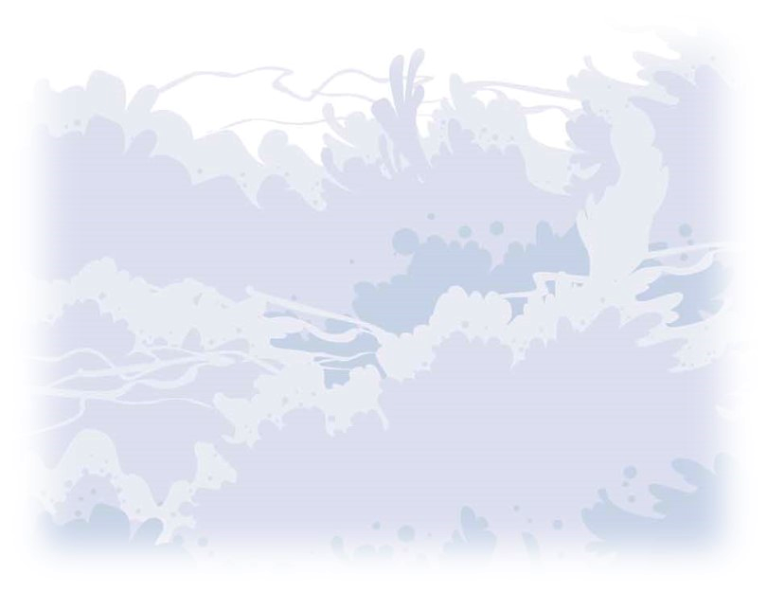
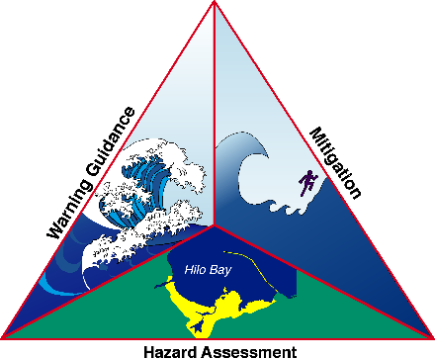
NTHMP
Tsunami Information
Guide
Presented by:
National Tsunami Hazard Mitigation Program
https://nws.weather.gov/nthmp/guide/
NTHMP
Tsunami Information
Guide
Presented by:
National Tsunami Hazard Mitigation Program
https://nws.weather.gov/nthmp/guide/
NTHMP
Tsunami Information
Guide
Presented by:
National Tsunami Hazard Mitigation Program
https://nws.weather.gov/nthmp/guide/
NTHMP
Tsunami Information
Guide
Presented by:
National Tsunami Hazard Mitigation Program
https://nws.weather.gov/nthmp/guide/

Slide 2
A tsunami is one of nature’s most destructive forces. If you live, work, or play at the coast, you should prepare for a tsunami. Tsunamis don’t happen very often, but they pose a major threat to coastal communities. The NTHMP Tsunami Information Guide answers questions about:
Tsunami Basics
Tsunamis in the United States
U.S. Tsunami Warning System
Tsunami Safety
Download a free copy at:
https://nws.weather.gov/nthmp/guide/
A tsunami is one of nature’s most destructive forces. If you live, work, or play at the coast, you should prepare for a tsunami. Tsunamis don’t happen very often, but they pose a major threat to coastal communities. The NTHMP Tsunami Information Guide answers questions about:
Tsunami Basics
Tsunamis in the United States
U.S. Tsunami Warning System
Tsunami Safety
Download a free copy at:
https://nws.weather.gov/nthmp/guide/
A tsunami is one of nature’s most destructive forces. If you live, work, or play at the coast, you should prepare for a tsunami. Tsunamis don’t happen very often, but they pose a major threat to coastal communities. The NTHMP Tsunami Information Guide answers questions about:
Tsunami Basics
Tsunamis in the United States
U.S. Tsunami Warning System
Tsunami Safety
Download a free copy at:
https://nws.weather.gov/nthmp/guide/
A tsunami is one of nature’s most destructive forces. If you live, work, or play at the coast, you should prepare for a tsunami. Tsunamis don’t happen very often, but they pose a major threat to coastal communities. The NTHMP Tsunami Information Guide answers questions about:
Tsunami Basics
Tsunamis in the United States
U.S. Tsunami Warning System
Tsunami Safety
Download a free copy at:
https://nws.weather.gov/nthmp/guide/

Slide 3
A tsunami is one of nature’s most destructive forces. If you live, work, or play at the coast, you should prepare for a tsunami. Tsunamis do not occur very often, but they pose a major threat to coastal communities. While they cannot be prevented, there are things you can do before, during, and after a tsunami that could save lives.
If you are near the coast and you
Get an official tsunami warning,
Feel a long or strong earthquake,
See a sudden rise or fall of the ocean, or
Hear a load roar from the ocean,
a tsunami may be coming.
Go to high ground or inland!
Tsunami.gov
A tsunami is one of nature’s most destructive forces. If you live, work, or play at the coast, you should prepare for a tsunami. Tsunamis do not occur very often, but they pose a major threat to coastal communities. While they cannot be prevented, there are things you can do before, during, and after a tsunami that could save lives.
If you are near the coast and you
Get an official tsunami warning,
Feel a long or strong earthquake,
See a sudden rise or fall of the ocean, or
Hear a load roar from the ocean,
a tsunami may be coming.
Go to high ground or inland!
Tsunami.gov
A tsunami is one of nature’s most destructive forces. If you live, work, or play at the coast, you should prepare for a tsunami. Tsunamis do not occur very often, but they pose a major threat to coastal communities. While they cannot be prevented, there are things you can do before, during, and after a tsunami that could save lives.
If you are near the coast and you
Get an official tsunami warning,
Feel a long or strong earthquake,
See a sudden rise or fall of the ocean, or
Hear a load roar from the ocean,
a tsunami may be coming.
Go to high ground or inland!
Tsunami.gov
A tsunami is one of nature’s most destructive forces. If you live, work, or play at the coast, you should prepare for a tsunami. Tsunamis do not occur very often, but they pose a major threat to coastal communities. While they cannot be prevented, there are things you can do before, during, and after a tsunami that could save lives.
If you are near the coast and you
Get an official tsunami warning,
Feel a long or strong earthquake,
See a sudden rise or fall of the ocean, or
Hear a load roar from the ocean,
a tsunami may be coming.
Go to high ground or inland!
Tsunami.gov

