Slide 1
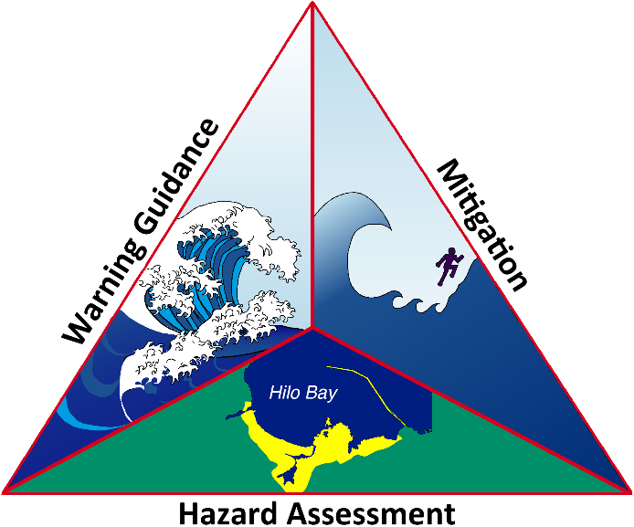
NTHMP
Tsunami
Information
Guide
Presented by the National Tsunami Hazard Mitigation Program
Download a free copy at:
https://nws.weather.gov/nthmp/guide/

Slide 2
Table of Contents
1. Introduction
1.1. What is the purpose of this guide?
1.2. Who will benefit from this information?
1.3. How is this guide organized?
1.4. What is the National Tsunami Hazard Mitigation Program?
2. Tsunami Basics
2.1. What is a tsunami?
2.2. What causes a tsunami?
2.3. Where do tsunamis happen?
2.4. When do tsunamis happen?
2.5. What is the difference between a local and a distant tsunami?
2.6. Why are tsunamis dangerous?
3. Tsunamis in the United States
3.1. Where can tsunamis happen in the United States?
4. U.S. Tsunami Warning System
4.1. What is the U.S. Tsunami Warning System?
4.2. What do the U.S. tsunami warning centers do?
4.3. How do the U.S. tsunami warning centers detect and observe tsunamis?
4.4. How do the U.S. tsunami warning centers forecast and warn about tsunamis?
4.5. What is a tsunami message?
4.6. How do the U.S. tsunami warning centers issue tsunami messages?
4.7. What federal agencies support the U.S. Tsunami Warning System and what are their roles?
4.8. What roles do state/territory and local governments have in the U.S. Tsunami Warning System?
4.9. How does the United States support international tsunami warning systems?
5. Tsunami Safety
5.1. What is my risk?
5.2. How will I know if a tsunami is coming?
5.3. How can I prepare for a tsunami?
5.4. How should I respond to a tsunami message?
5.5. What should I do after a tsunami?
5.6. What do I need to do to prepare for and respond to a tsunami if I am a boat owner or captain?
5.7. How can coastal communities prepare for a tsunami?
Appendix A: Acronyms
Appendix B: Historic Tsunamis
Appendix C: Key Resources
Appendix D: NTHMP Partner Contact Information

