Slide 1
Aviation Weather Center
briefing for
WFO LWX
Aviation Customers Forum
Jonathan Leffler, Warning Coordination Meteorologist

Slide 2
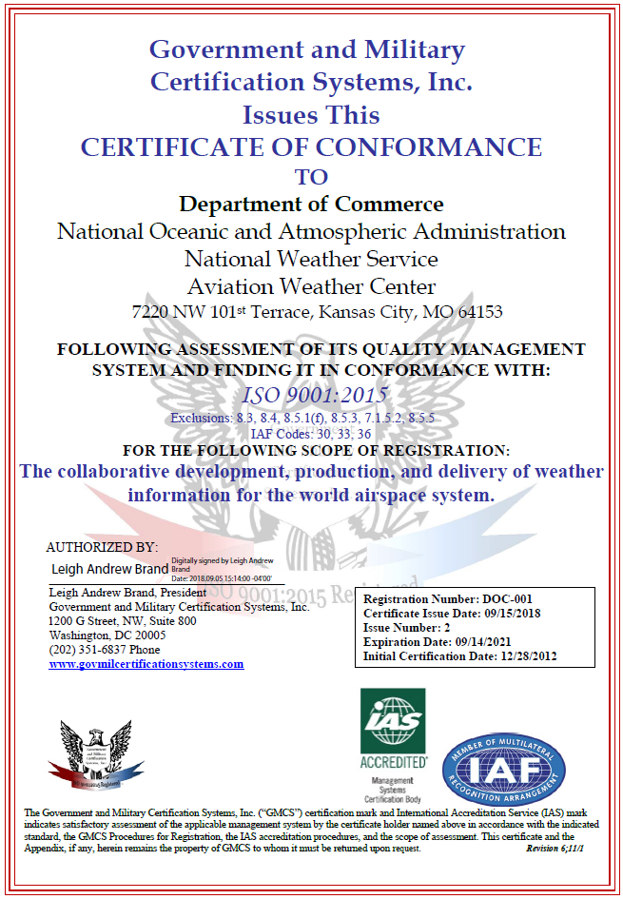
ISO 9001:2015 Quality Management System
Ensures AWC continuously improves
Incorporates internal and external audits
AWC has been certified under the ISO:9001 standard since 2012.
The AWC is currently the only United States government weather forecasting center that meets ICAO requirements to adhere to the ISO:9001 standard.

Slide 3
AWC National Footprint
557th Weather Wing 1st Weather Group COOP Site - Offutt AFB, Omaha
557th WW/1st WXG/ 15th Operational Weather Squadron
Backup Site - Scott AFB, St. Louis
Aviation Weather Center
World Area Forecast Center - Washington Kansas City, MO
National Aviation Meteorologists FAA Air Traffic Control System Command Center Warrenton, VA
Notes:
A few of the other national centers of NCEP include the Tropical Prediction / Hurricane Center, the Storm Prediction Center, and the Space Weather Prediction Center.

Slide 4
AWC Key Stakeholders
Federal Aviation Administration (FAA)
National Transportation Safety Board (NTSB)
National Business Aviation Association (NBAA)
Commercial Airlines
General Aviation Community
Aircraft Owner and Pilot Association (AOPA)
International Meteorological Service Providers
International Civil Aviation Organization (ICAO)
United States Air Force (USAF)

Slide 5
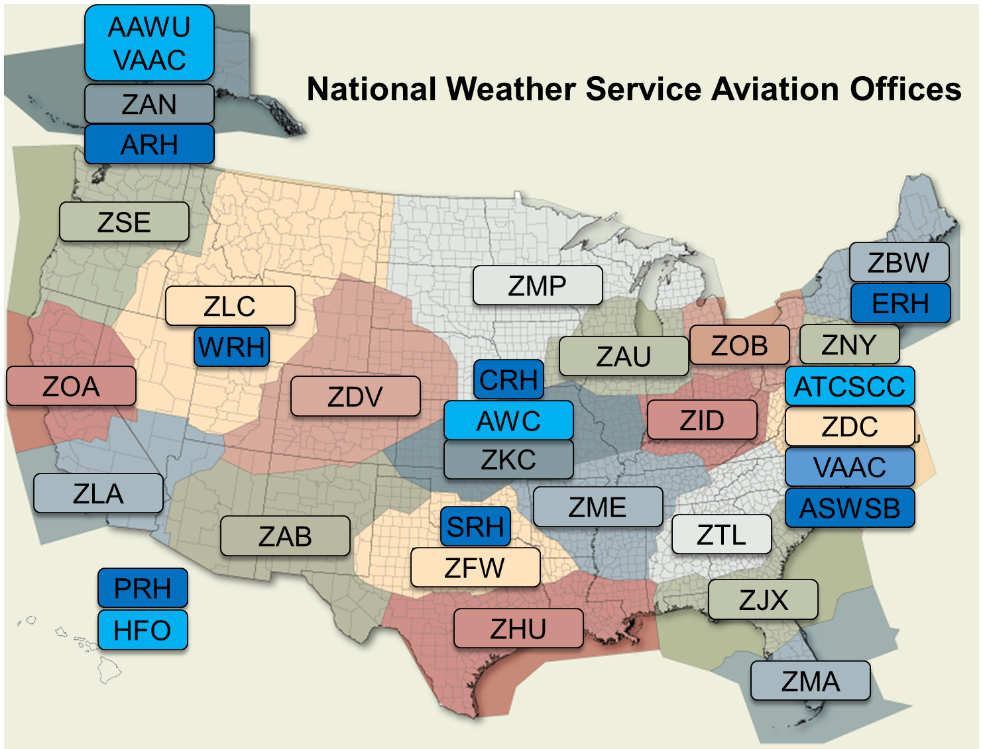
NOAA/NWS Aviation Program
3
MWO
2
VAAC
21
CWSU
122
WFO

Slide 6
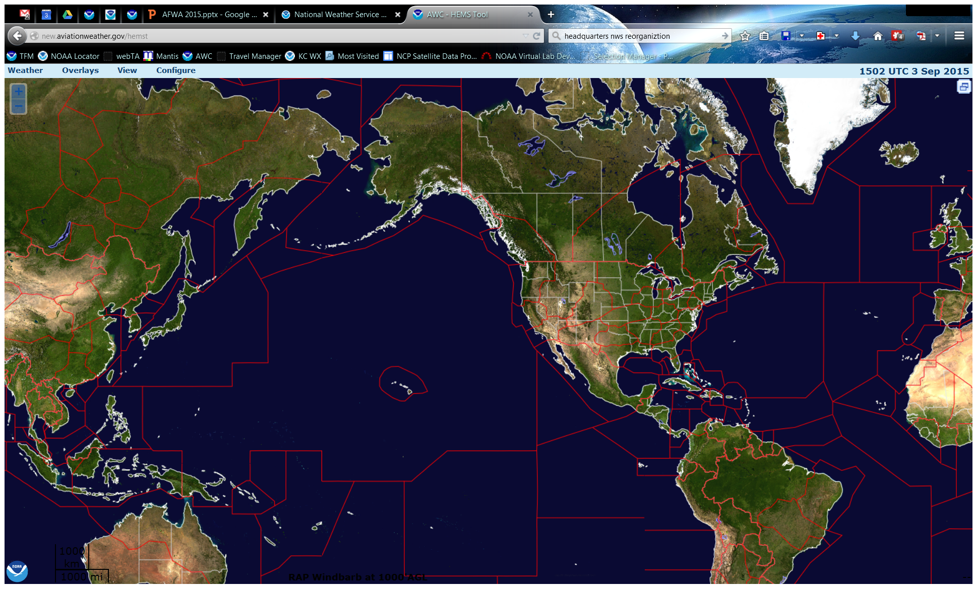
US Area of Responsibility for
Aviation Warnings (SIGMETs)
AAWU
AWC
HFO

Slide 7
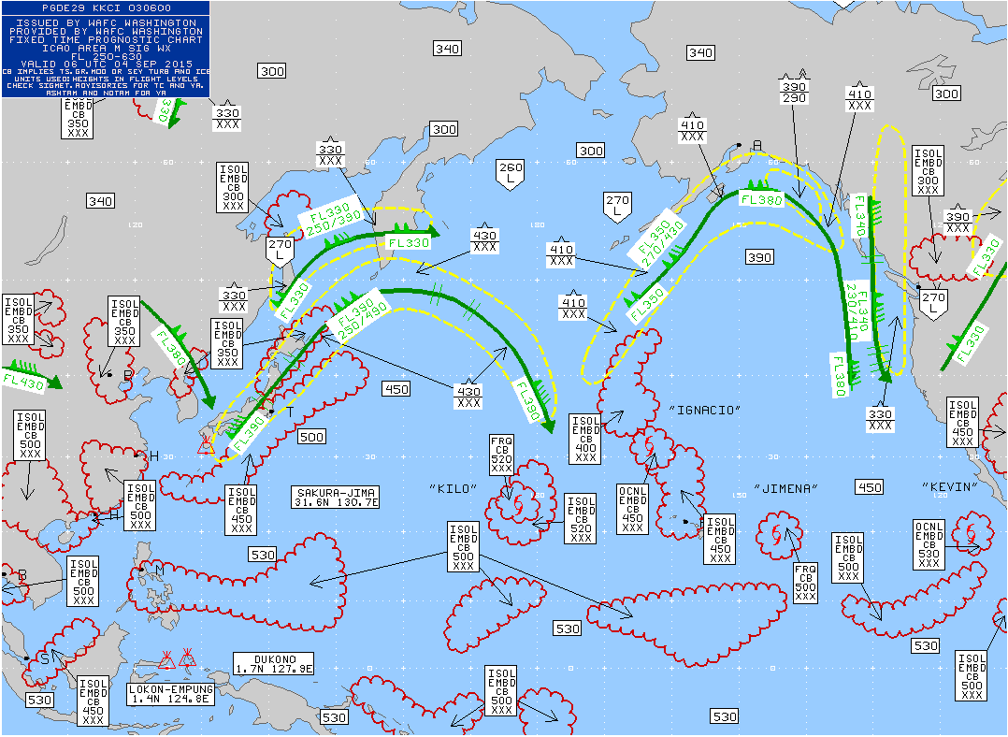
World Area Forecast Centers
WAFC Washington
Formulated by ICAO and WMO
One of Two International WAFCs
Global Area of Responsibility
Products & Services
Global Significant Weather Charts
WAFC Internet File System (WIFS)
WAFC Global Grids
Wind and Temperature Charts

Slide 8
Meteorological Watch Office SIGMETs
Convection
Severe Turbulence
Severe Icing
Widespread Duststorm & Sandstorms
Volcanic Ash Cloud
Tropical Cyclones

Slide 9
International Aviation Operations
Warnings
Forecasts
Collaboration
Desks
SIGMETs
Atlantic
Pacific
Global Sig Weather (SIGWX)
Area Forecasts
Gulf of Mexico
Caribbean
Global Met. Services
Tropical
SIGWX North
SIGWX South

Slide 10
Domestic Aviation Operations
Warnings
Advisories & Forecasts
Collaboration
Desks
SIGMETs
CONUS
Coastal Waters
AIRMET
TFM Convective Forecast
Low-Level SIGWX
CWSUs
Airlines
FAA
Convective SIGMET
TCF
Turbulence
Icing
Clouds & Visibility

Slide 11
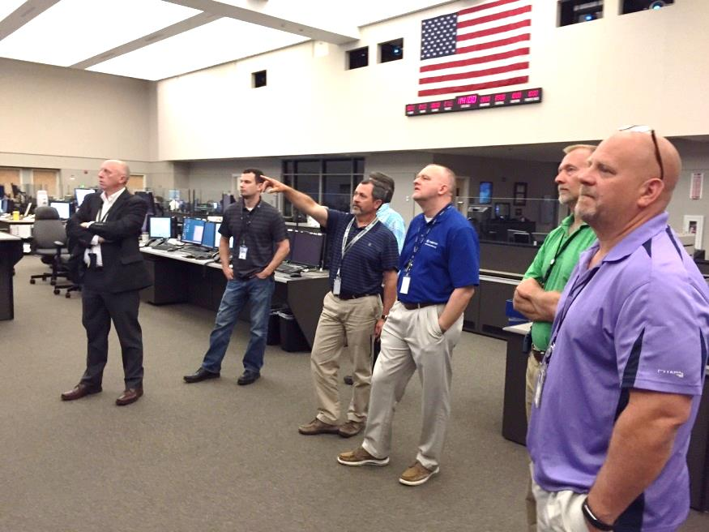
National Aviation Meteorologists
Decision Support
NAS Assessment
PERTI
JATOC/J-CAT
Embedded Impact Decision Support Services
Post-event Reviews
Debriefings
Plan
Execute
Review
Train
Improve
Joint Air Traffic Operations Command’s Incident Command System

Slide 12
Aviation Support Branch
Products & Services
Data, Technology & Infrastructure
Science and Technology
Web Services
WAFS Internet Files Service
Numerical Aviation Wx Prediction
Shift Fill-In
IT Architecture
IT Security
Production Systems
Data Management
Aviation Weather Testbed
Aviation Weather Research Program
Clouds/Visibility Research

Slide 13
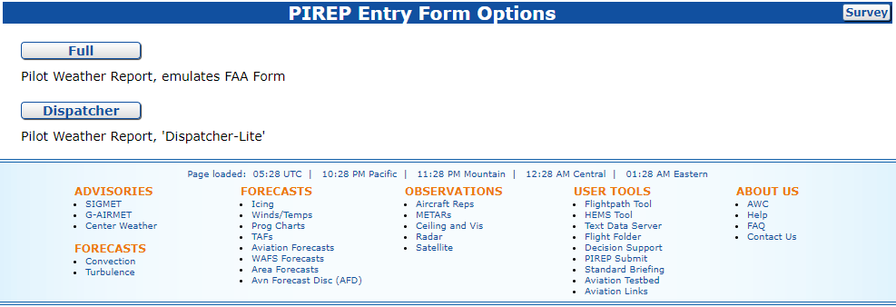
Improving Aviation Services
PIREPs
Primary source for validating AIRMET/SIGMET
Null values are just as important as severe
Submit reports at aviationweather.gov/pirep/submit

Slide 14
Improving Aviation Services
TAFs/Aviation Forecast Discussions
Timing beyond near term is important
Examples: TCF & TS, IFR & LL SIGWX/AIRMET
Alternate scenarios for conditions unable to convey in TAF
Collaboration
CWSU staffed 16/7, mid shift TCF sets up morning push
Industry & WFO participation in chat very helpful

Slide 15
Questions?

