Slide 2
NWS Service Assessments are typically commissioned for the most high-impact events.
Full report available at:
http://www.nws.noaa.gov/om/assessments/index.shtml
The South Carolina Floods of 2015 are the subject of the most recent NWS
Service Assessment.
This event was related to Hurricane Joaquin, which, while not making landfall, did funnel
very high amounts of moisture into the region.

Slide 3
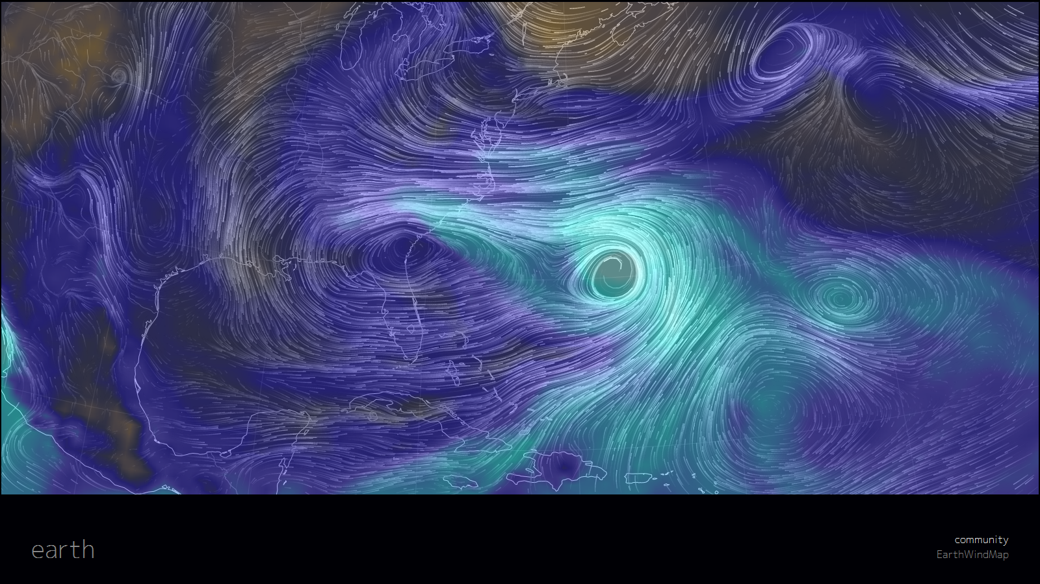
Hurricane Joaquin and moisture flux
0 kg/m2
35kg/m2
70kg/m2
EarthWindMap Using GFS 850mb Wind 12Z analysis for 10/04/2015.
TPW in color background image.
From: http://earth.nullschool.net/#2015/10/04/1200Z/wind/isobaric/850hPa/overlay=total_precipitable_water/stereographic=-73.67,30.46,3000

Slide 4
Parts of South Carolina received
record rainfall

Slide 5
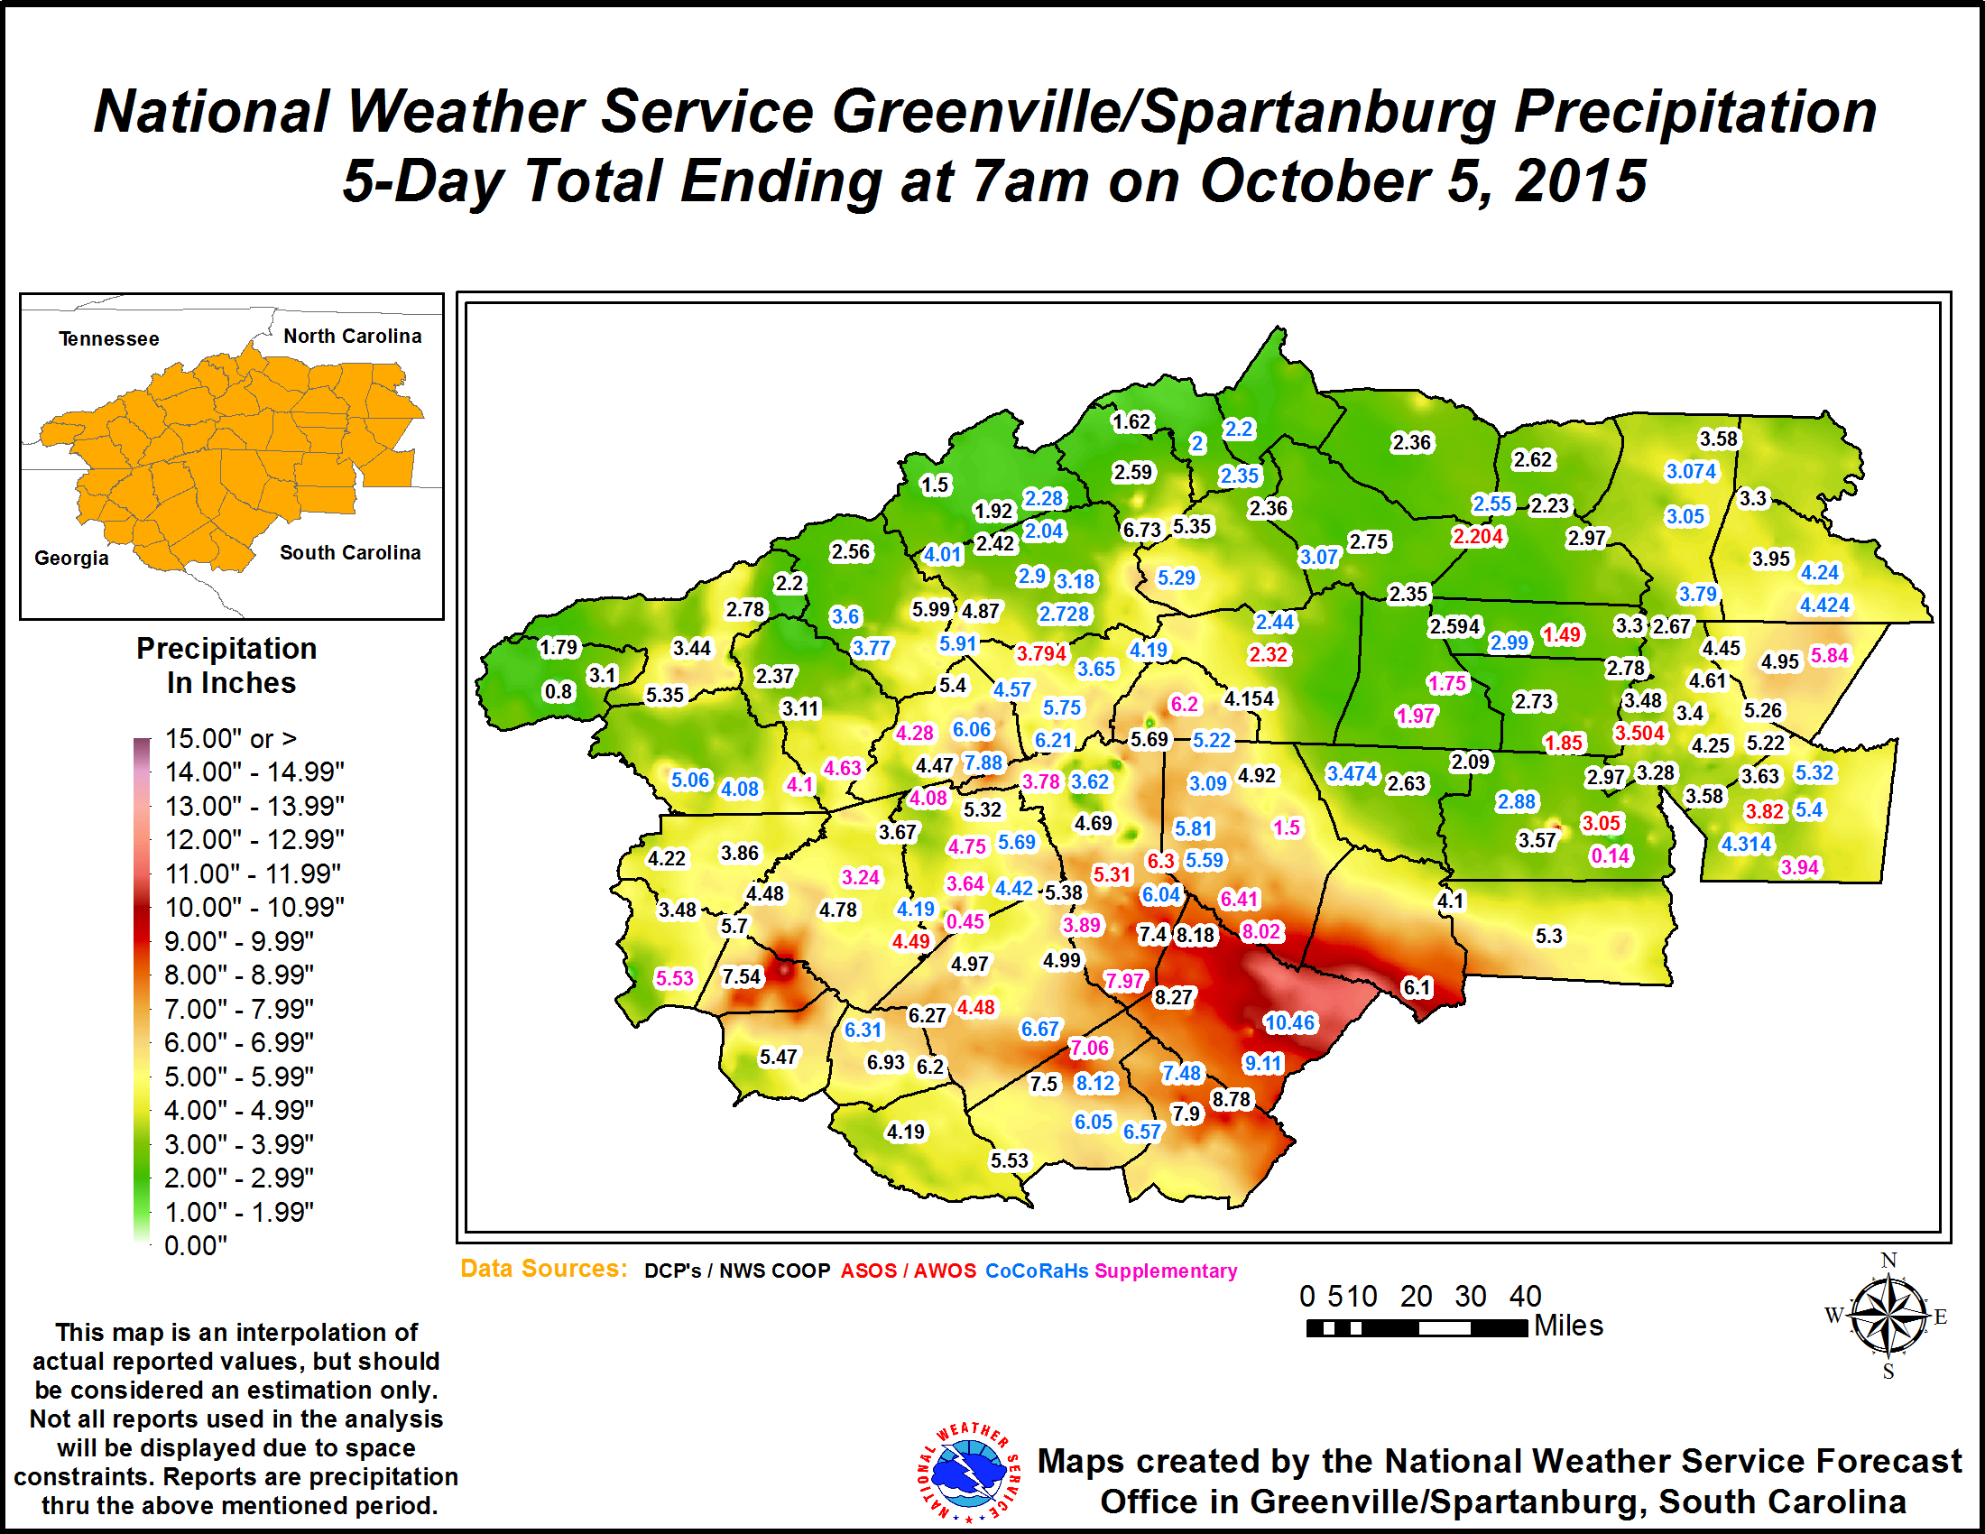
The GSP service area also had some high rainfall amounts, and more
extreme amounts had been forecast earlier.

Slide 6
Excessive Rain Events with up to 10 inches are not unprecedented in the GSP CWA:
Sep. 17-22 2009: 19.94” at Lake Toxaway, 10” inches over several counties.
June 25-27 2006: 7” to 14” over 8 counties.
Oct. 7-8 2005: Tropical Storm Tammy 6 to 14”
Sep. 2004: Tropical Storms Frances (Sep. 7-8) and Ivan (Sep. 17-18)
10” to 18” over Blue Ridge Mountains from Frances
5” to 17” from Ivan
July 1-3 2003: Remnants of Tropical Storm Bill, up to 9”
Plus many cases of flash flooding from convective storms with local amounts
in the 6” to 8” range.
Excessive Rain events generally focused over the mountains, with some exceptions.

Slide 7
Official Service Assessment Report had 40 Findings/Recommendations
The top 9 are below

Slide 8
WFO Charleston’s use of "Historic and Life-Threatening Flash Flooding" terminology
and its issuance of flash flood emergencies were highly effective in garnering
the attention of NWS partners, stakeholders, and public.
Finding 2: During the floods, there were 36 dam failures across South Carolina.
Some of these failures had posed a threat to life and property.
Recommendation 2: If a dam break poses a severe threat to human life or
catastrophic damage, the WFO, in coordination with the EM, should issue a
flash flood emergency for more effective communication to the public.

Slide 9
During the event, the WFOs issued numerous watches, warnings, and advisories.
The WFOs struggled with whether to issue areal flood or flash flood warnings.
There was confusion in extending the warning times, allowing warnings to expire,
transitioning from flash flood to areal flood warnings, and/or providing more specific
impact statements about the floods.
Finding 3: It was challenging for NWS forecasters to understand when to transition from
one flood product to another (e.g., when to transition from a flash flood watch/warning to
areal flood warning—especially for this magnitude of a storm).
Recommendation 3: With the help of social scientists, the NWS should revise
NWS Instruction 10-922 to provide simplified criteria for issuing a flash flood warning,
areal flood warning, and urban small stream flood advisory. Additionally, forecasters
should be trained on these revised products, as well as best practices for transitioning
between products.

Slide 10
Finding 22: The public, media partners, and EMs were confused by the many types and the
quantity of watches/warnings WFOs issued.
Recommendation 22: The NWS should review hydrologic products described in 10-922 and
determine if the suite of flood products can be condensed, revise this directive, and
provide training to forecasters on the revised 10-922, especially concerning when and
how to use specific hydrologic warning products.

Slide 11
WFOs Wilmington and Greenville-Spartanburg used the SERFC Meteorological Models
Ensemble Forecast System (MMEFS) in their briefings to convey the probability of their
forecast points reaching flood stage, moderate flood stage, and major flood stage.
EMs and dam operators found these briefings helpful and conveyed additional
information beyond the deterministic forecasts.
Finding 4: EMs and dam operators commented that additional hydrologic forecasts
beyond the deterministic river forecasts would have helped determine the range of
severity for the pending event.
Recommendation 4: RFCs should provide additional probabilistic information to
complement the deterministic forecasts routinely for all forecast points.

Slide 12
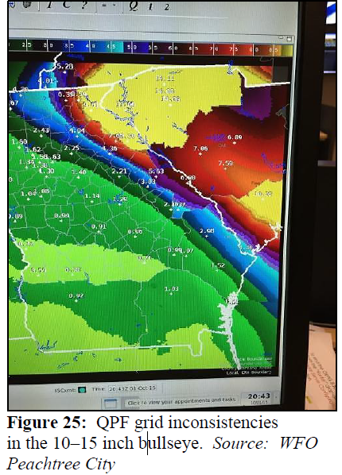
Recommendation 15: The NWS should track and
accelerate the development of a visual grid
collaboration tool for use between WPC, WFOs,
and RFCs to make collaboration more effective
and help address spatial inconsistencies.

Slide 13
Finding 32: Because the SERFC staff member deployed to FEMA Region IV Center did not
have prior Incident Command System (ICS) Training specific to Region IV, this person
initially had difficulty understanding the NWS role and how to integrate into the
ICS in that setting.
Recommendation 32: The NWS should expedite the existing goal of ICS training for
meteorologists and hydrologists. Likewise, the NWS should expedite the development
of a cadre of Emergency Response Specialists (ERS) experienced in various disciplines
such as hydrologic and water resources issues, who have taken appropriate FEMA
preparatory coursework and ERS training.

Slide 14
Finding 34: Social scientific research is needed to determine an effective outreach strategy
with effective Public Service Announcement (PSA) content designed to minimize the
dangerous practice of motorists driving through flooded roadways.
Recommendation 34: NWS should work with social scientists to provide
behavior-based statements and videos to demonstrate the results of not following
the “Turn Around Don’t Drown” slogan.
Finding 35: Most public respondents interviewed had never visited NWS web pages or
NWS social media outlets.
Recommendation 35a: The NWS should work with marketing specialists to bring more
awareness to NWS web pages and NWS social media outlets.
Recommendation 35b: The NWS should work with social media outlets to push
life-threatening alerts to social media users via zip codes in the threatened areas.

Slide 15
Finding 40: Several EM county directors indicated they were not aware of the IWT concept.
Recommendation 40: The NWS should increase awareness of the IWT concept with
core partners and conduct IWT workshops to strategically harness the existing relationships.

