Slide 1





Winter Weather
Forecast Scenario
YOU MAKE THE CALL
Title
North & Central GA Partners Workshop (IWT)
December 4, 2018
Notes:
Intro Slide

Slide 2
Ground Rules and Info
Title
You are the forecaster in this situation.
Base your forecast on what you would like to see as part of the field you are in (ex. EM, Media, Private, etc…)
You will have limited info to go on for this scenario.
There are NO wrong answers!
Scenario is designed to foster good discussion and if we get off on a tangent, that is OK!
For practical purposes, you will only be forecasting for the downtown Atlanta area.
North & Central GA Partners Workshop (IWT)
December 4, 2018
Notes:
Intro Slide

Slide 3
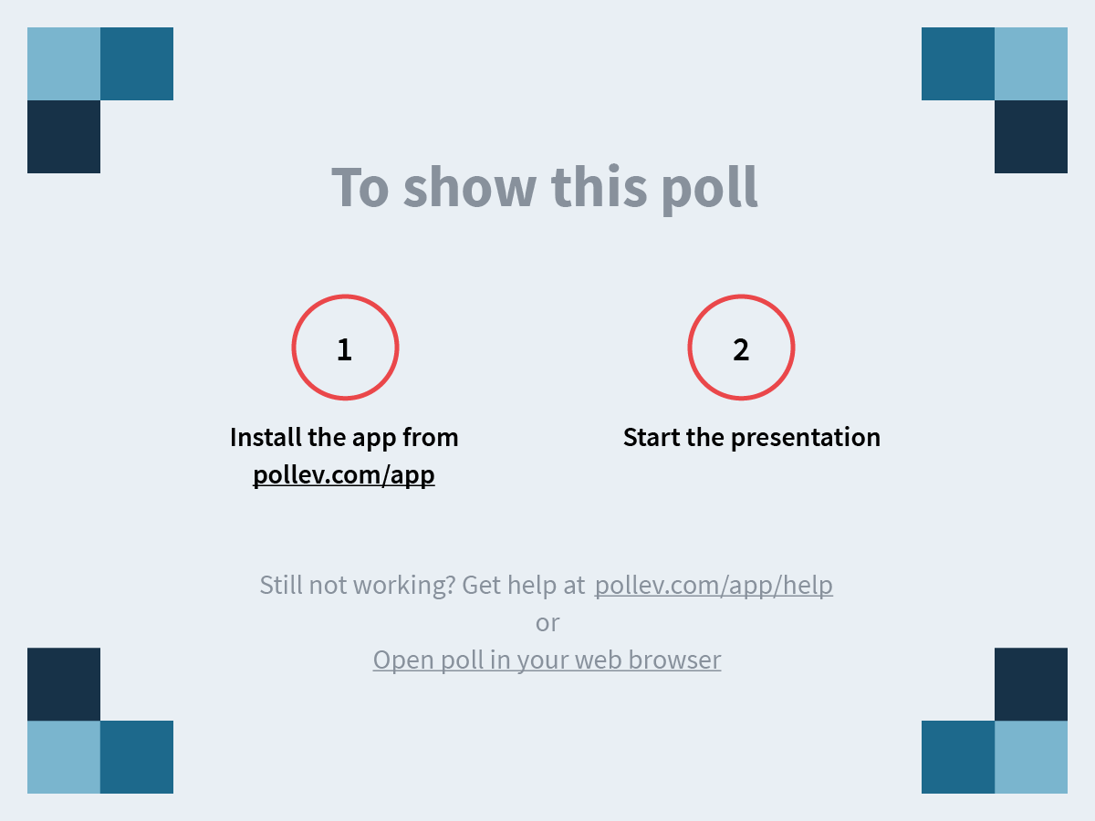
Notes:
Where are you from originally?
https://www.polleverywhere.com/clickable_images/ReywZUtewQH4Oam

Slide 4
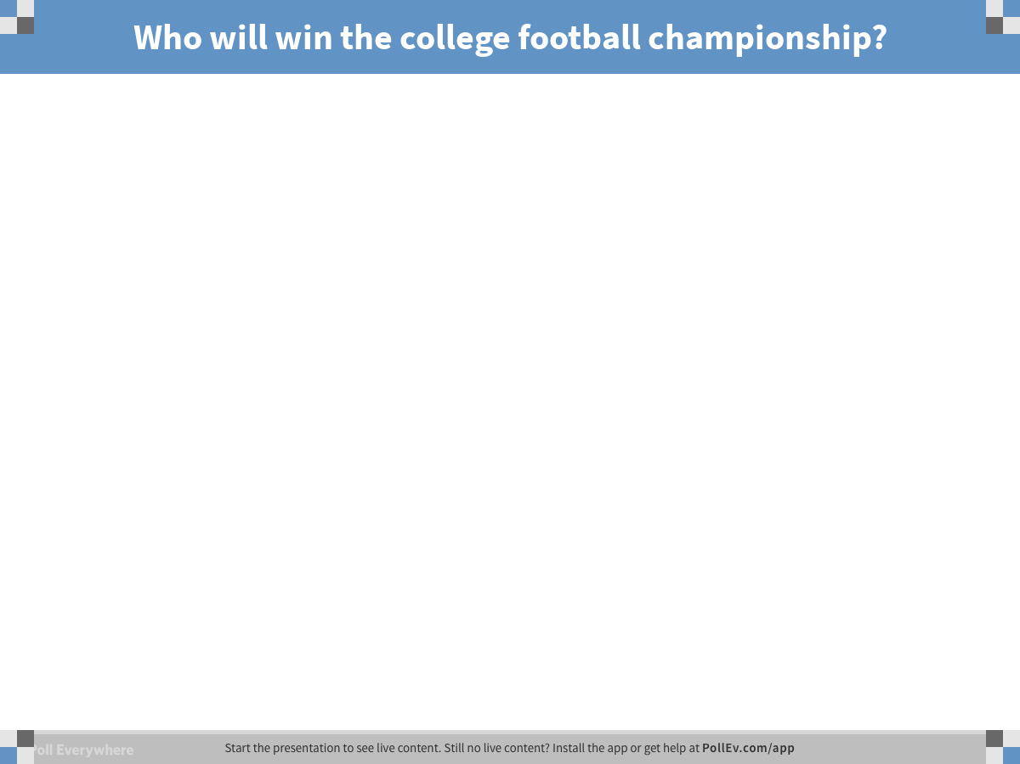
Notes:
Poll Title: Who will win the college football championship?
https://www.polleverywhere.com/free_text_polls/7iL7eg2fC8hWPiA

Slide 5
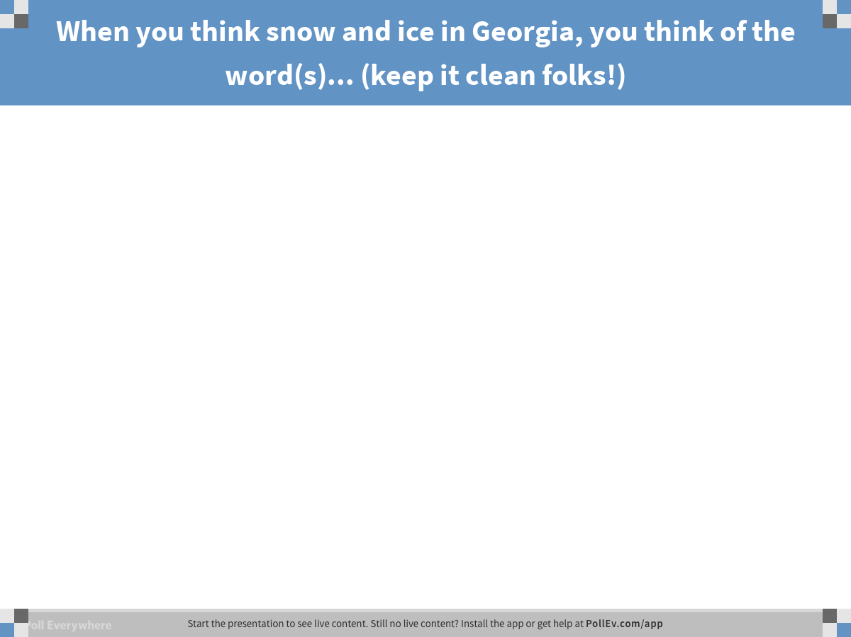
Notes:
Poll Title: When you think snow and ice in Georgia, you think of the word(s)... (keep it clean folks!)
https://www.polleverywhere.com/free_text_polls/s44vGX5A50JaaTH

Slide 6
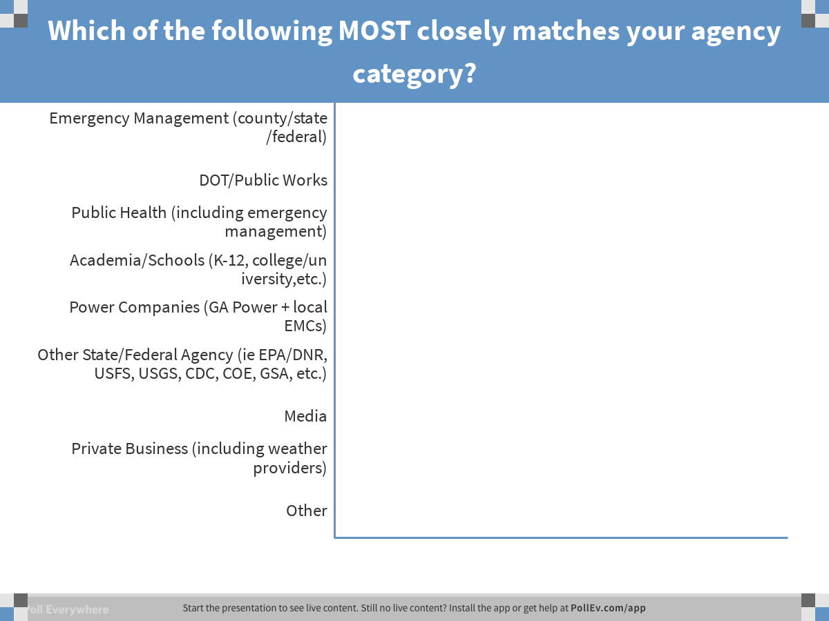
Notes:
Poll Title: Which of the following MOST closely matches your agency category?
https://www.polleverywhere.com/multiple_choice_polls/aoGmLNoPgrTzWHV

Slide 7
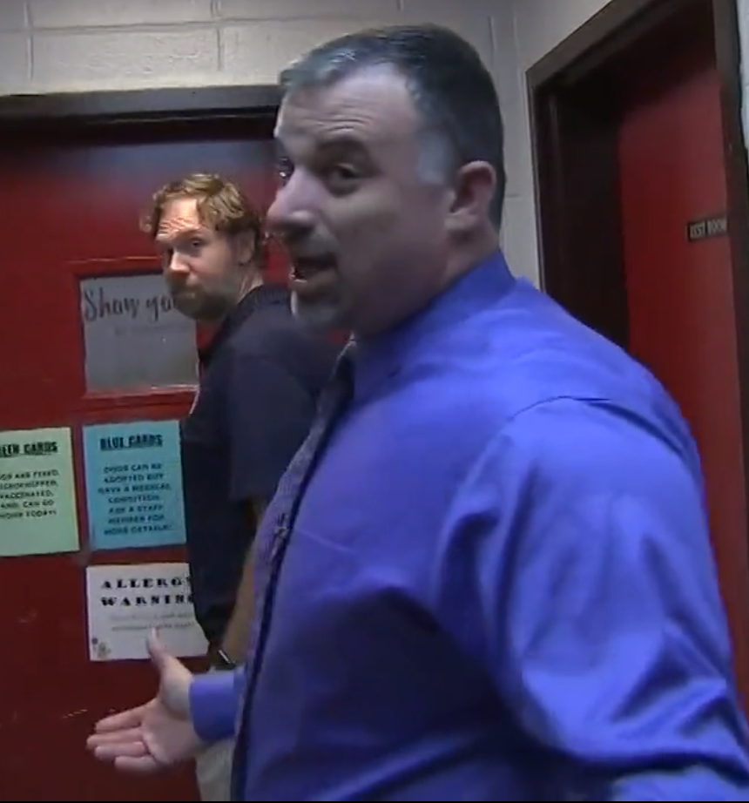
Scenario Overview
Title
You have just taken the helm at the ol’ Weather Bureau for a late January quiet evening shift. Absolutely nothing is going on so you have some time to watch the news.
Nothing going on except another Kallmyer animal shelter story.
You turn your attention to the forecast and what to your wondering eyes should appear but a potential winter storm shown by 6 of your 38 computer models for day 7. You check the Facebook and Twitter and indeed, it has already been picked up on by some social media meteorologists.
North & Central GA Partners Workshop (IWT)
December 4, 2018
Notes:
Intro Slide

Slide 8
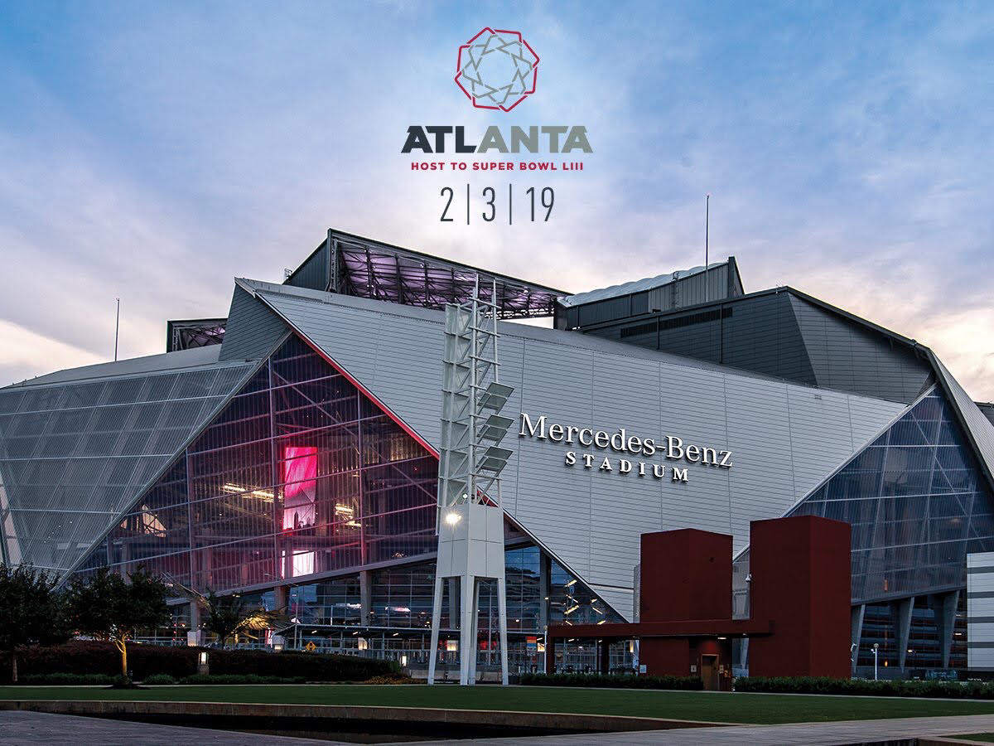
Scenario Overview
Title
Wait a minute…7 days out. Isn’t there something going on in 7 days. What was that? Does it include the Falcons? No that’s not it.
Oh yeah, its’ the Super Bowl!!!
Guess we better actually put some effort into this one!!!
North & Central GA Partners Workshop (IWT)
December 4, 2018
Notes:
Intro Slide

Slide 9
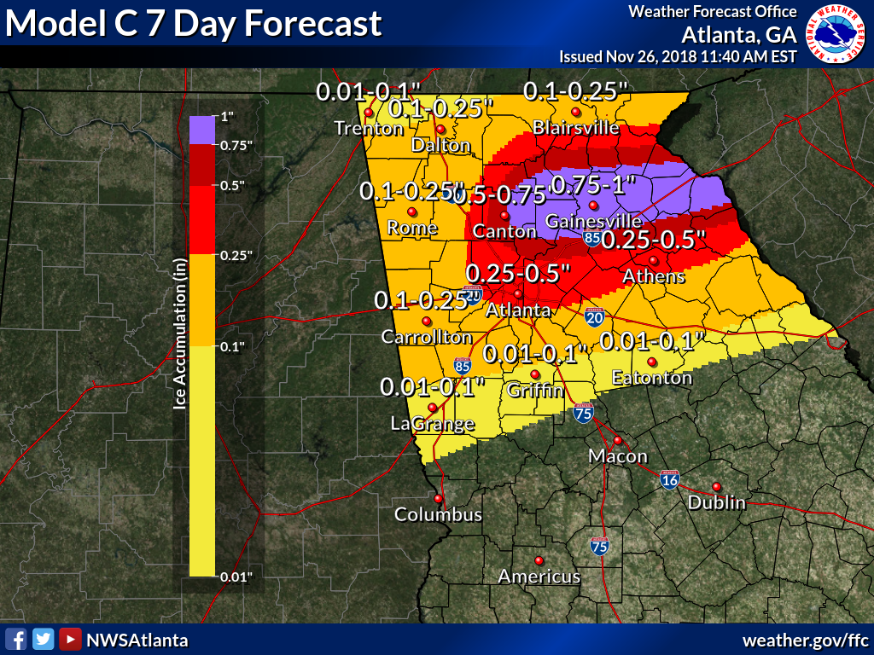
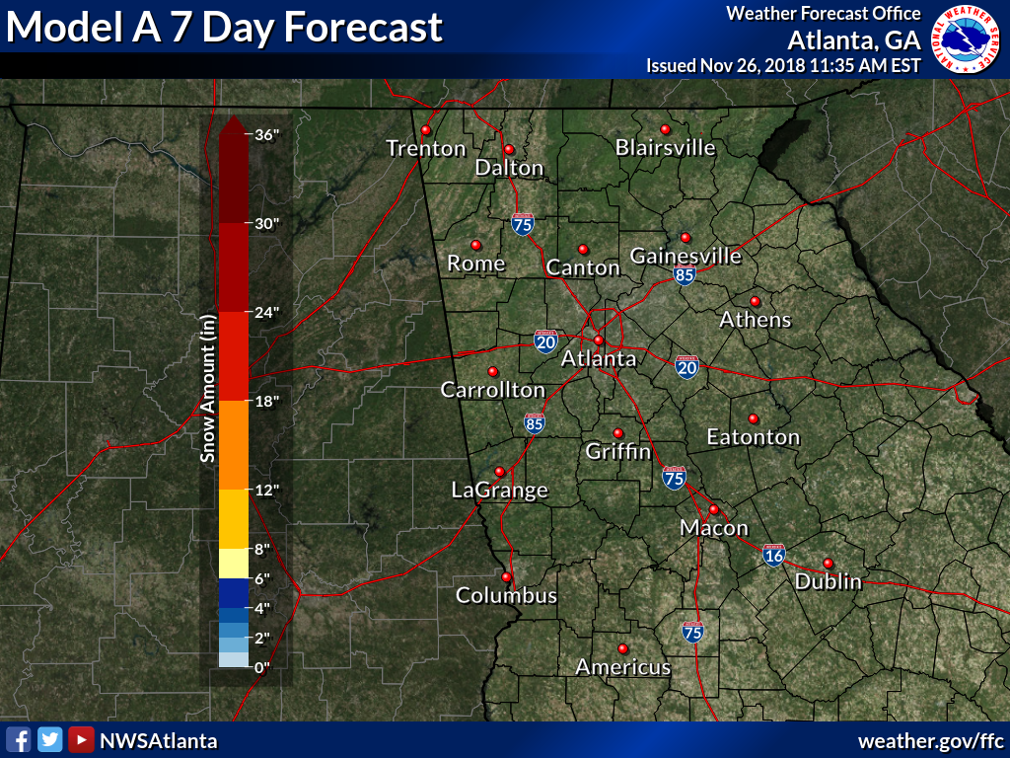
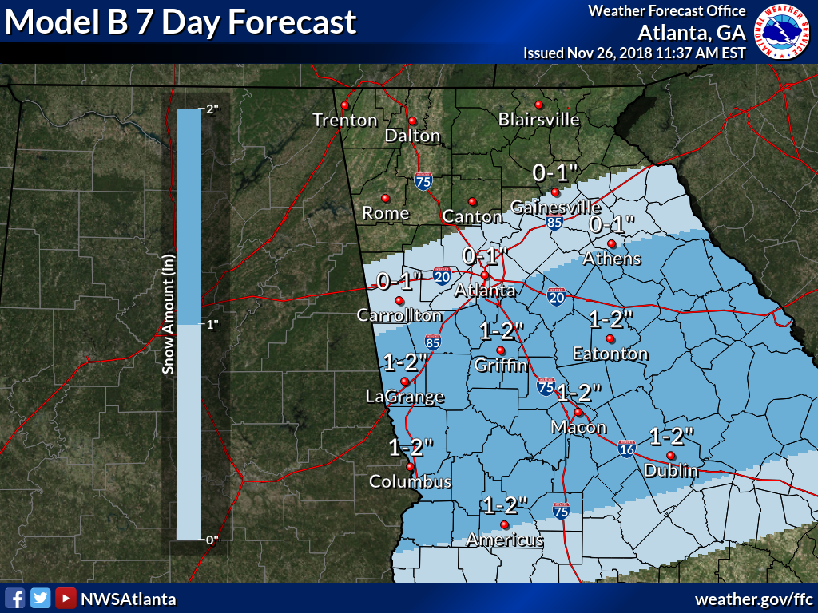
Scenario Overview
Title
North & Central GA Partners Workshop (IWT)
December 4, 2018
Notes:
Intro Slide

Slide 10
Title
A
B
C
Notes:
Intro Slide

Slide 11
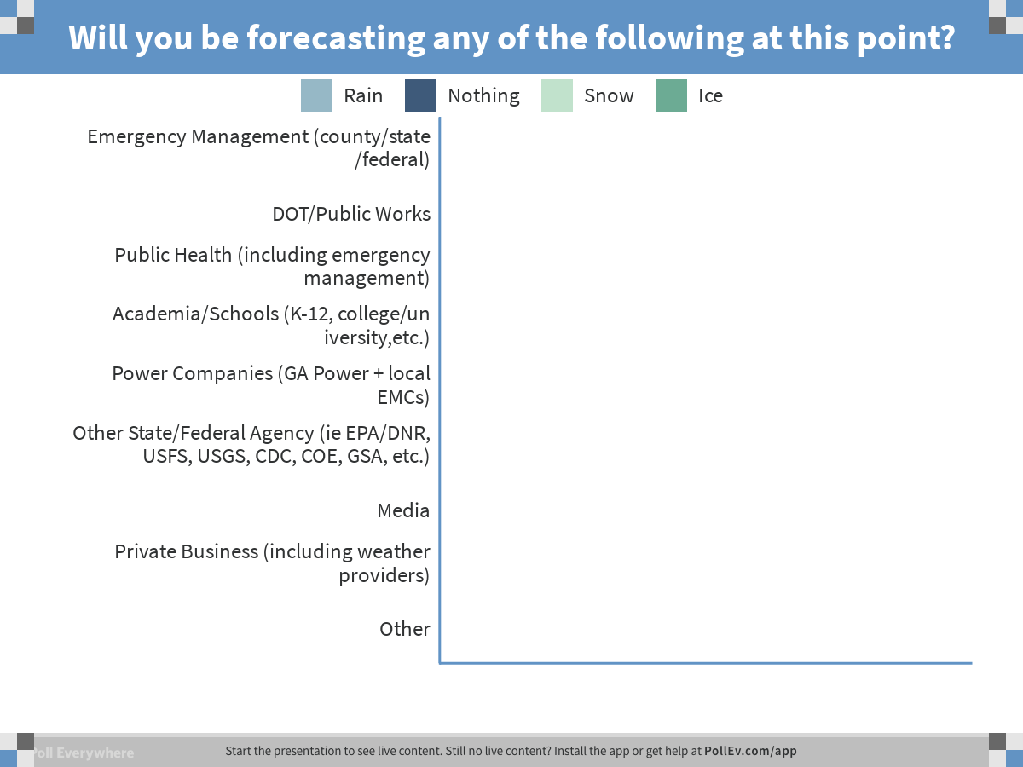
Notes:
Poll Title: Will you be forecasting any of the following at this point?
https://www.polleverywhere.com/multiple_choice_polls/JqxE44WpDwUy6q5

Slide 12
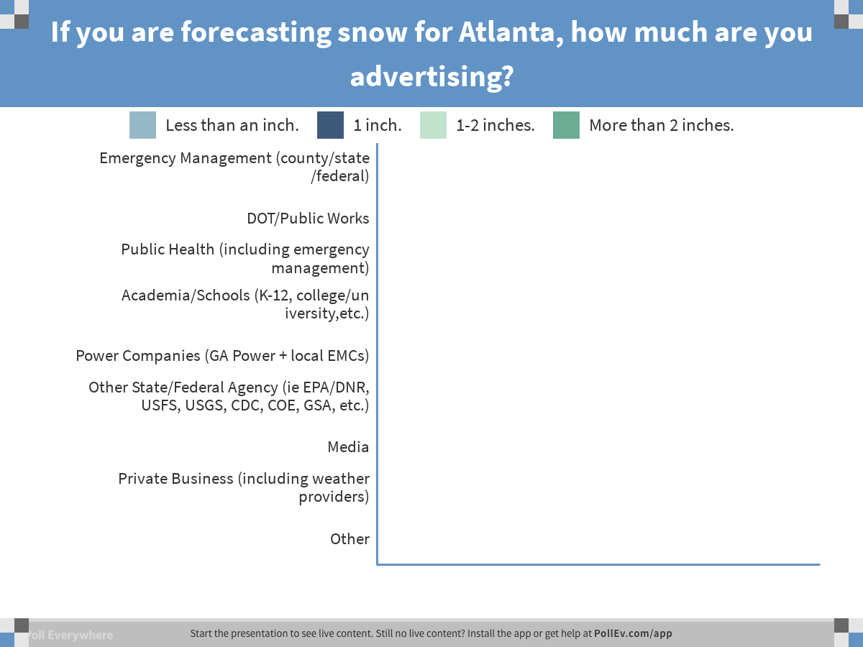
Notes:
Poll Title: If you are forecasting snow for Atlanta, how much are you advertising?
https://www.polleverywhere.com/multiple_choice_polls/6lMxn3PztILE9gp

Slide 13
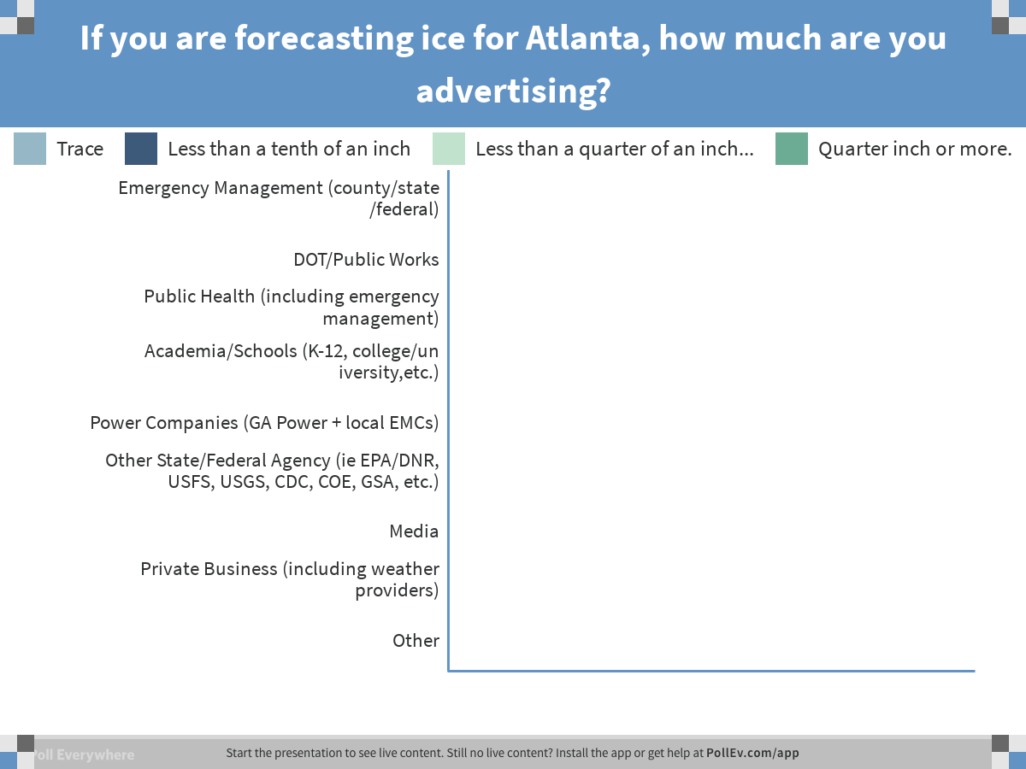
Notes:
Poll Title: If you are forecasting ice for Atlanta, how much are you advertising?
https://www.polleverywhere.com/multiple_choice_polls/dgxwfEPFDMfAWQr

Slide 14
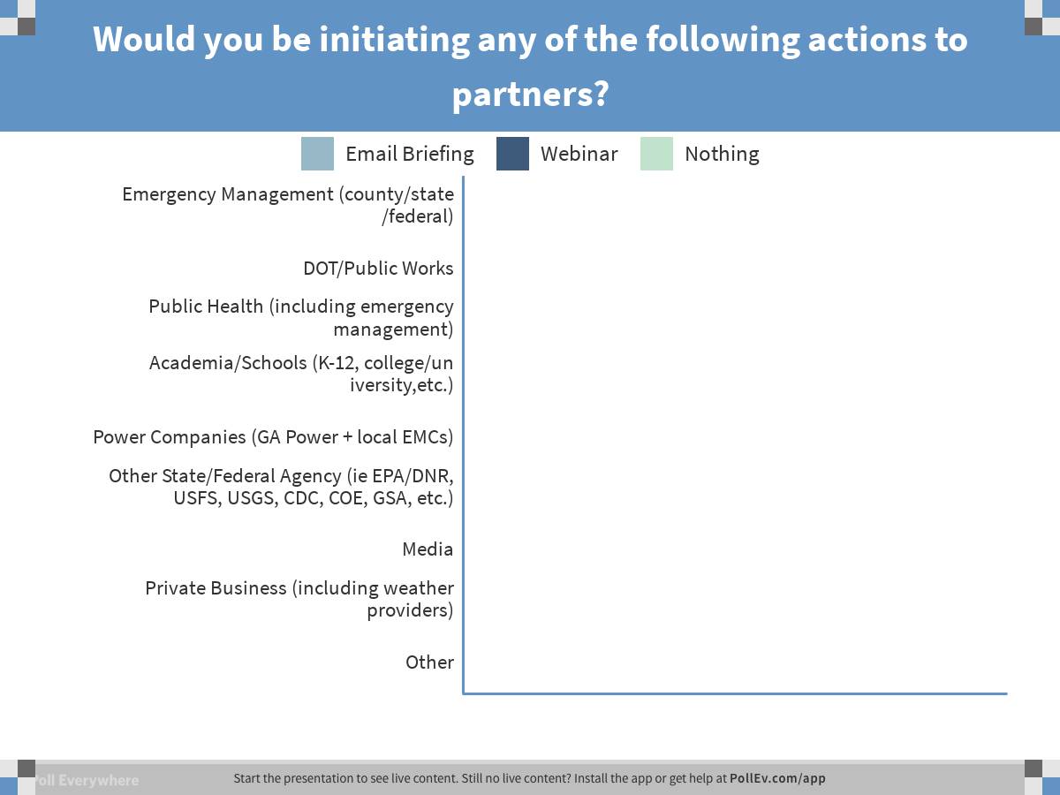
Notes:
Poll Title: Would you be initiating any of the following actions to partners?
https://www.polleverywhere.com/multiple_choice_polls/rGTPwJ6FvfgUF4P

Slide 15
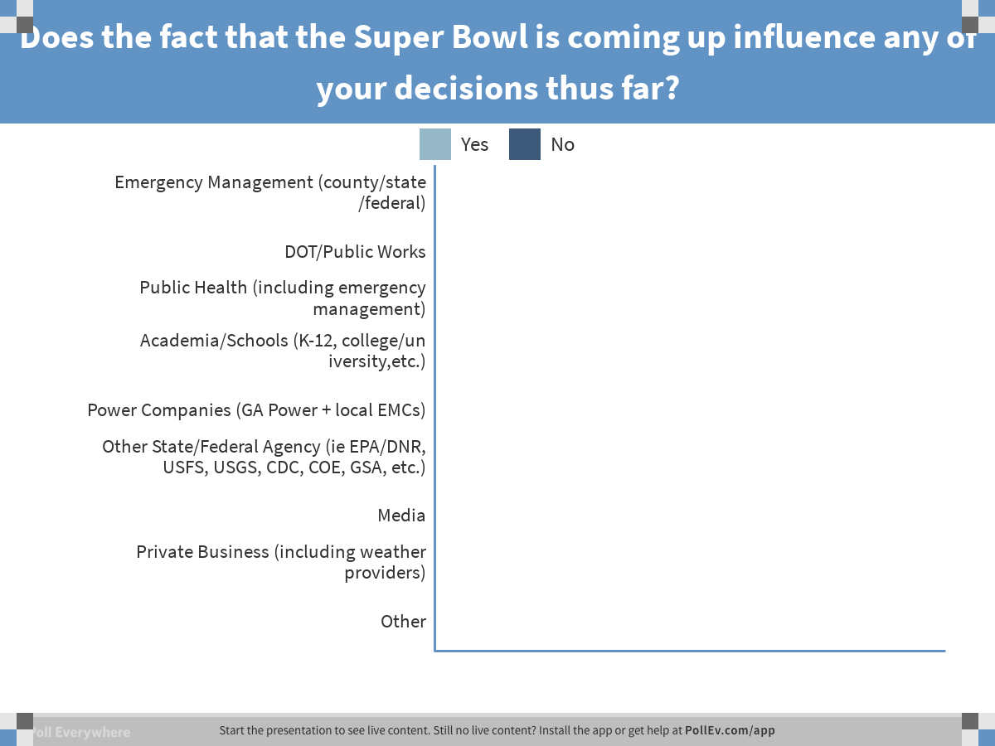
Notes:
Poll Title: Does the fact that the Super Bowl is coming up influence any of your decisions thus far?
https://www.polleverywhere.com/multiple_choice_polls/JLMPBCThDN5ZAHB

Slide 16
Scenario Overview
Questions
Will you be forecasting any of the following at this point
a. Rain, hey I gotta forecast something and don’t want to freak everyone out!
b. Nothing, dude, it is 7 days out and as long as I got some models showing nada, then that’s what I’m going with.
c. Snow, too early to freak people out with ice but I can show snow.
d. Ice, it’s the worst of the impacts so why not advertise the potential and back down later.
2. If you are forecasting snow for Atlanta, how much are you advertising?
a. Less than an inch.
b. 1 inch
c. 1-2 inches
d. More than 2 inches.
Same question but ice.
From a messaging standpoint, what is it time for?
  a. Email to partners only discussing potential.
  b. Email to partners and social media post to public discussing potential.
  c. GoToMeeting briefing to partners and social media post to public discussing potential.
  d. I don’t know enough to message anything yet.
  e. other
  5. Does the fact that the super bowl is during this time period influence your decisions?
Title
Notes:
Intro Slide

Slide 17
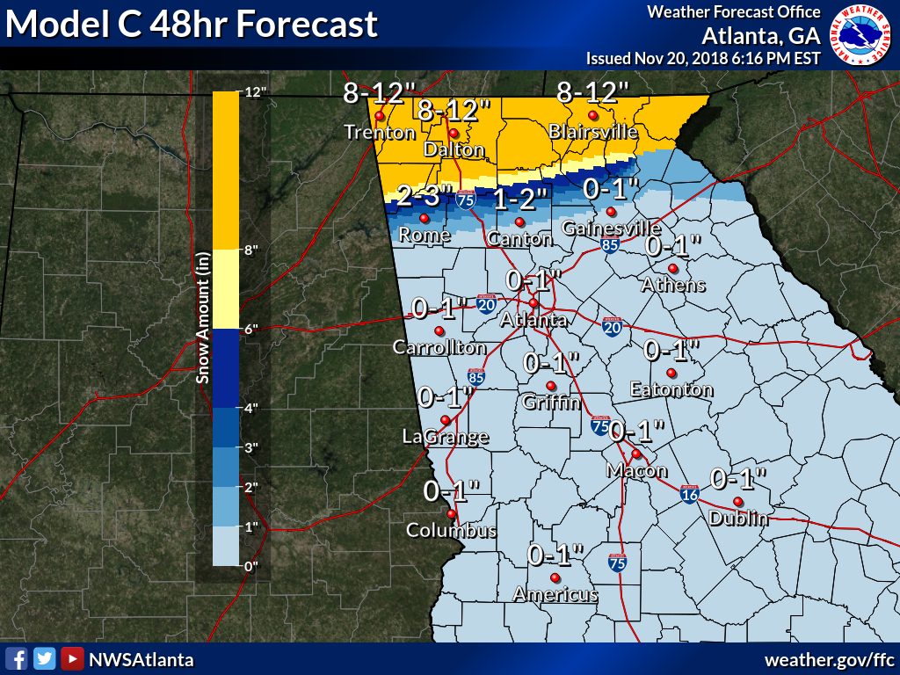
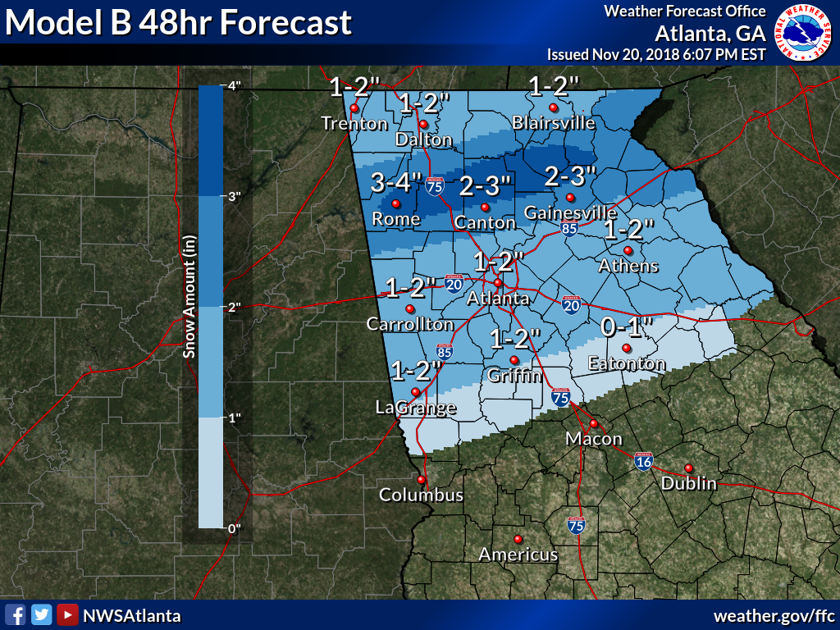
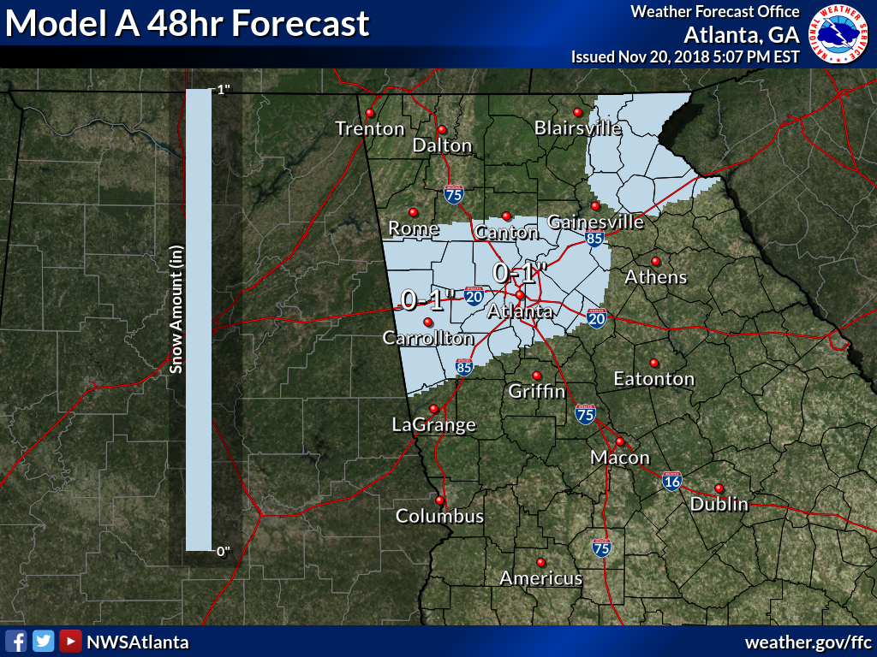
Scenario Overview
Title
North & Central GA Partners Workshop (IWT)
December 4, 2018
Notes:
Intro Slide

Slide 18
Title
A
B
C
Notes:
Intro Slide

Slide 19
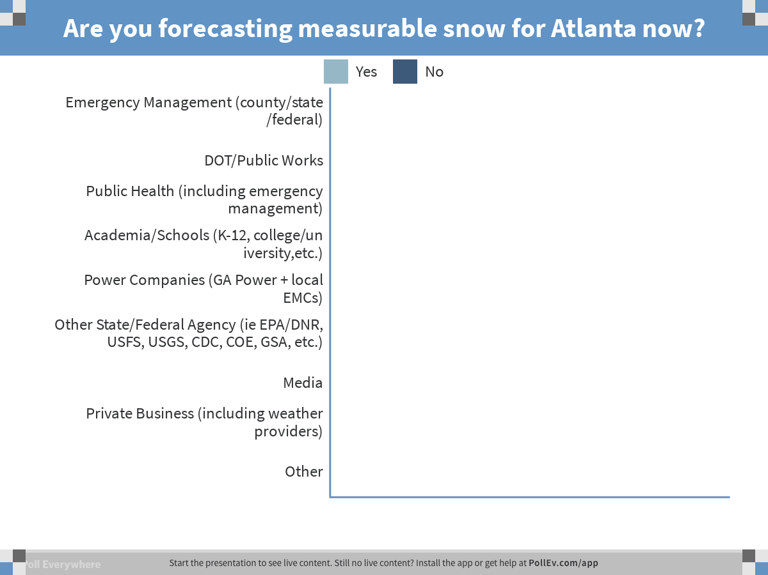
Notes:
Poll Title: Are you forecasting measurable snow for Atlanta now?
https://www.polleverywhere.com/multiple_choice_polls/FopXcP5tZVTCmAz

Slide 20
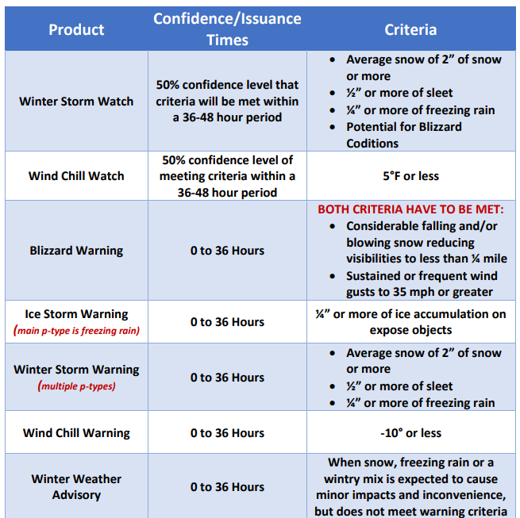
Title
North & Central GA Partners Workshop (IWT)
December 4, 2018
Notes:
Intro Slide

Slide 21
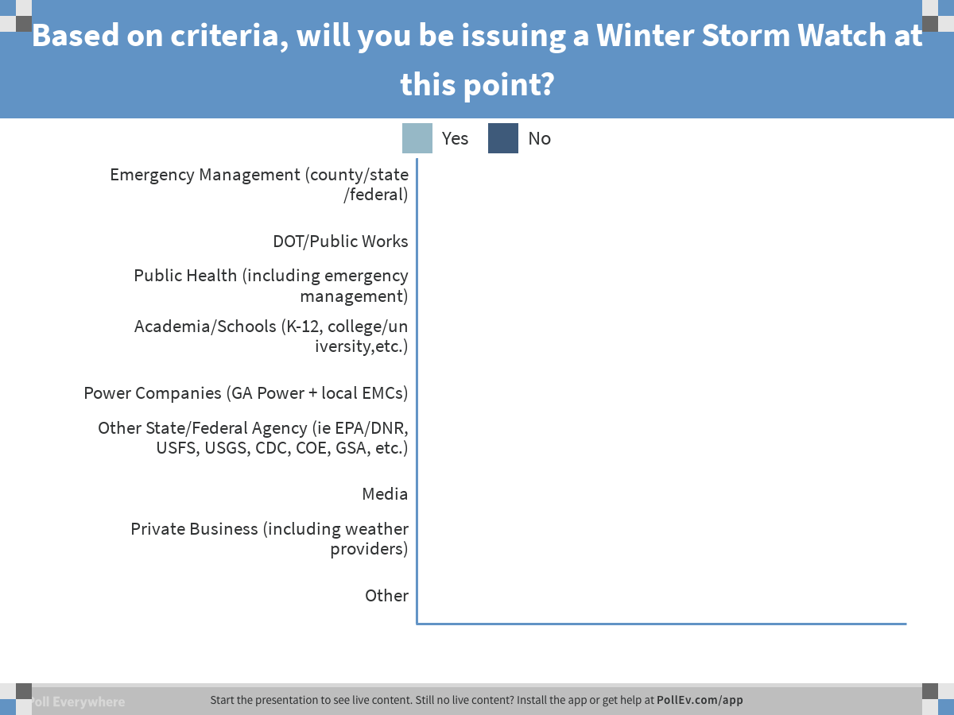
Notes:
Poll Title: Based on criteria, will you be issuing a Winter Storm Watch at this point?
https://www.polleverywhere.com/multiple_choice_polls/ZBZx1xfQsLhR2OX

Slide 22
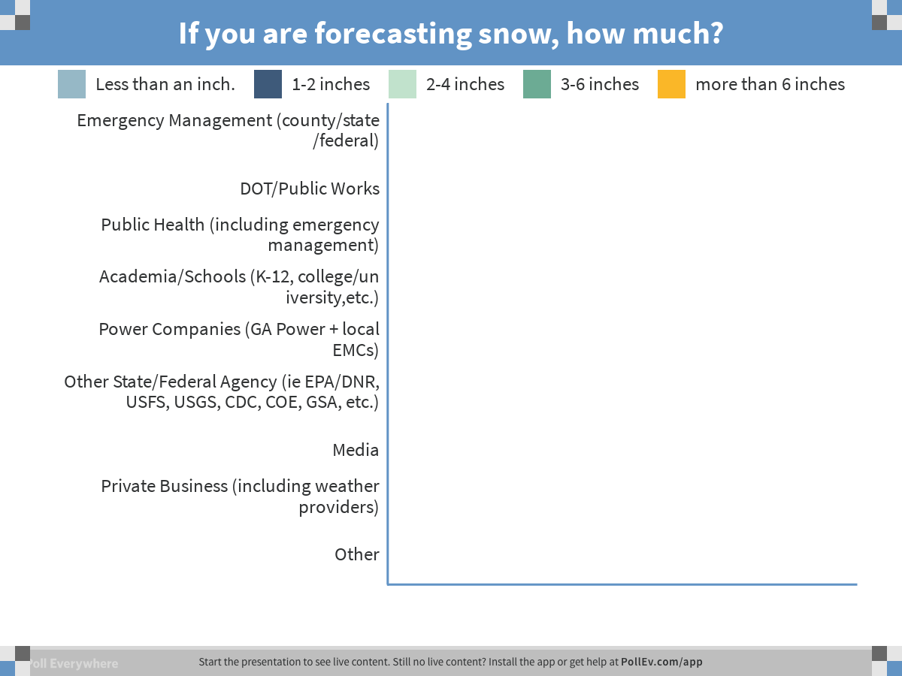
Notes:
Poll Title: If you are forecasting snow, how much?
https://www.polleverywhere.com/multiple_choice_polls/cV02YeaeqICzKgK

Slide 23
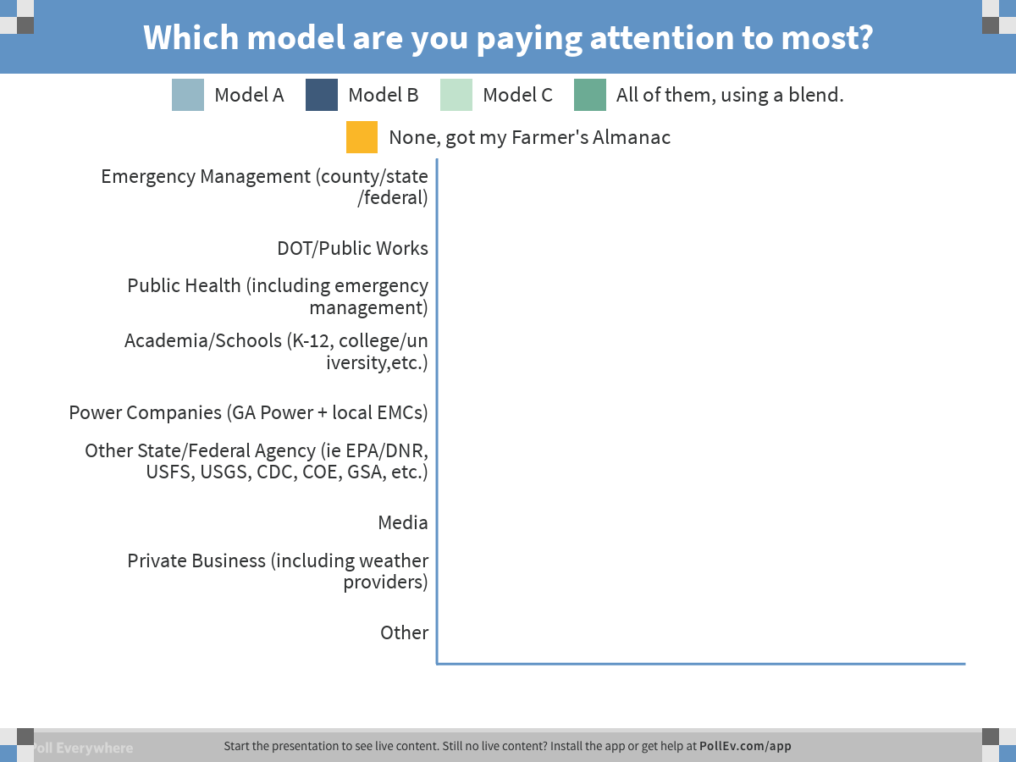
Notes:
Poll Title: Which model are you paying attention to most?
https://www.polleverywhere.com/multiple_choice_polls/xigx3aS0uRyIftB

Slide 24
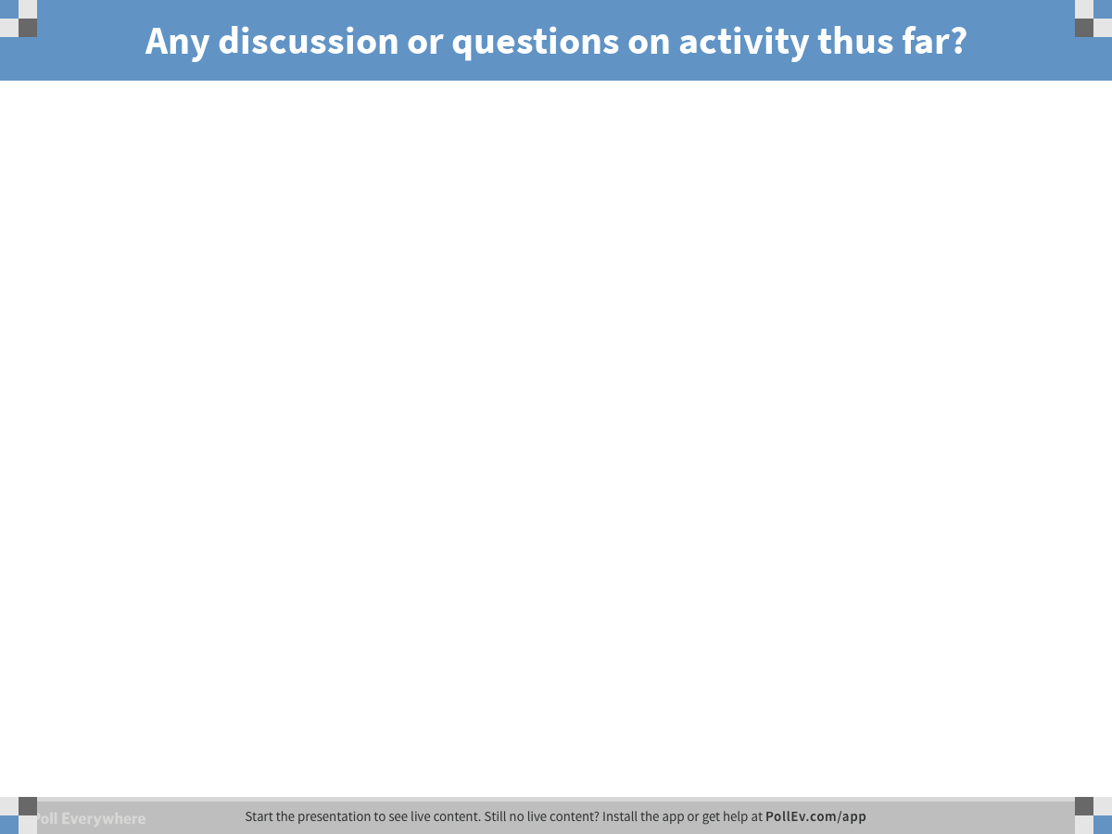
Notes:
Poll Title: Any discussion or questions on activity thus far?
https://www.polleverywhere.com/free_text_polls/VOW1CT5mn36JBoc

Slide 25
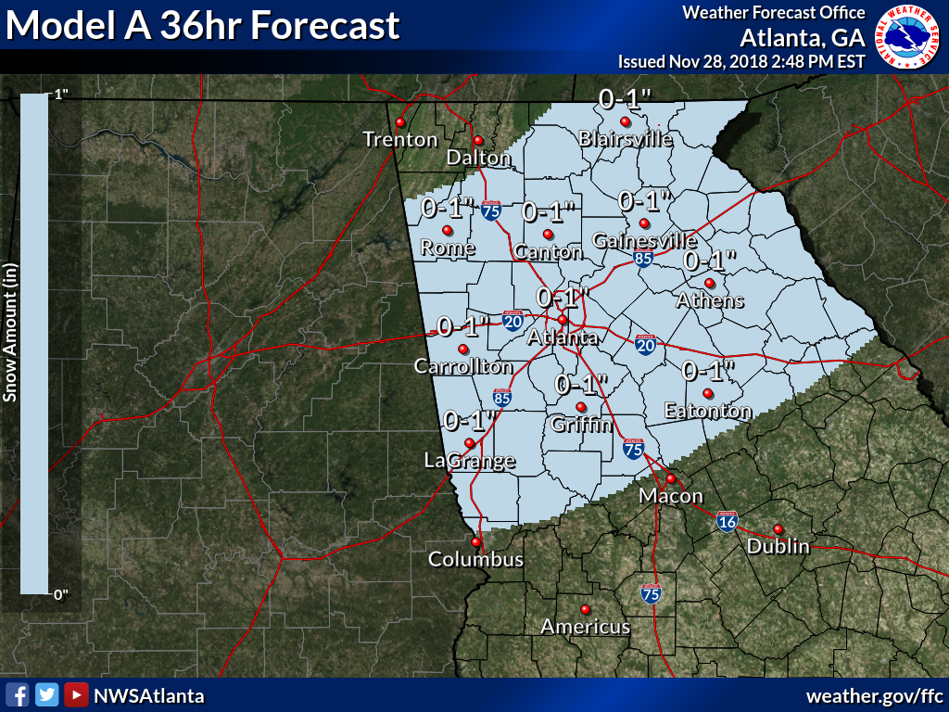
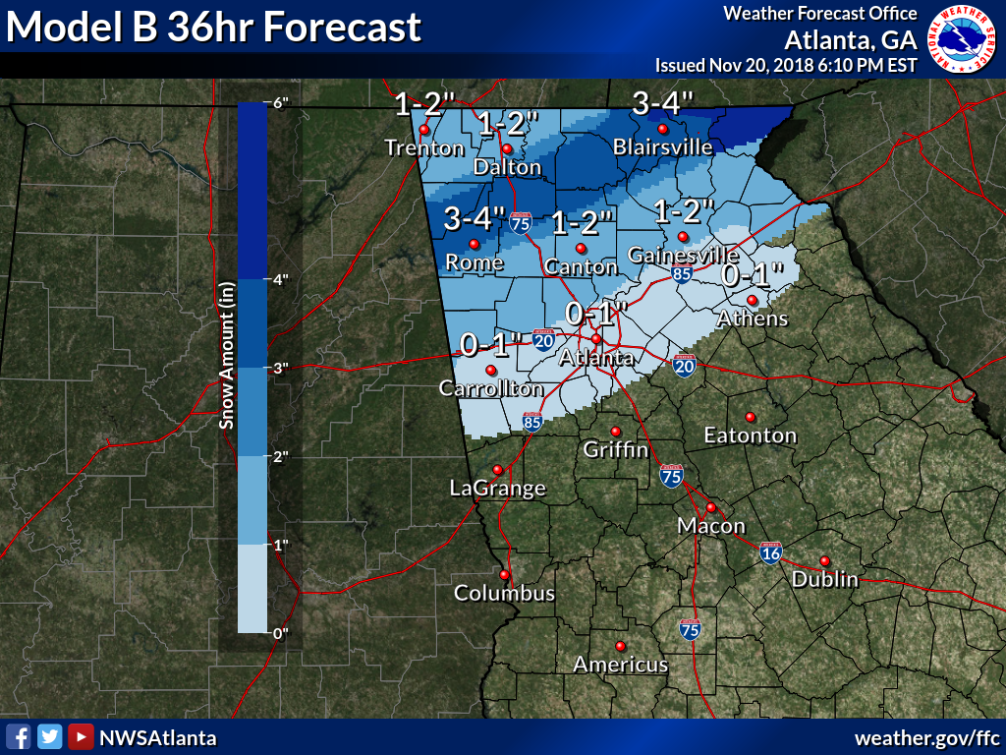
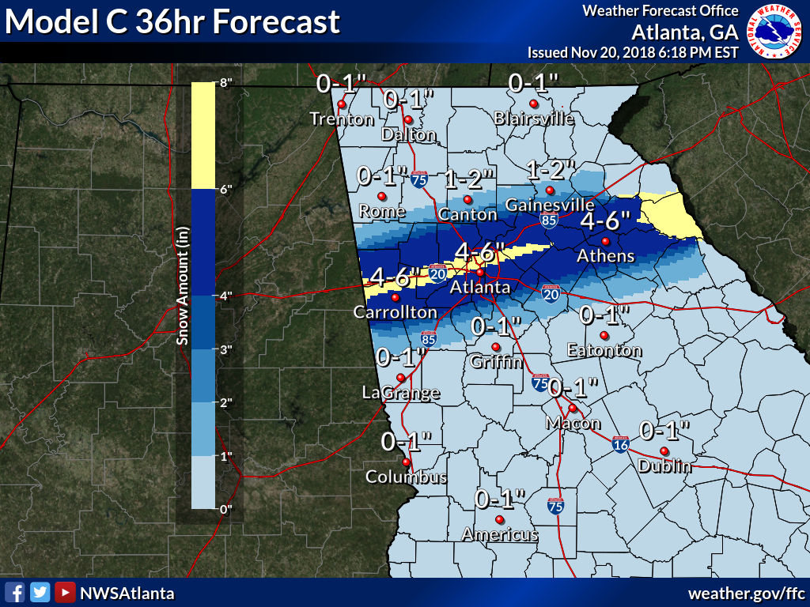
Scenario Overview
North & Central GA Partners Workshop (IWT)
December 4, 2018
Notes:
Intro Slide

Slide 26
Title
A
B
C
Notes:
Intro Slide

Slide 27
Title
North & Central GA Partners Workshop (IWT)
December 4, 2018
Notes:
Intro Slide

Slide 28
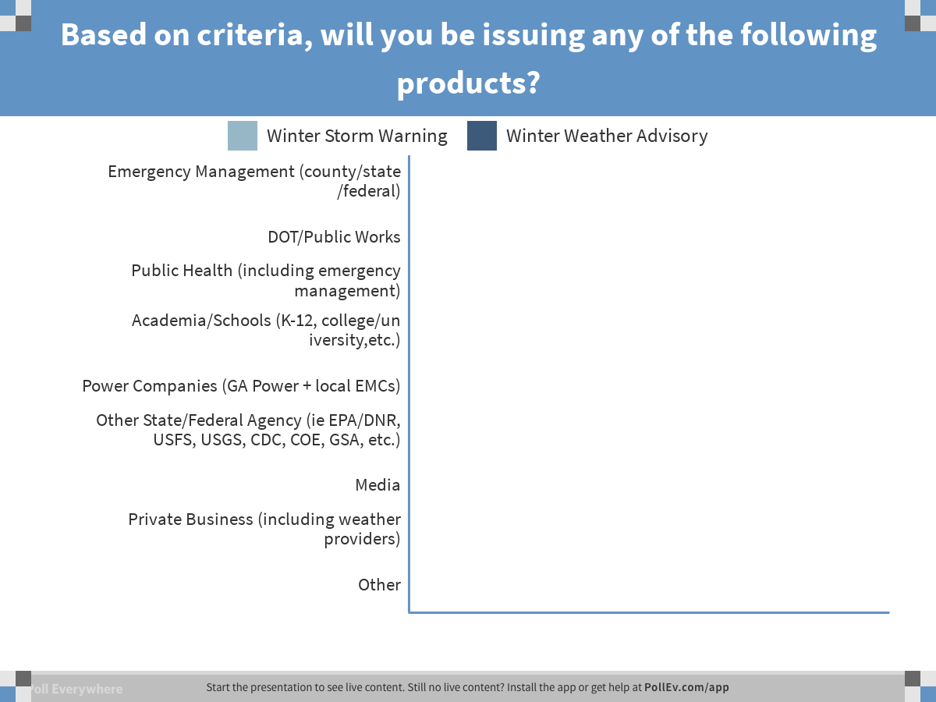
Notes:
Poll Title: Based on criteria, will you be issuing any of the following products?
https://www.polleverywhere.com/multiple_choice_polls/vXJflLkWzCs8nx9

Slide 29
Notes:
Poll Title: If you are forecasting snow, how much?
https://www.polleverywhere.com/multiple_choice_polls/xL2d0AEJ5QgZzIX

Slide 30
Scenario Overview
Questions
Is everyone forecasting at least a little snow for Atlanta now?
2. If you are forecasting snow, how much?
a. Less than an inch.
b. 1-2 inches
c. 2-4 inches
d. 3-6 inches
e. more than 6 inches
Which model are you paying attention to most?
  a. Model A.
  b. Model B.
  c. Model C.
  d. All of them, using a blend.
  e. None of them, I got my Farmers Almanac right here.
  5. Does the fact that the super bowl is during this time period influence your decisions?
Title
Notes:
Intro Slide

Slide 31
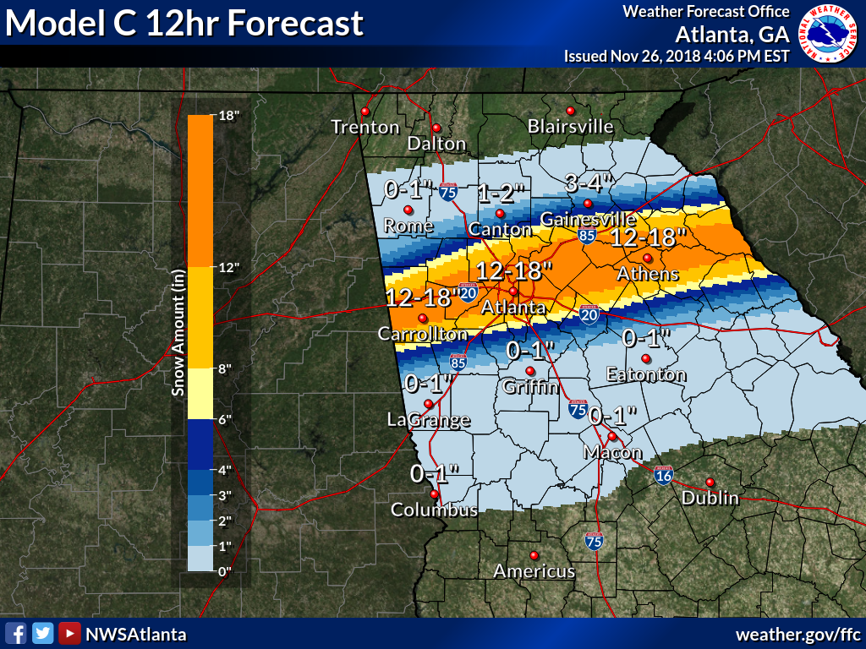
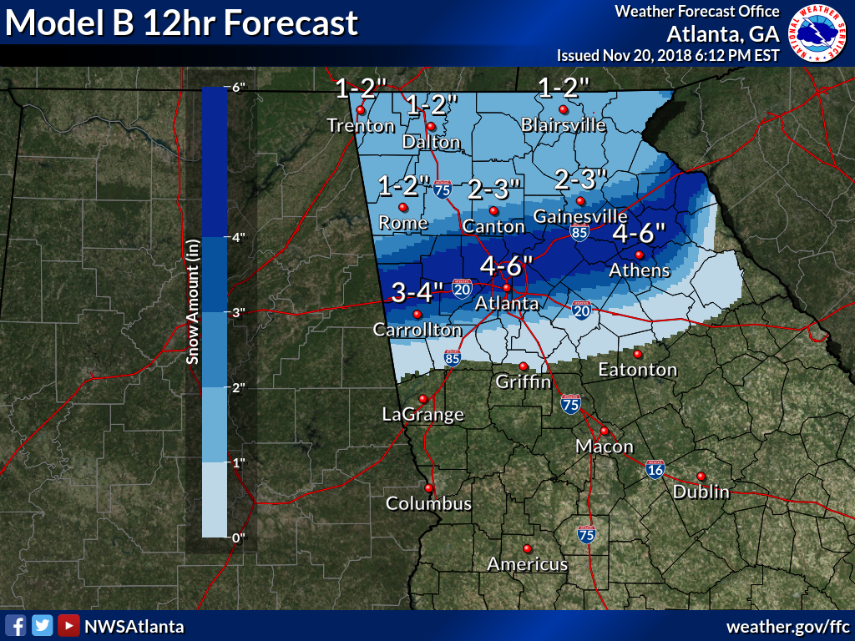
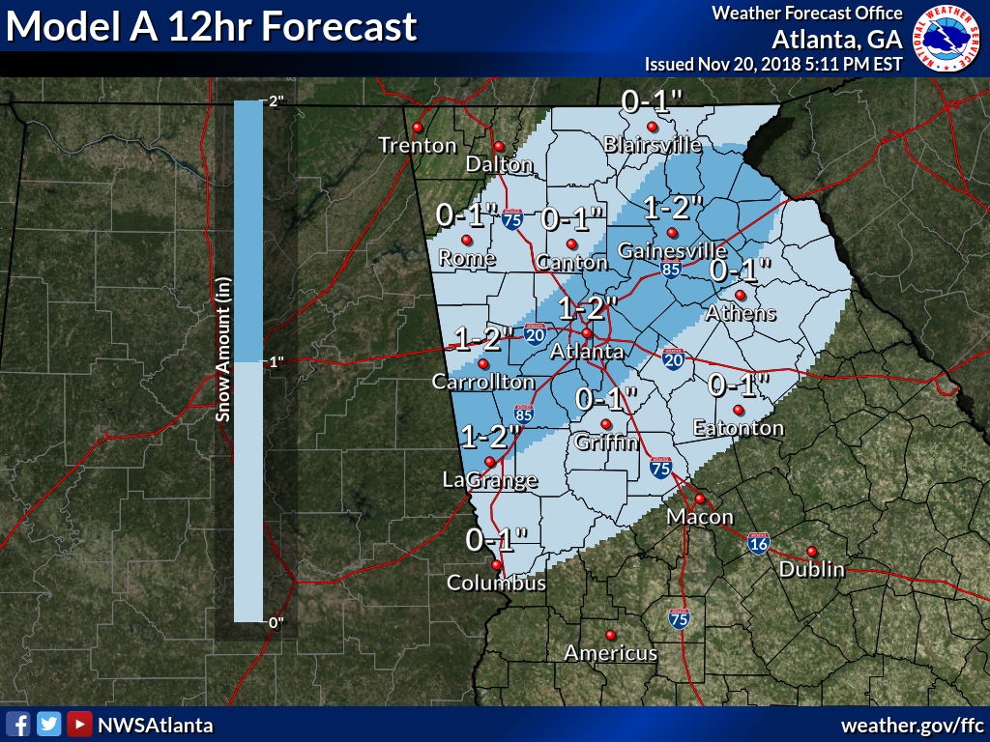
Scenario Overview
Title
North & Central GA Partners Workshop (IWT)
December 4, 2018
Notes:
Intro Slide

Slide 32
Title
A
B
C
Notes:
Intro Slide

Slide 33
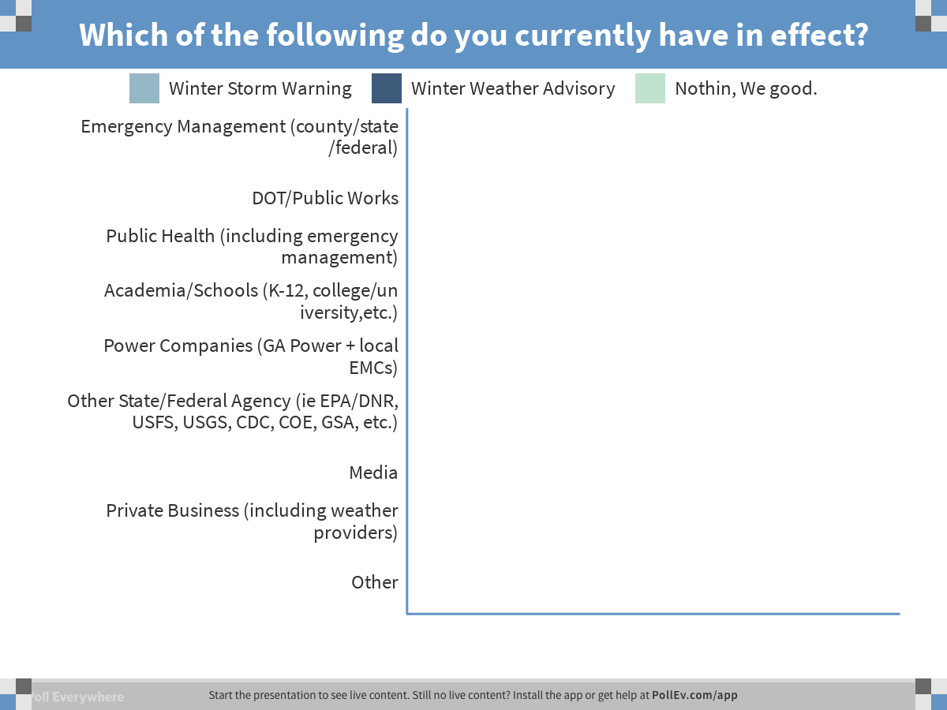
Notes:
Poll Title: Which of the following do you currently have in effect?
https://www.polleverywhere.com/multiple_choice_polls/kNr0ikX7vsKYTKm

Slide 34
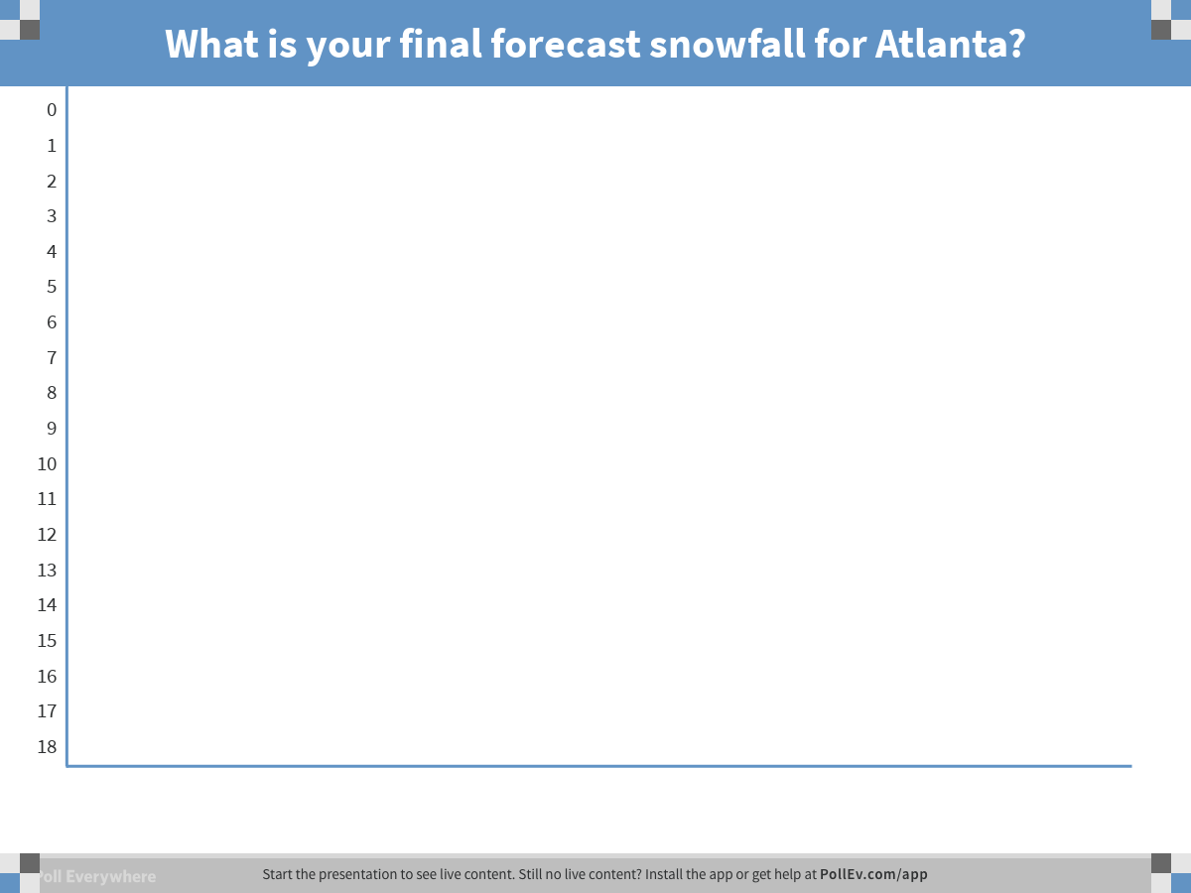
Notes:
Poll Title: What is your final forecast snowfall for Atlanta?
https://www.polleverywhere.com/multiple_choice_polls/RbDIfHiA0Vpdglk

Slide 35
Scenario Overview
Questions
How much snow are you forecasting for Atlanta?
  0-18
2. If you are forecasting snow, how much?
a. Less than an inch.
b. 1-2 inches
c. 2-4 inches
d. 3-6 inches
e. more than 6 inches
Which model are you paying attention to most?
  a. Model A.
  b. Model B.
  c. Model C.
  d. All of them, using a blend.
  e. None of them, I got my Farmers Almanac right here.
  5. Does the fact that the super bowl is during this time period influence your decisions?
Title
Notes:
Intro Slide

Slide 36
Deterministic Forecasting
Title
15 to 20 Model Outputs-Pick One!
Pros
Doesn’t dilute forecast
You have a chance of getting exactly right.
You can plan for specific amounts
Cons
You can get a forecast REALLY wrong!
Large chance of forecast varying by large amounts with each model run.
Notes:
Intro Slide

Slide 37

Ensemble Forecasting
Title
Average of 40 to 60 Models
Pros
Forecast from run to run is more stable.
Eliminates outliers in the model output
Cons
Sometimes the outliers are right!
Averages out the important details.
Notes:
Intro Slide

Slide 38
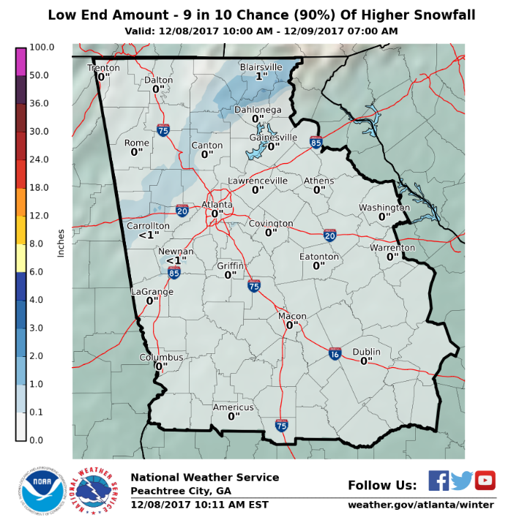
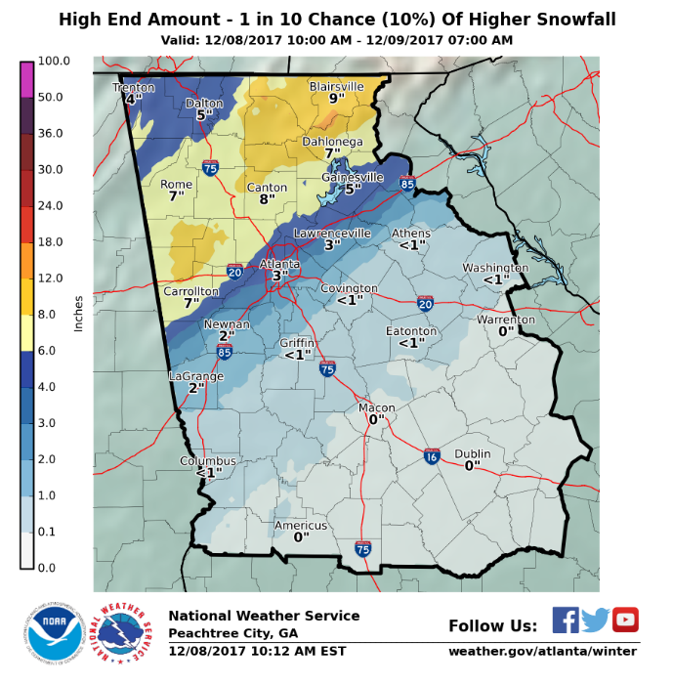
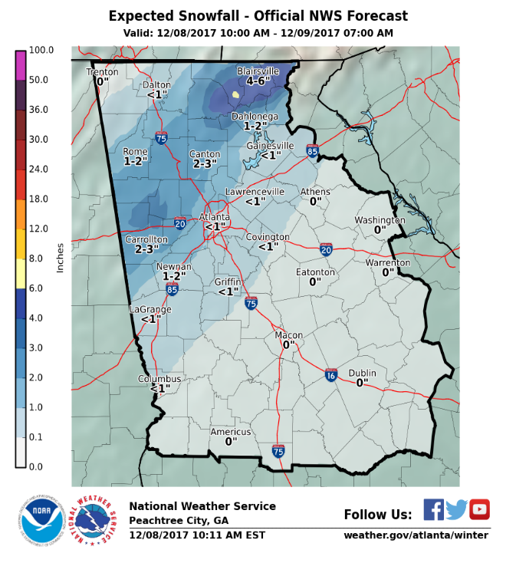
Probabilistic Forecasting
Title
Probability of Occurrence of Certain Criteria
Pros
Gives a range of possibilities
Doesn’t change as drastically as deterministic approach.
Good for planning purposes.
Cons
Outlier scenarios can still be masked.
Averages out the important details.
Notes:
Intro Slide

Slide 39
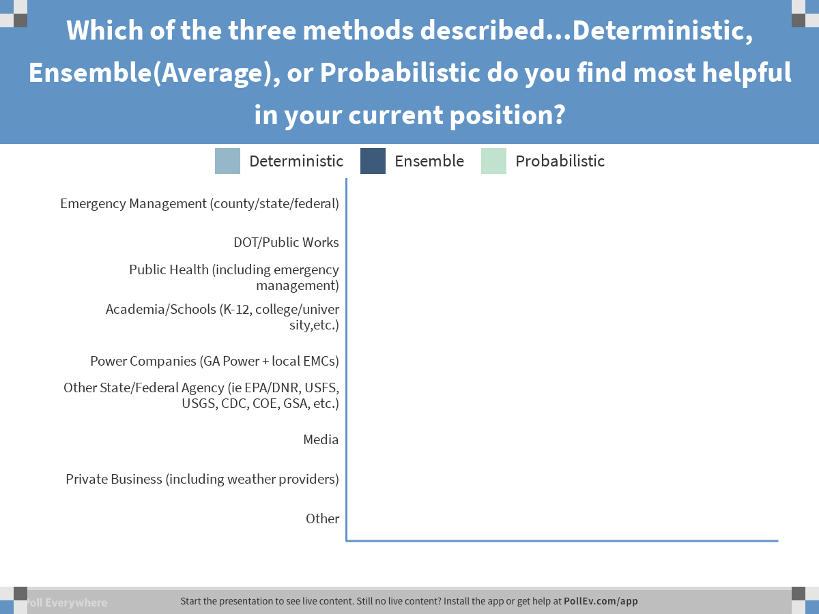
Notes:
Poll Title: Which of the three methods described...Deterministic, Ensemble(Average), or Probabilistic do you find most helpful in your current position?
https://www.polleverywhere.com/multiple_choice_polls/MNT6yIo2AnrumBv

Slide 40
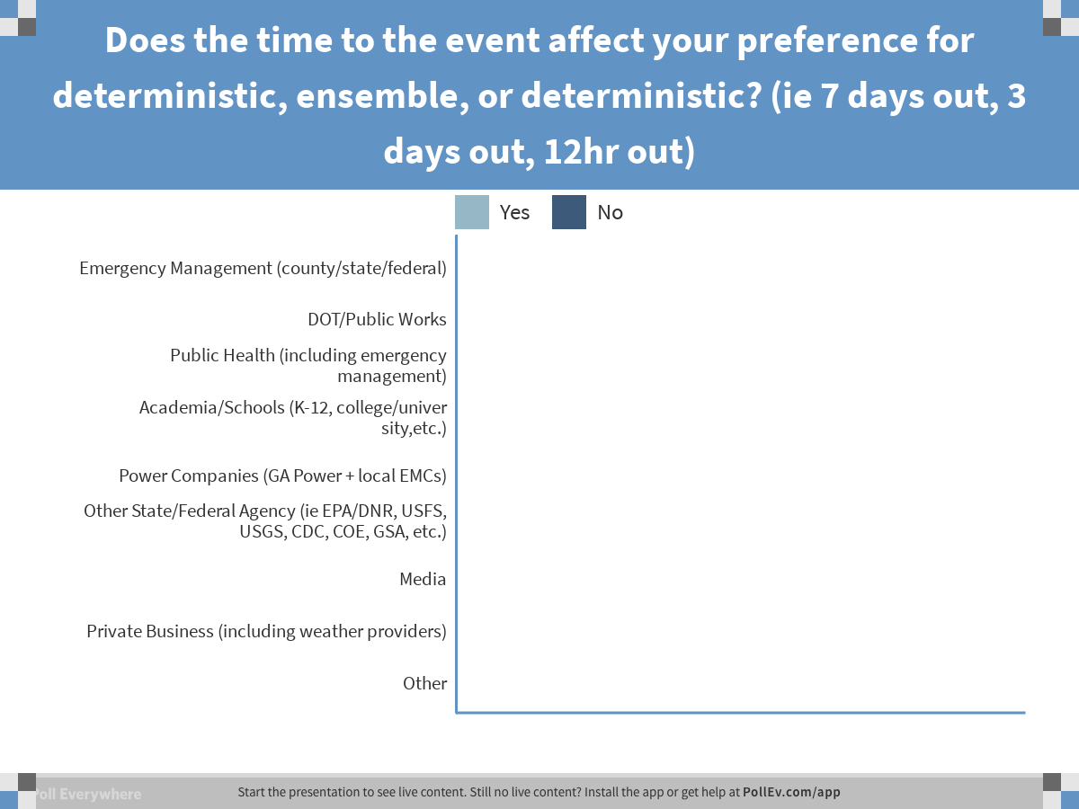
Notes:
Poll Title: Does the time to the event affect your preference for deterministic, ensemble, or deterministic? (ie 7 days out, 3 days out, 12hr out)
https://www.polleverywhere.com/multiple_choice_polls/9iUpQi0aDzxYfUz

Slide 41

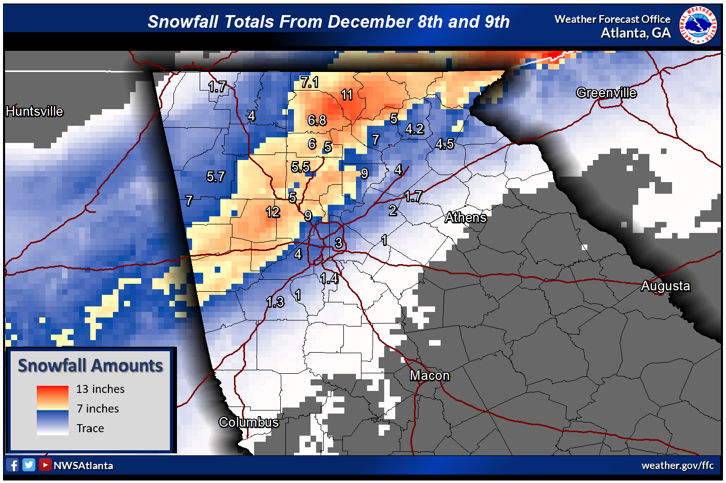
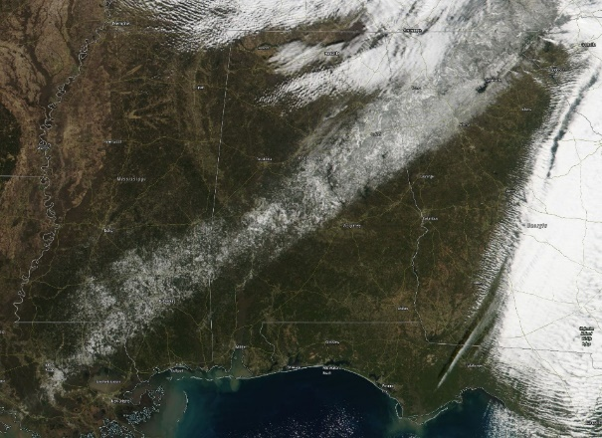
Title
North & Central GA Partners Workshop (IWT)
December 4, 2018
Notes:
Intro Slide

Slide 42
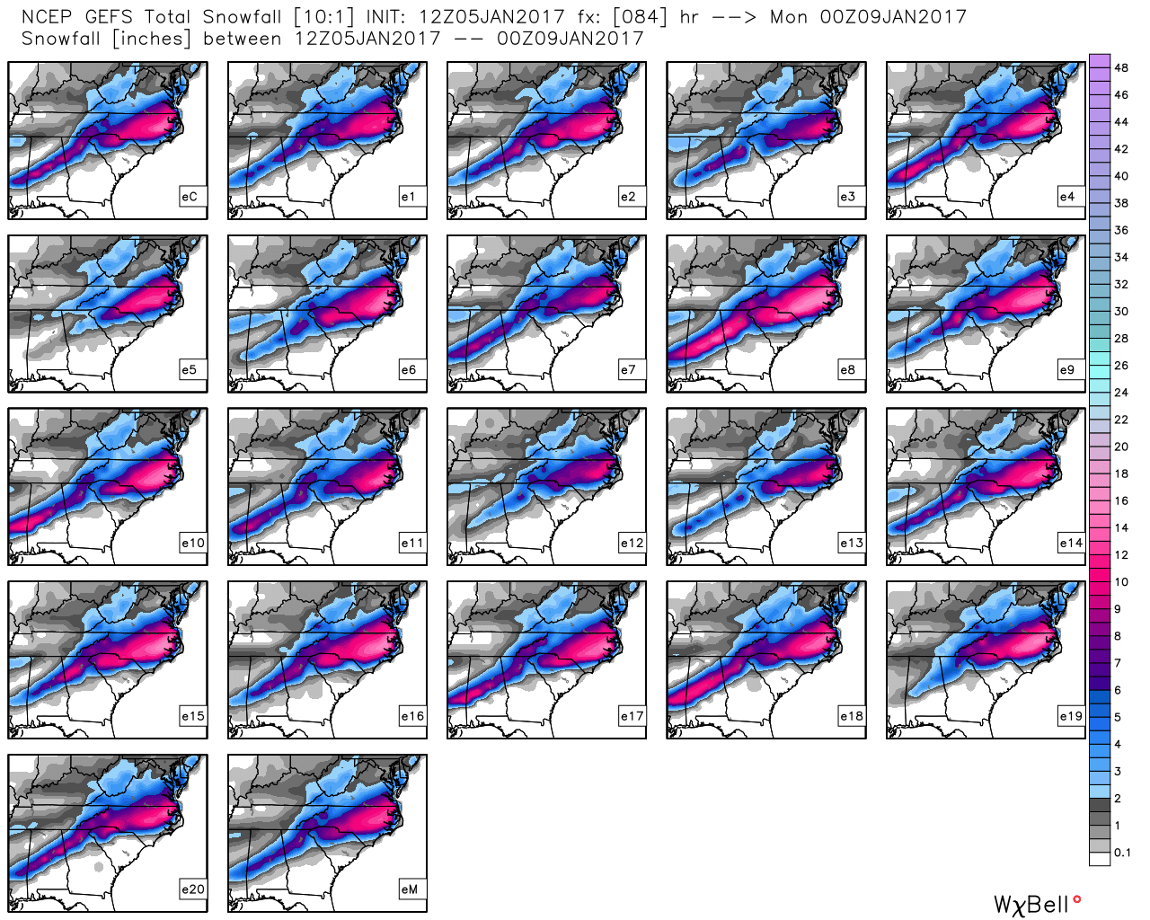
Title
GFS Computer model ensemble showing all 21 model runs
Swath of 6”+ NW Metro including some to 10”
The problem:
This is the January 6-7, 2017 forecast!
North & Central GA Partners Workshop (IWT)
December 4, 2018
Notes:
Intro Slide

Slide 43
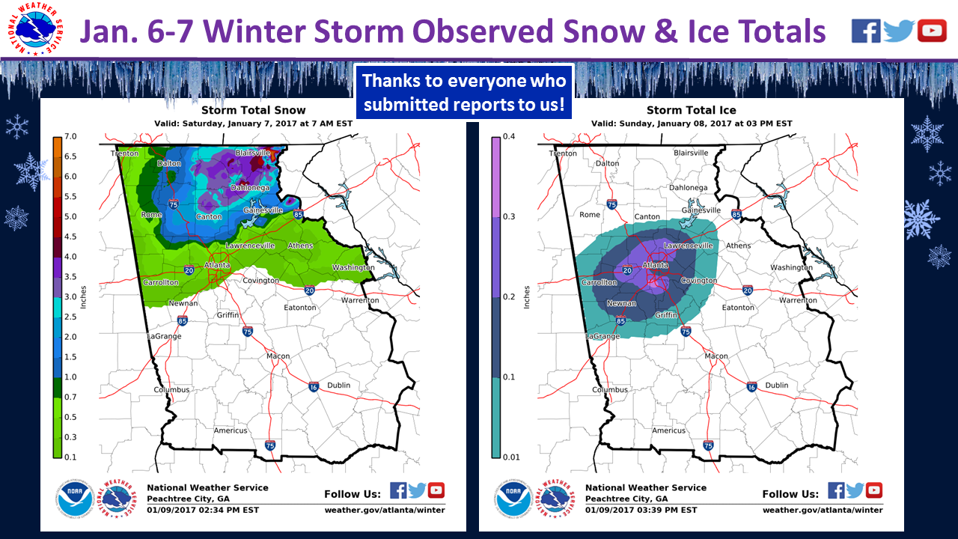
Title
North & Central GA Partners Workshop (IWT)
December 4, 2018
Notes:
Intro Slide

Slide 44

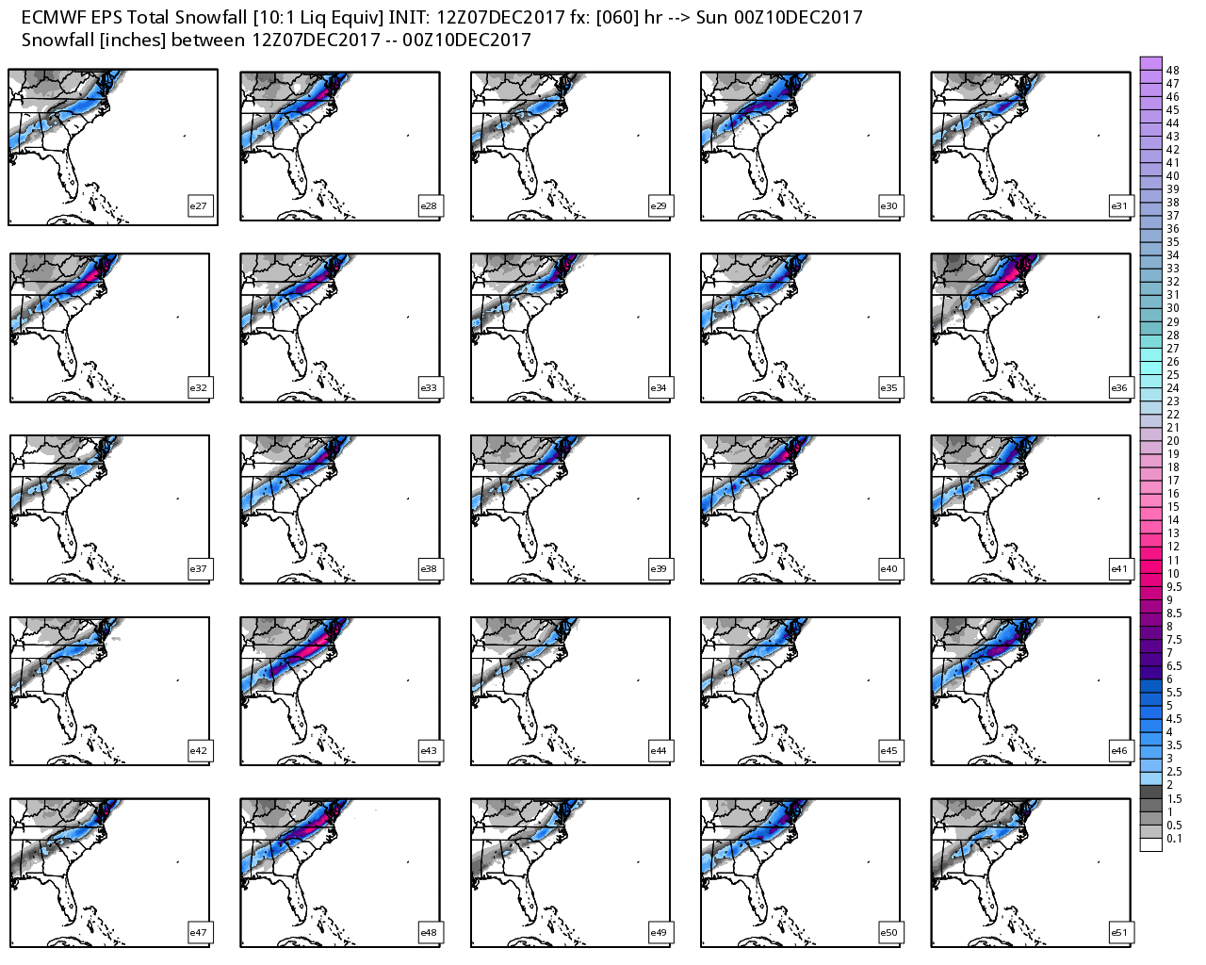
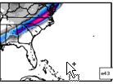
Note a few runs with higher spots, but not all.
Title
North & Central GA Partners Workshop (IWT)
December 4, 2018
Notes:
Intro Slide

Slide 45
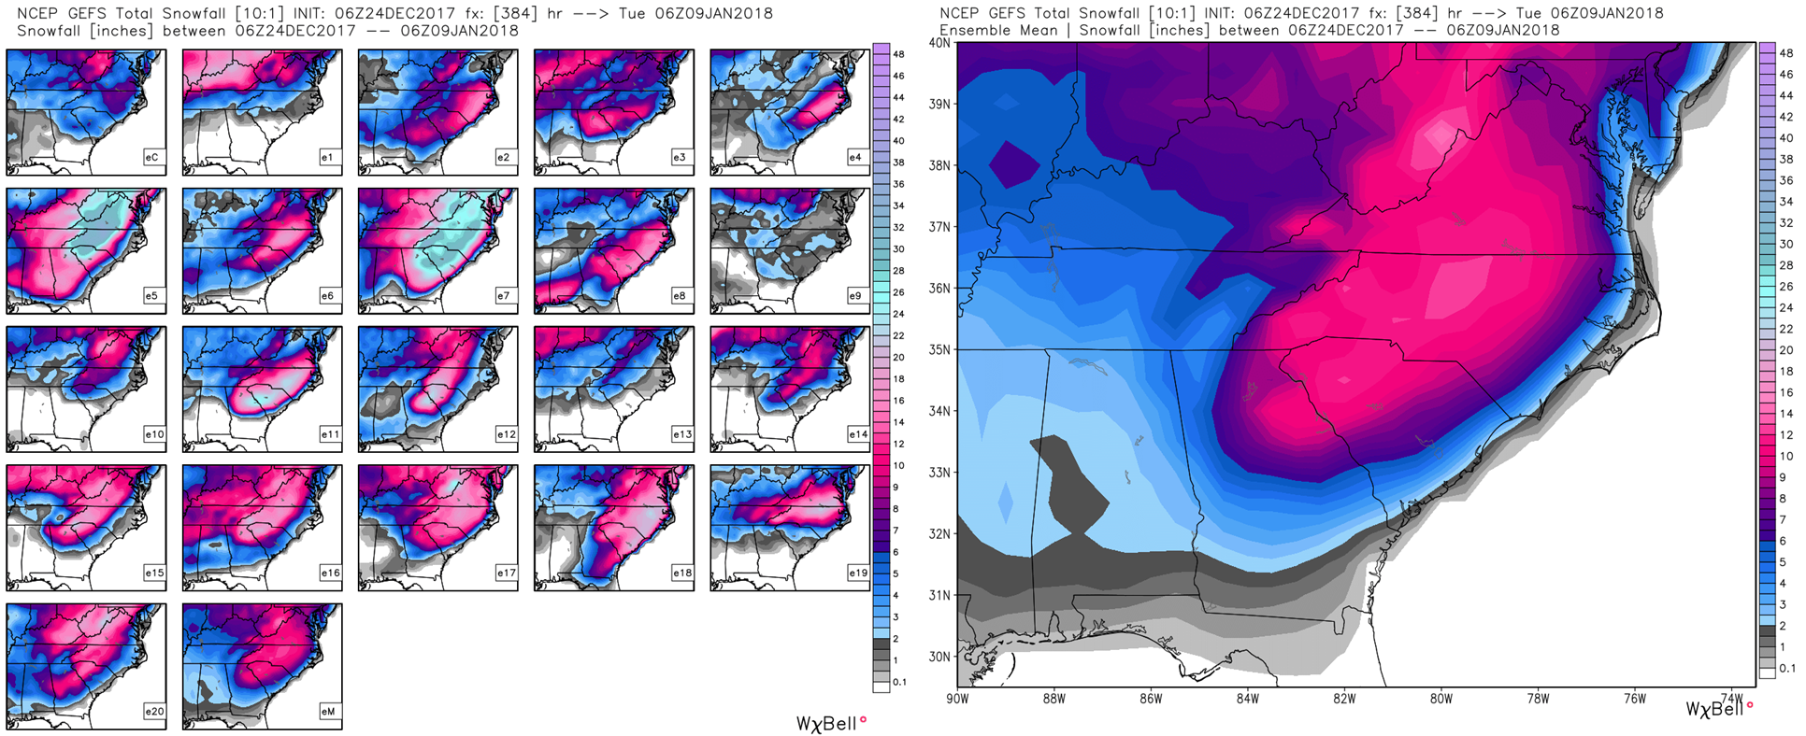
The January 2018 Major North GA Snowstorm
Title
North & Central GA Partners Workshop (IWT)
December 4, 2018
Notes:
Intro Slide

Slide 46
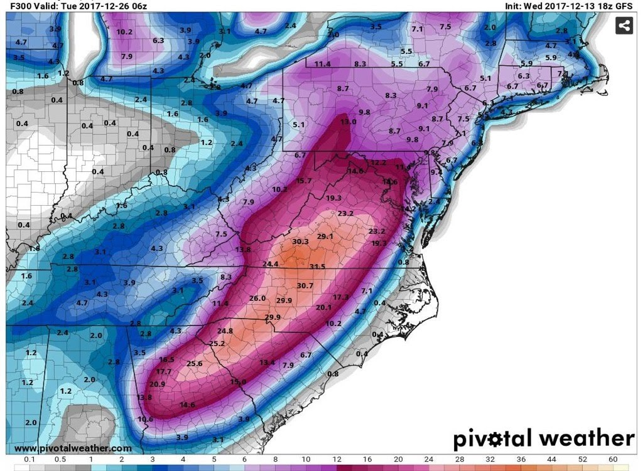
The 2017 GA White Christmas… Record breaking snows
Title
North & Central GA Partners Workshop (IWT)
December 4, 2018
Notes:
Intro Slide

Slide 47
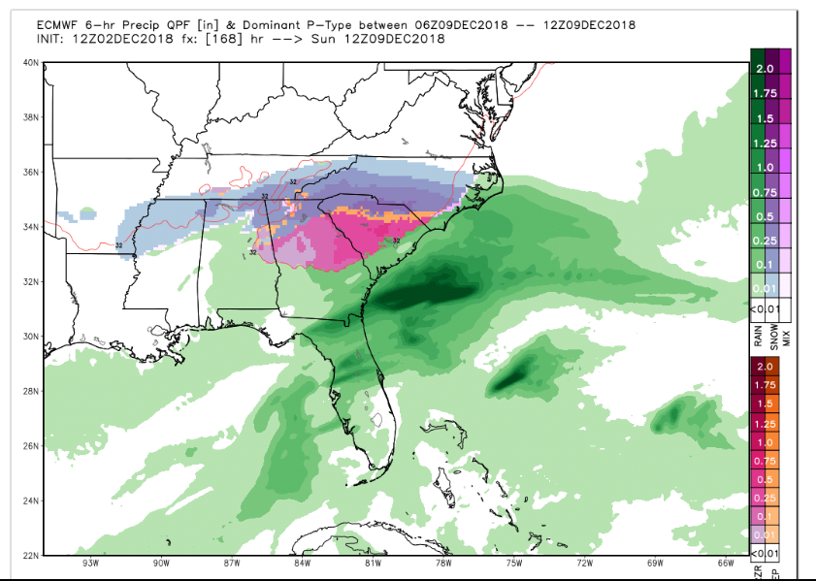
12Z Euro
Title
North & Central GA Partners Workshop (IWT)
December 4, 2018
Notes:
Intro Slide

Slide 48
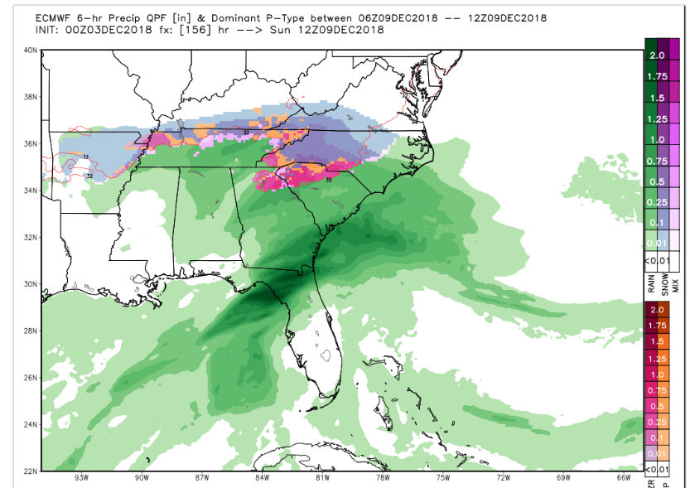
00Z Euro
Title
North & Central GA Partners Workshop (IWT)
December 4, 2018
Notes:
Intro Slide

Slide 49
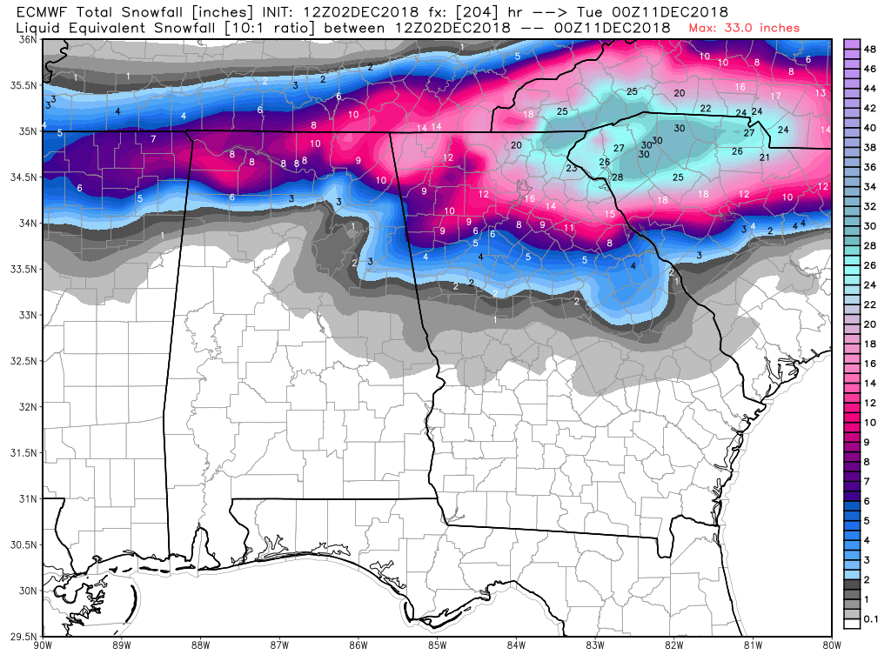
December 10th 2018???????
Title
North & Central GA Partners Workshop (IWT)
December 4, 2018
Notes:
Intro Slide

Slide 50
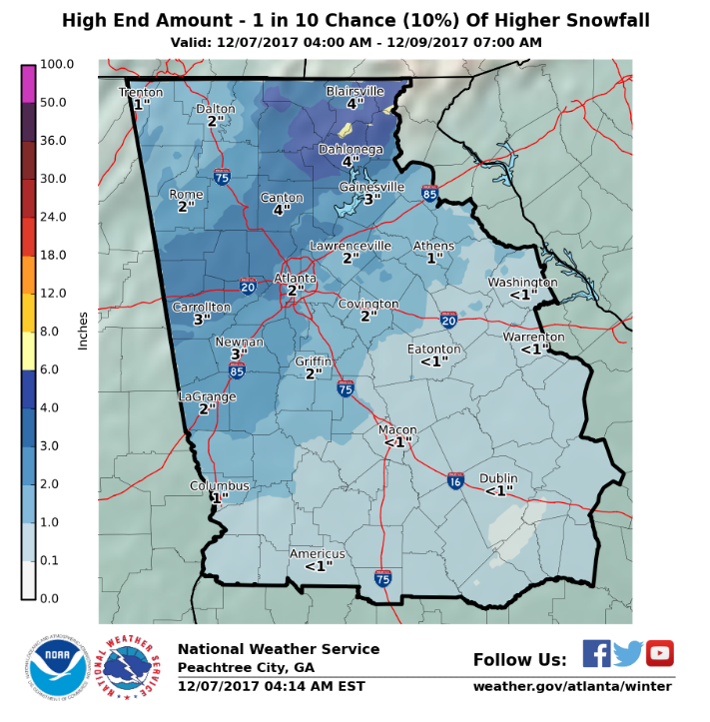
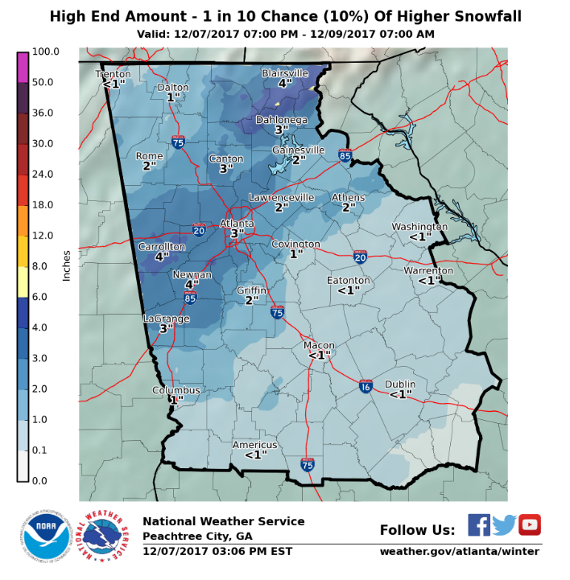

Title
Probabilistic and Ensemble Approach
Thursday 4 AM Update
Thursday 3 PM Update
Friday 4 AM Update
North & Central GA Partners Workshop (IWT)
December 4, 2018
Notes:
Intro Slide

Slide 51

Notes:
Poll Title: Are you comfortable showing probabilistic information as related to winter weather?
https://www.polleverywhere.com/multiple_choice_polls/KOjQW2sKkkUnYhC

Slide 52


Where We Can Do Better
Title
EVERYONE ELSE
Mainly Public
Notes:
Intro Slide

Slide 53

Notes:
Poll Title: How many cumulative winter storm warnings or advisories are issued per year for Atlanta?
https://www.polleverywhere.com/multiple_choice_polls/79AY2unlC3GhrtE

Slide 54

Winter Storm Per Year
Advisory/Warning Frequency
Title
Notes:
Intro Slide

Slide 55

Winter Storm 10 Year
Advisory/Warning Frequency
Title
Notes:
Intro Slide

Slide 56

Winter Storm Per Year
Warning Frequency
Title
Notes:
Intro Slide

Slide 57

Notes:
Poll Title: In your field, what triggers more action on your part (ie cancelling school), the products we issue or the info we send in emails and webinars?
https://www.polleverywhere.com/multiple_choice_polls/2iApkFLPock4alY

Slide 58

Notes:
Poll Title: If you had to choose one form of media to get your information from us it would be...
https://www.polleverywhere.com/multiple_choice_polls/yxRlDvaETi6y0ls

Slide 59

Notes:
Poll Title: Ideally, the frequency of your emails should be based on...
https://www.polleverywhere.com/multiple_choice_polls/t8CPay6lrzn1uay

Slide 60
Questions?
Title
Notes:
Intro Slide

Slide 61

Notes:
Poll Title: Any final discussion or questions ?
https://www.polleverywhere.com/free_text_polls/rSuAOPobHktunVW

