Slide 1


NWSChat
For Androids

Slide 2
NWS Chat for Mobile Devices -Android
Some mobile apps can access NWSChat, like “Xabber”
Search for “Xabber” in Android Google Play store

Slide 3
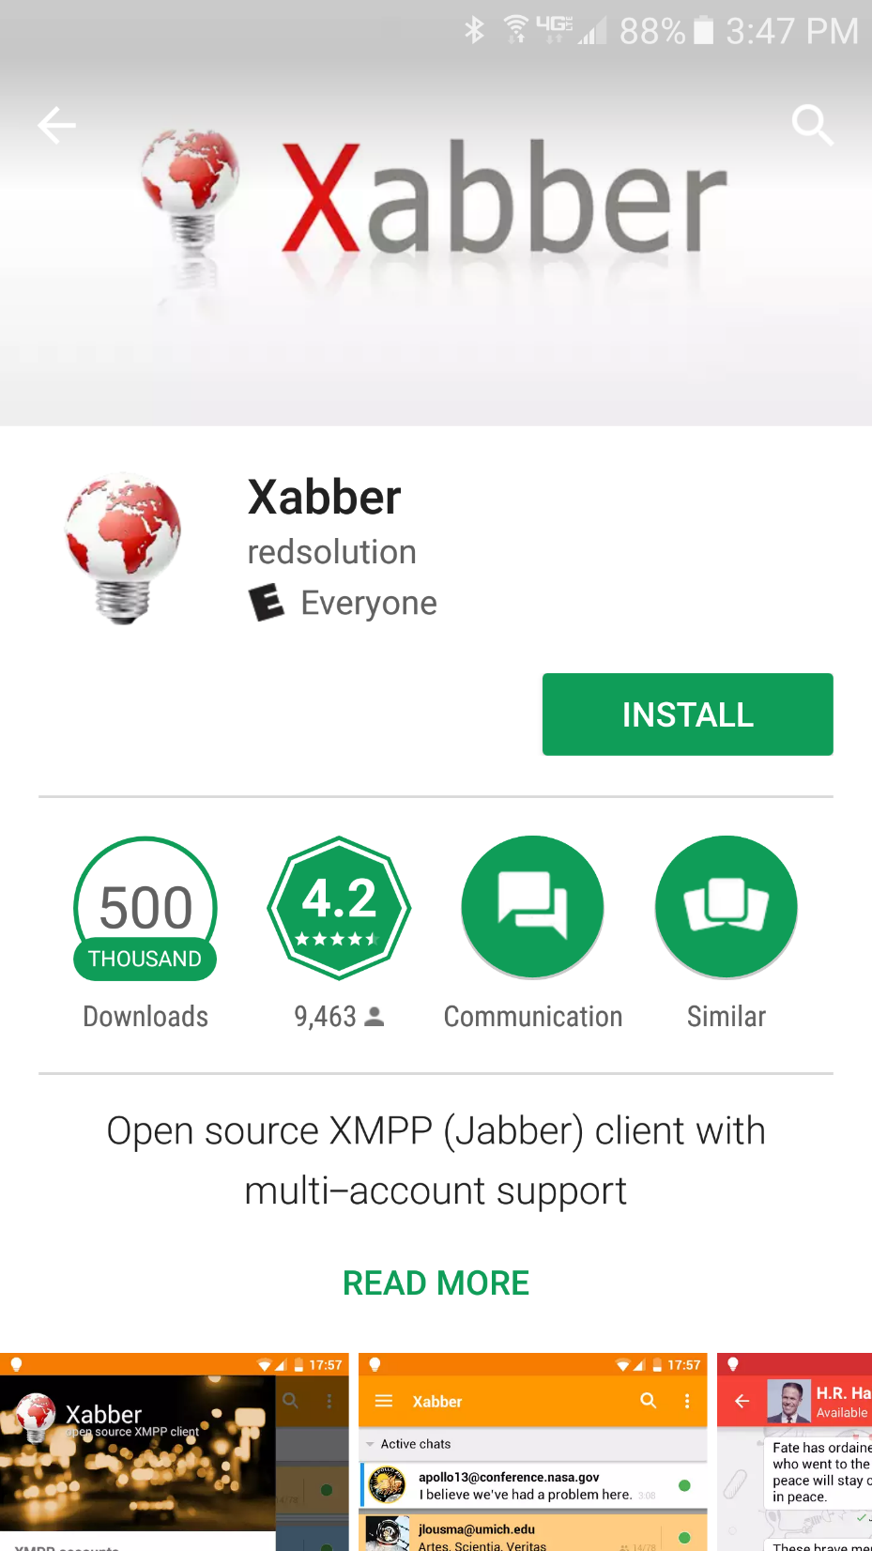
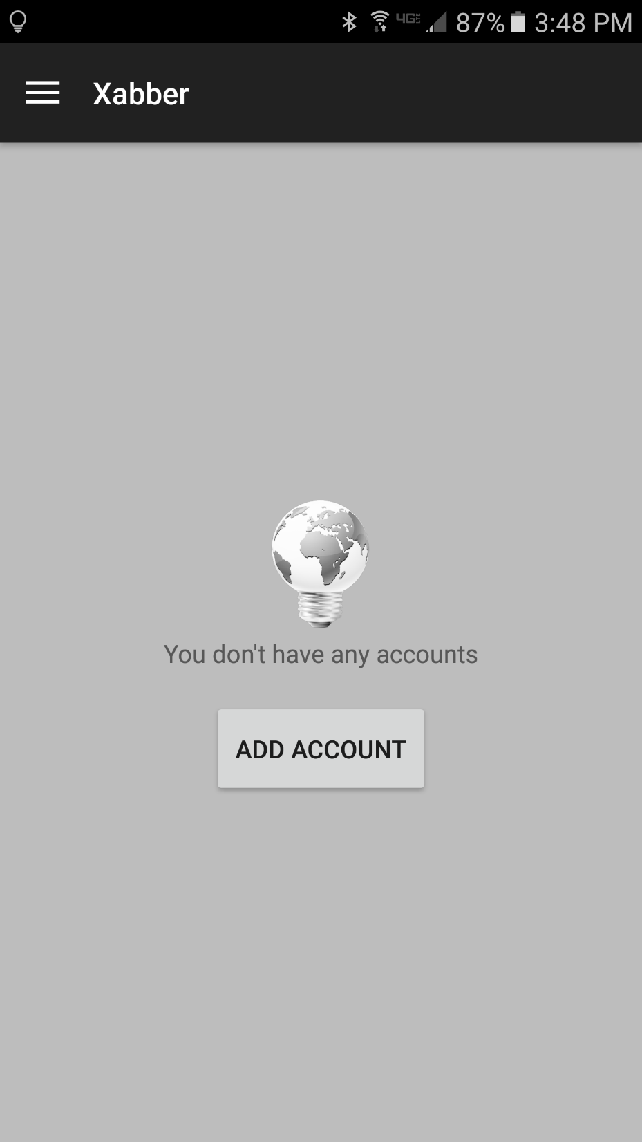
1
2

Slide 4
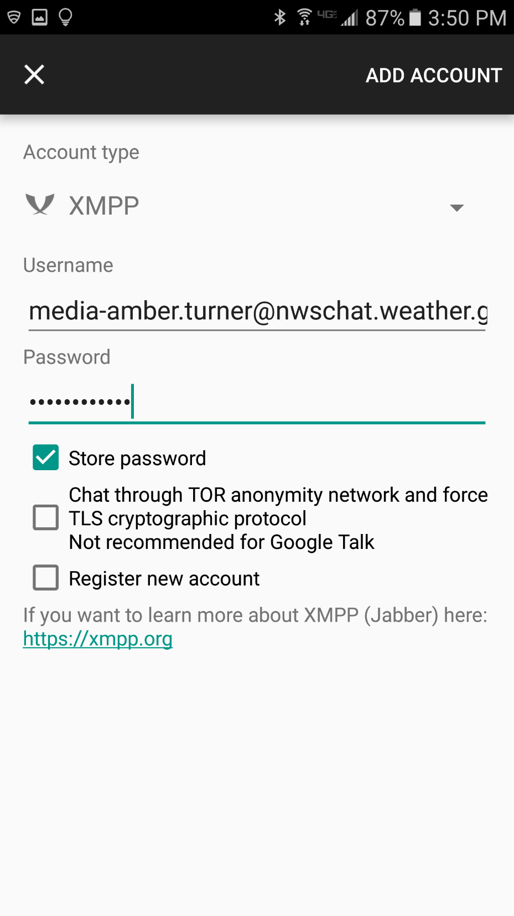
4
3) Fill out as shown here!
Username example:
em-clint.mathis@nwschat.weather.gov
4) When done, click “Add Account”

Slide 5
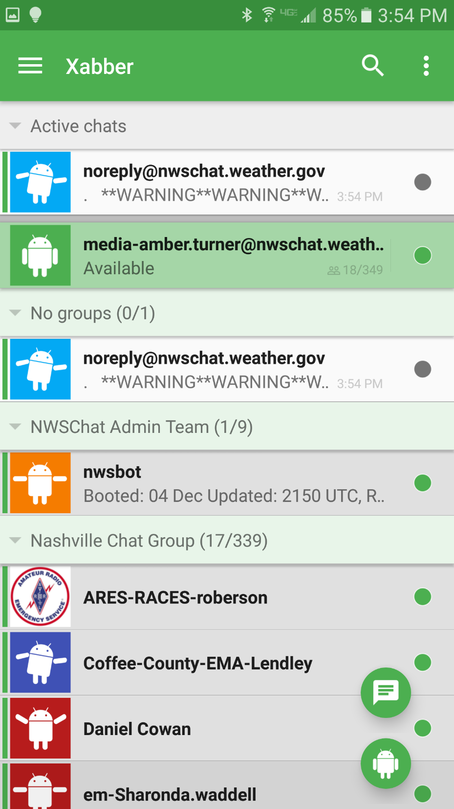
Account created – hooray!
5) Select “…” menu

Slide 6
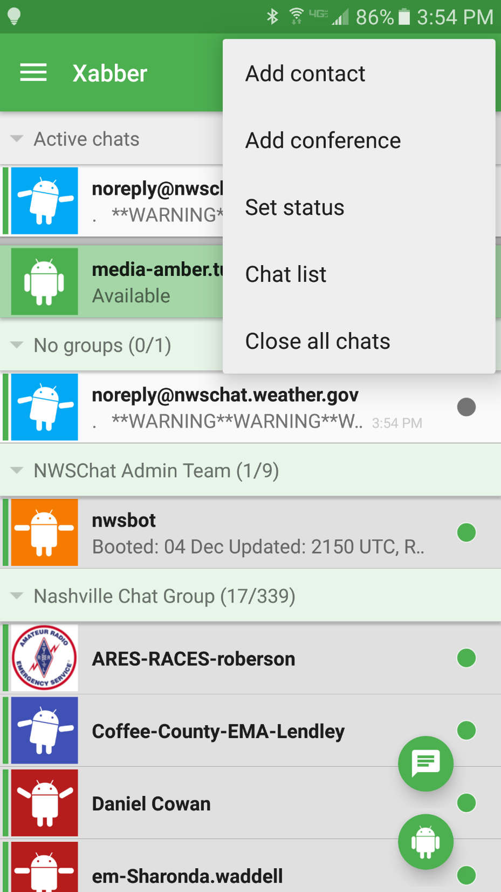
6) Select “Add conference”

Slide 7
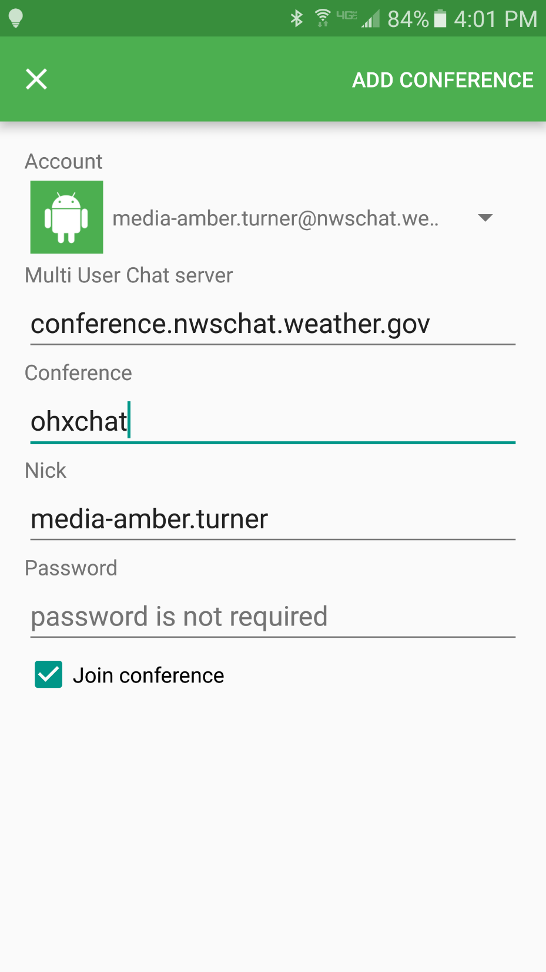
8
7) Fill out as shown here!
Use your username
(ex. em-clint.mathis)
for “Nick”
8) When done, click “Add Conference”
hunchat

Slide 8
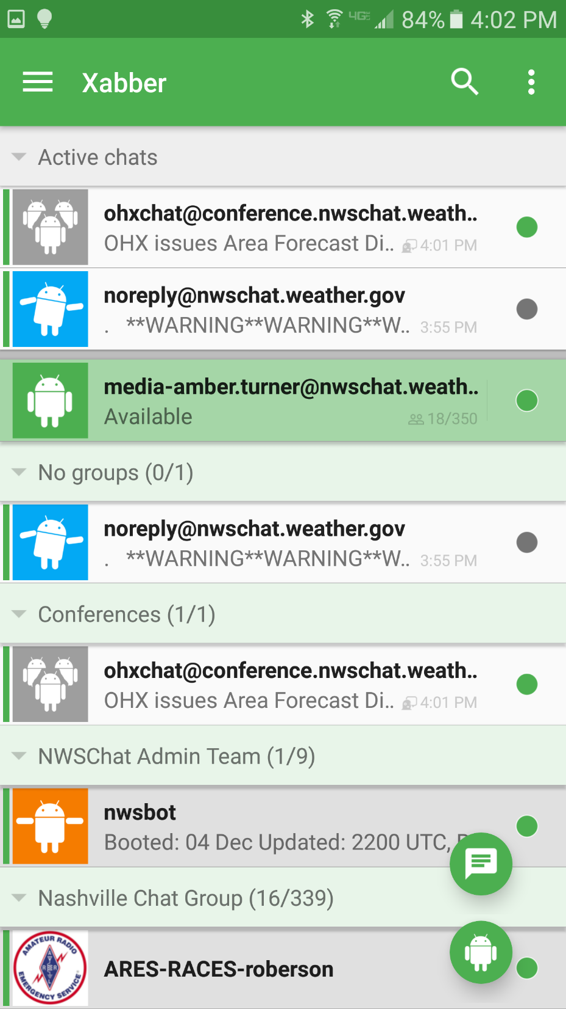
10) Click on hunchat under “Conferences” to join NWS Nashville chatroom
You’re in!
Enjoy!
hunchat@conferences.nwschat.weat...
HUN Issues Area Forecast Discu..

Slide 9
HOW TO USE NWSCHAT ON ANDROID PHONES
(Step by Step Instructions)
Download Xabber from the Google Play Store
Navigate to and open Xabber after installation
Click "Add Account“
Type in your login details - for your username, type the entirety of the username including "@nwschat.weather.gov“
When successful, Xabber will take you to the main chat screen
Click the menu option (3 dots) in the top right hand corner to bring down a menu
Click "Add Conference" to add a new chat room

Slide 10
HOW TO USE NWSCHAT ON ANDROID PHONES
(Step by Step Instructions)
8) Type in the following details:
    Multi User Chat Server: conference.nwschat.weather.gov
    Conference: hunchat
    Nick: your username (example: em-clint.mathis)
    Leave password blank
    Select “Join Conference”
Once your details have been added, click "Add Conference“
The hunchat room will then appear in your main chat screen under "Conferences.“ Click to join!

