Slide 1
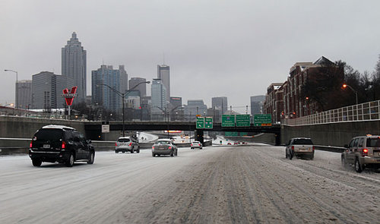
Winter Outlook, Tools/Resources
Source: AJC (1/10/11)
2017 North & Central Georgia Partners Workshop Adam Baker & David Nadler NWS Atlanta, GA

Slide 2
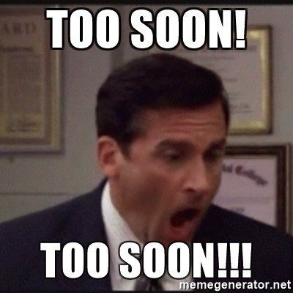
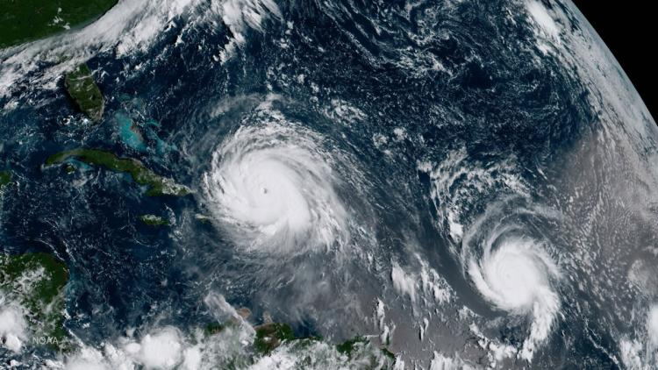
Tropical Systems
Projected Number of Named Storms though February

Slide 3
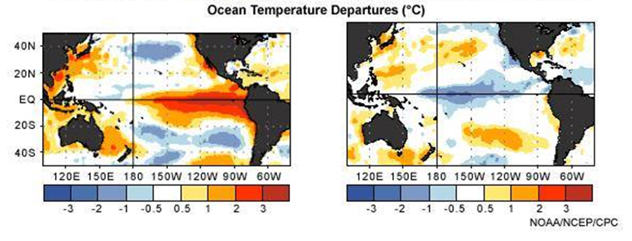
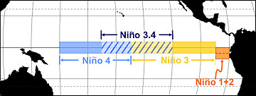
El Niño vs La Niña
El Niño
La Niña
Warmer
Cooler
ºC
ºC
3-month avg. sea surface temps (SST) ≥ +0.5C
3-month avg. sea surface temps (SST) ≤ -0.5C
Notes:
El Nino episodes (left side) reflect periods of exceptionally warm sea surface temperatures across the eastern tropical Pacific.
La Nina episodes (right side) represent periods of below-average sea-surface temperatures across the eastern tropical Pacific. These episodes typically last approximately 9-12 months.

Slide 4
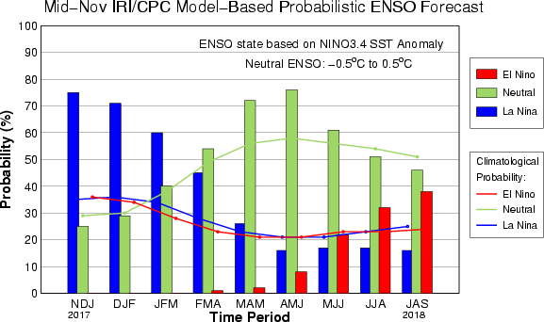
Forecast
Likely La Nina Through Winter
Neutral By Spring/Summer
Winter
Spring/Summer

Slide 5
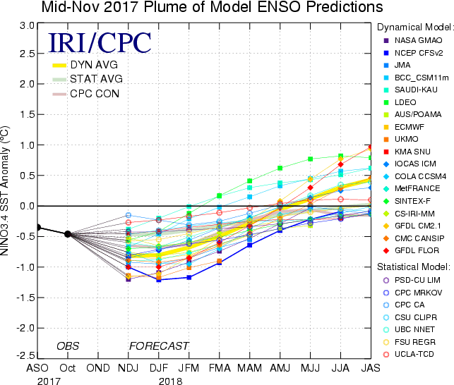
La Niña Forecast (into 2018)
Average solution through Winter

Slide 6
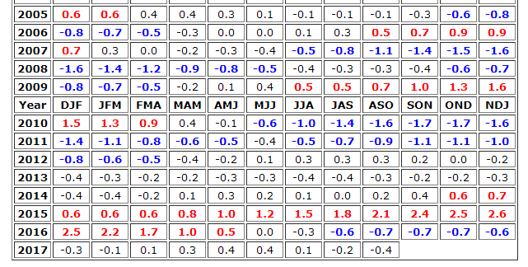
Past La Niña Winters (Over Last Decade)
Oceanic Nino Indices (La Nina -0.5C / Strong La Nina -1.5C)

Slide 7
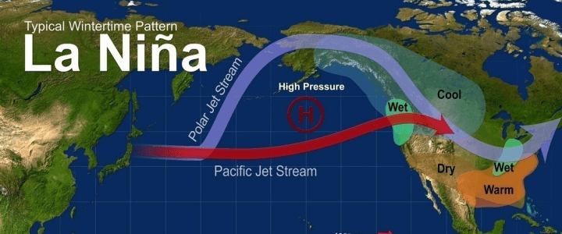
La Niña Winter Influences
“Subtropical Jet Stream” Farther north compared to El Nino pattern
Polar jet more likely to dip southward – could result in more “wedge” (CAD) events

Slide 8
Latest CPC Winter Outlook
December/January/February
Temperature
Precipitation
~40-45% chance of seeing “Warmer Than Normal”
~33-50% chance of seeing “Drier Than Normal”

Slide 9
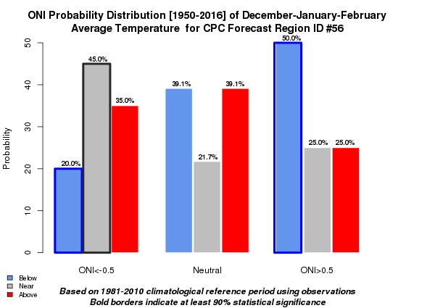
Local Study (North & Central GA)
Winter Temperature Comparison (since 1950)
Near Normal
ONI = Oceanic Nino Index
Notes:
La Nina conditions from 1950 to 2016 have resulted in a 45% probability of North and Central Georgia seeing near normal temperatures during the winter months.

Slide 10
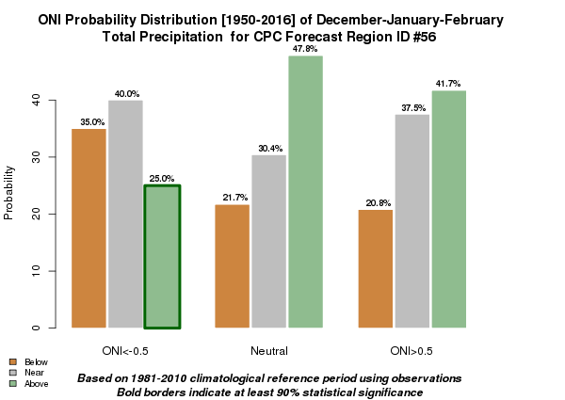
Local Study (North & Central GA)
Winter Precipitation Comparison (since 1950)
ONI = Oceanic Nino Index
Near Normal
Notes:
La Nina conditions from 1950 to 2016 have resulted in a 40% probability of North and Central Georgia seeing near normal precipitation during the winter months.

Slide 11
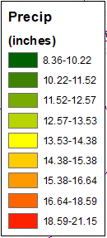
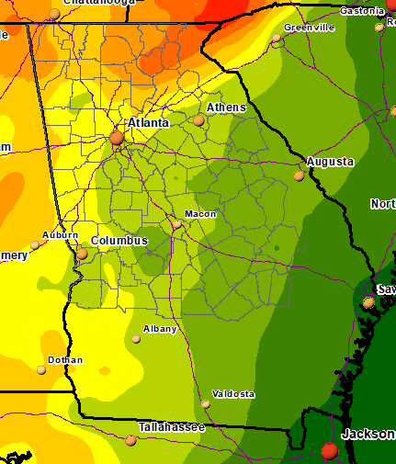
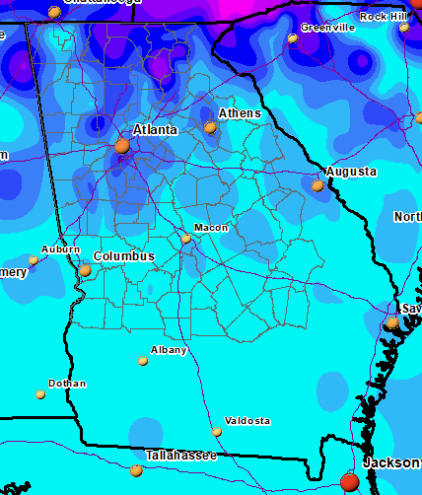
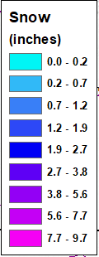
So What’s Normal?
Dec-Feb 30-year Averages
Precipitation Total
Snow Total
15-20”
3-6”
1-3”
12-15”
<1”
9-12”
<1”

Slide 12
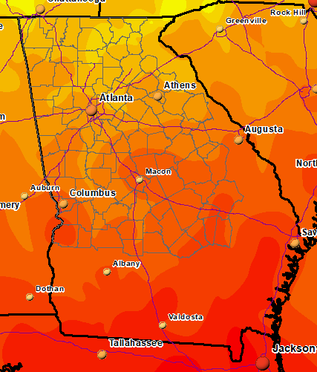
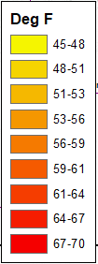
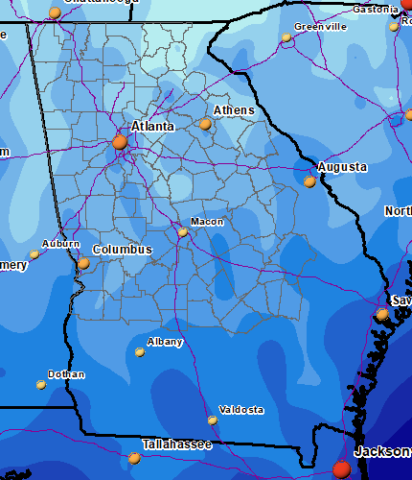
So What’s Normal?
Dec-Feb 30-year Averages
Max Temp
Min Temp
Upper 40s
Upper 20s
Low/Mid 50s
Low 30s
Mid/Upper 30s
Low/Mid 60s
Low 40s

Slide 13
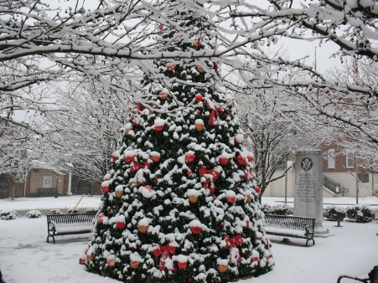
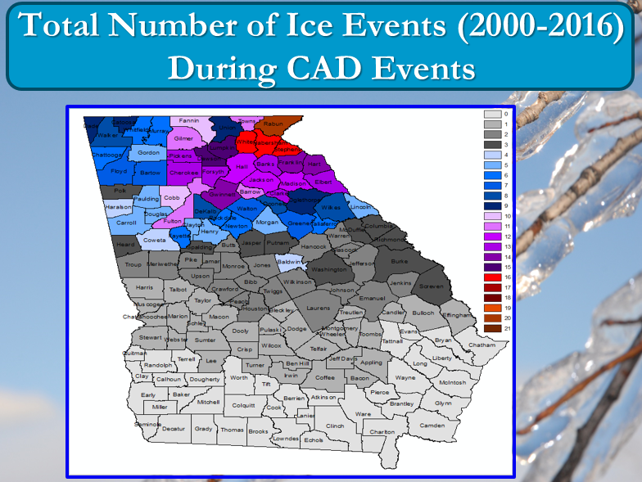
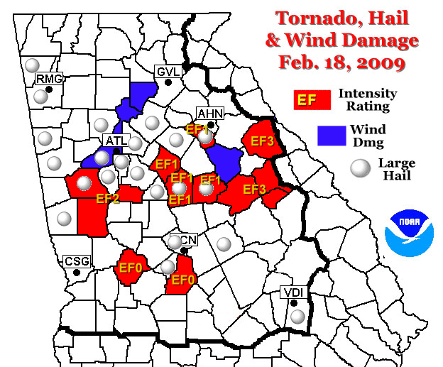
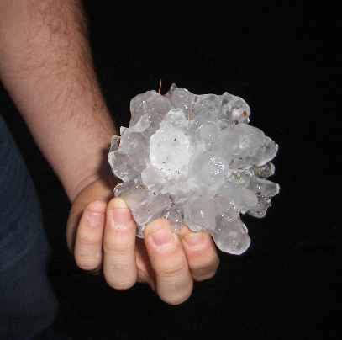
Past La Niña Winters
Notable Events (N/Cntrl GA) Since 2005-06
Myfoxatlanta.com
2010-11 (5th Snowiest):
White Christmas (ATL)
Jan 9-10 Heavy Snow (4-6” Atl, up to 10” north)
2000-2016 Ice Events:
Probability increases w/La Nina patterns →
Tornadic/Severe events occurred during all
Feb 28 & Dec 22 ‘11
Feb 18 ’09
Feb 17 ’08
Jan 2 ’06

Slide 14
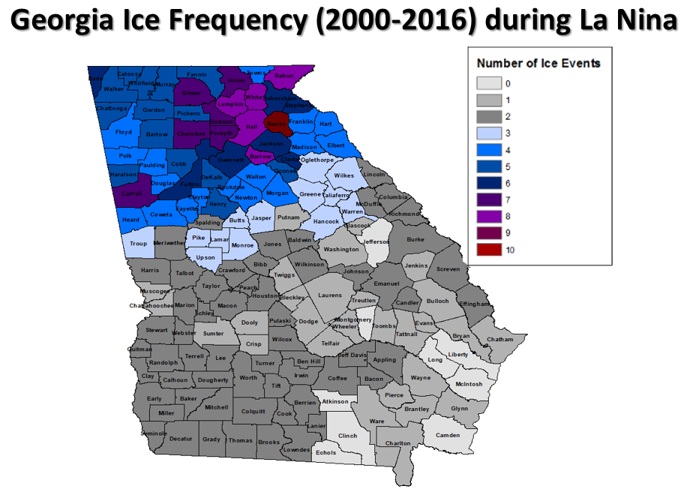
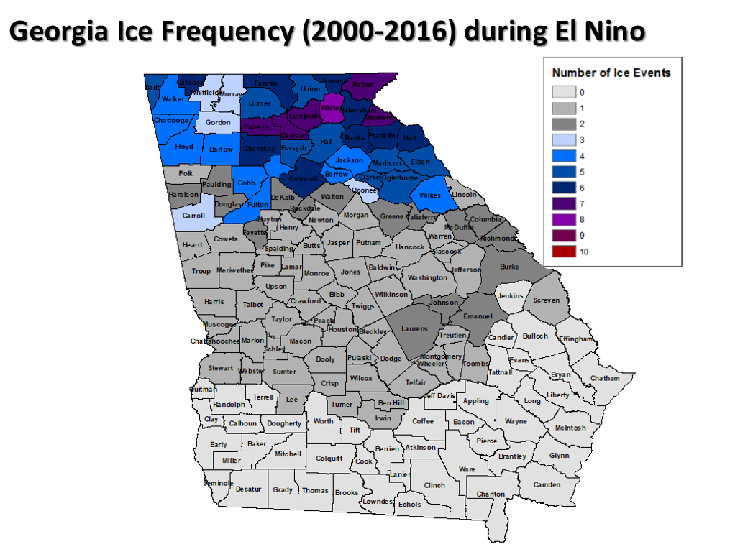
Ice Events (2000-2016)
La Nina patterns vs. El Nino
La Nina Winters (Dec/Jan/Feb)
El Nino Winters (Dec/Jan/Feb)

Slide 15
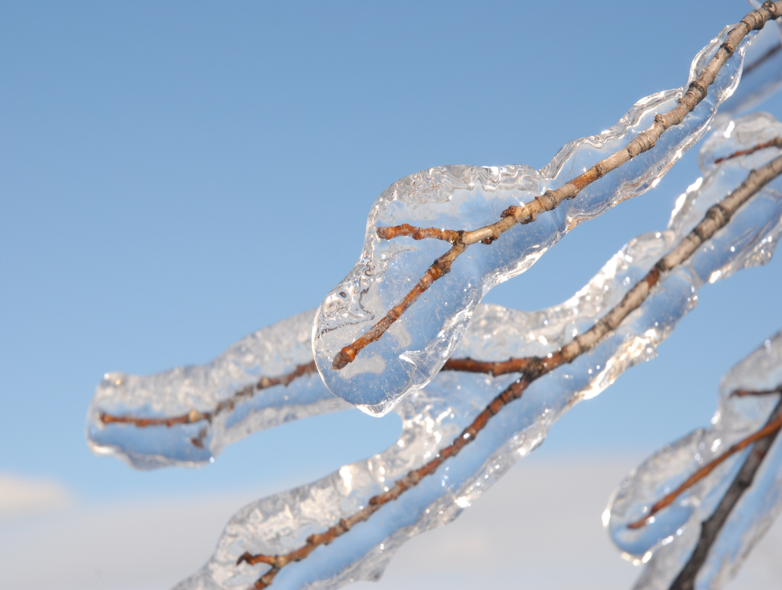
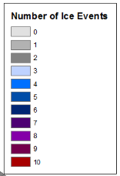
Total Number of Ice Events (2000-2016): El Nino
6 El Nino seasons

Slide 16
Total Number of Ice Events (2000-2016): La Nina
6 La Nina Seasons

Slide 17
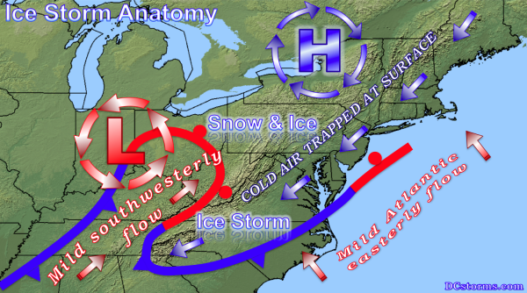
Cold Air Damming (CAD) Ice Events

Slide 18
Cold Air Damming (CAD) Ice Events

Slide 19
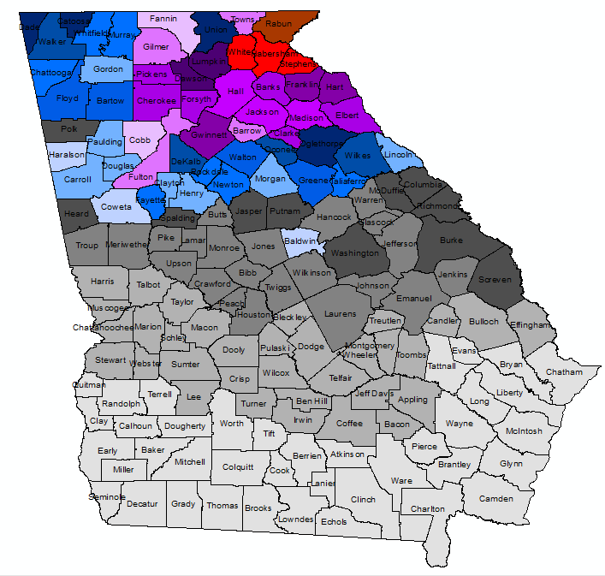
Total Number of Ice Events (2000-2016) During CAD Events

Slide 20
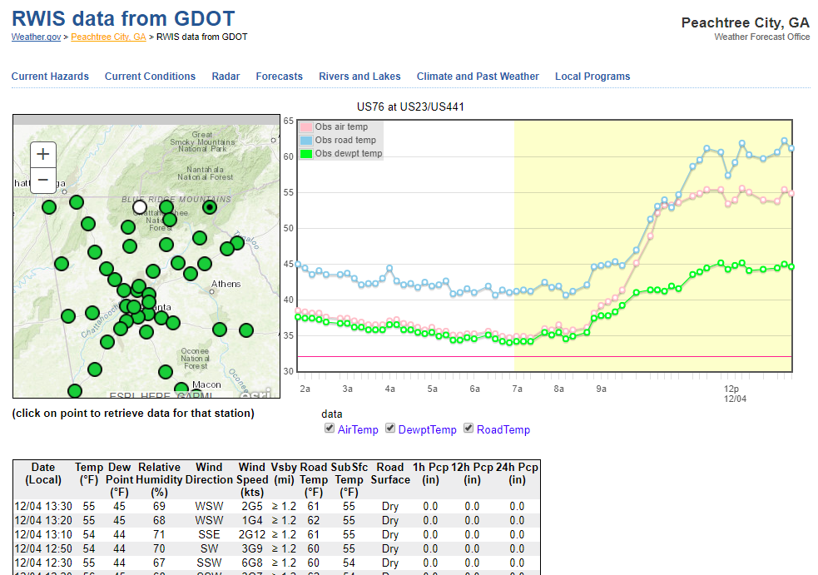
Road Temps www.weather.gov/ffc/gdot_rwis

Slide 21
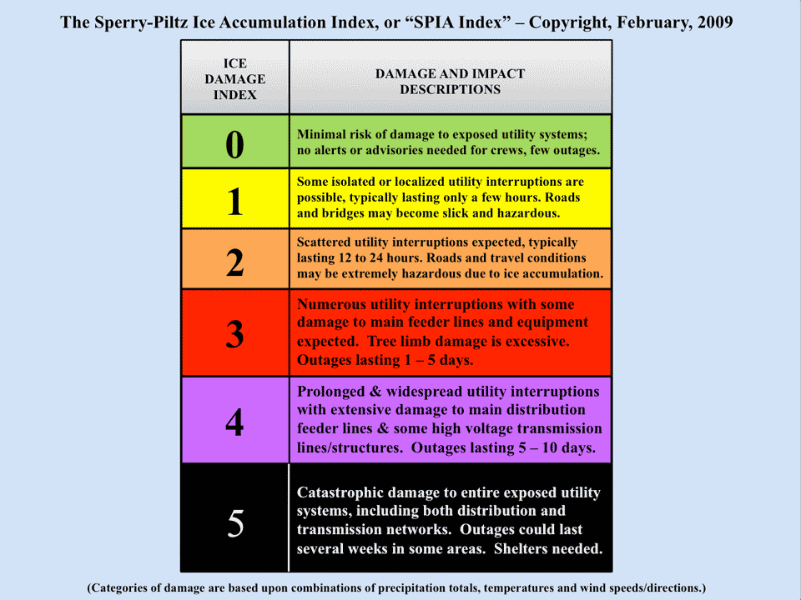
SPIA Index (http://www.spia-index.com/index.php)
Forward-looking ice storm damage index
*Impact-based* for utility industry
Several NWS test sites: FFC is one
For more information, contact SidSperry@gmail.com

Slide 22
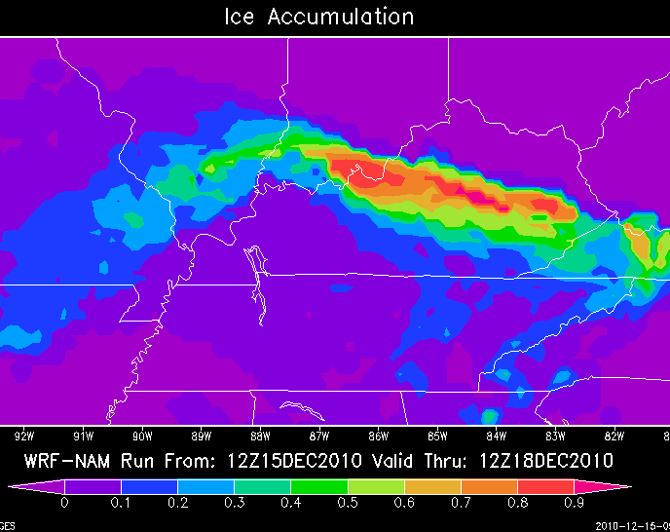
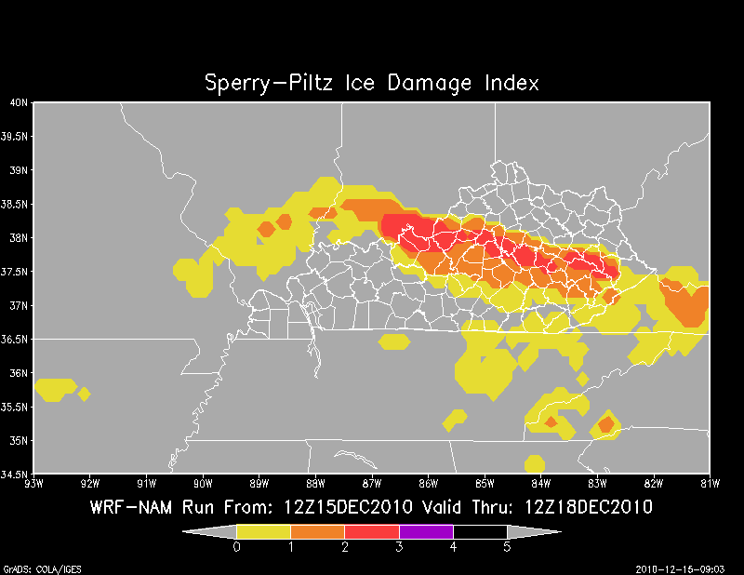
SPIA Index (http://www.spia-index.com/index.php)

Slide 23
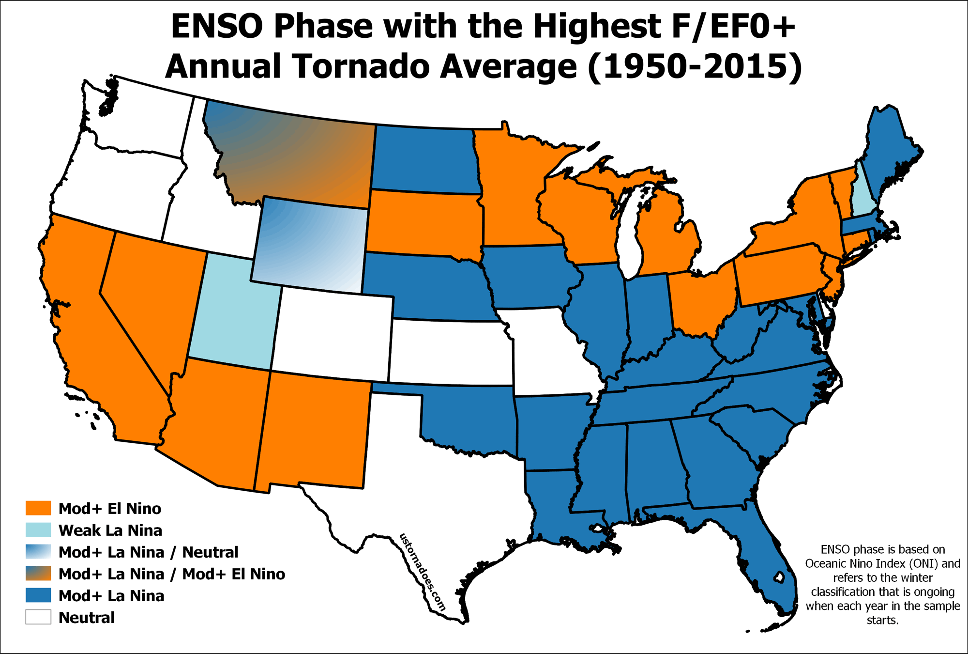
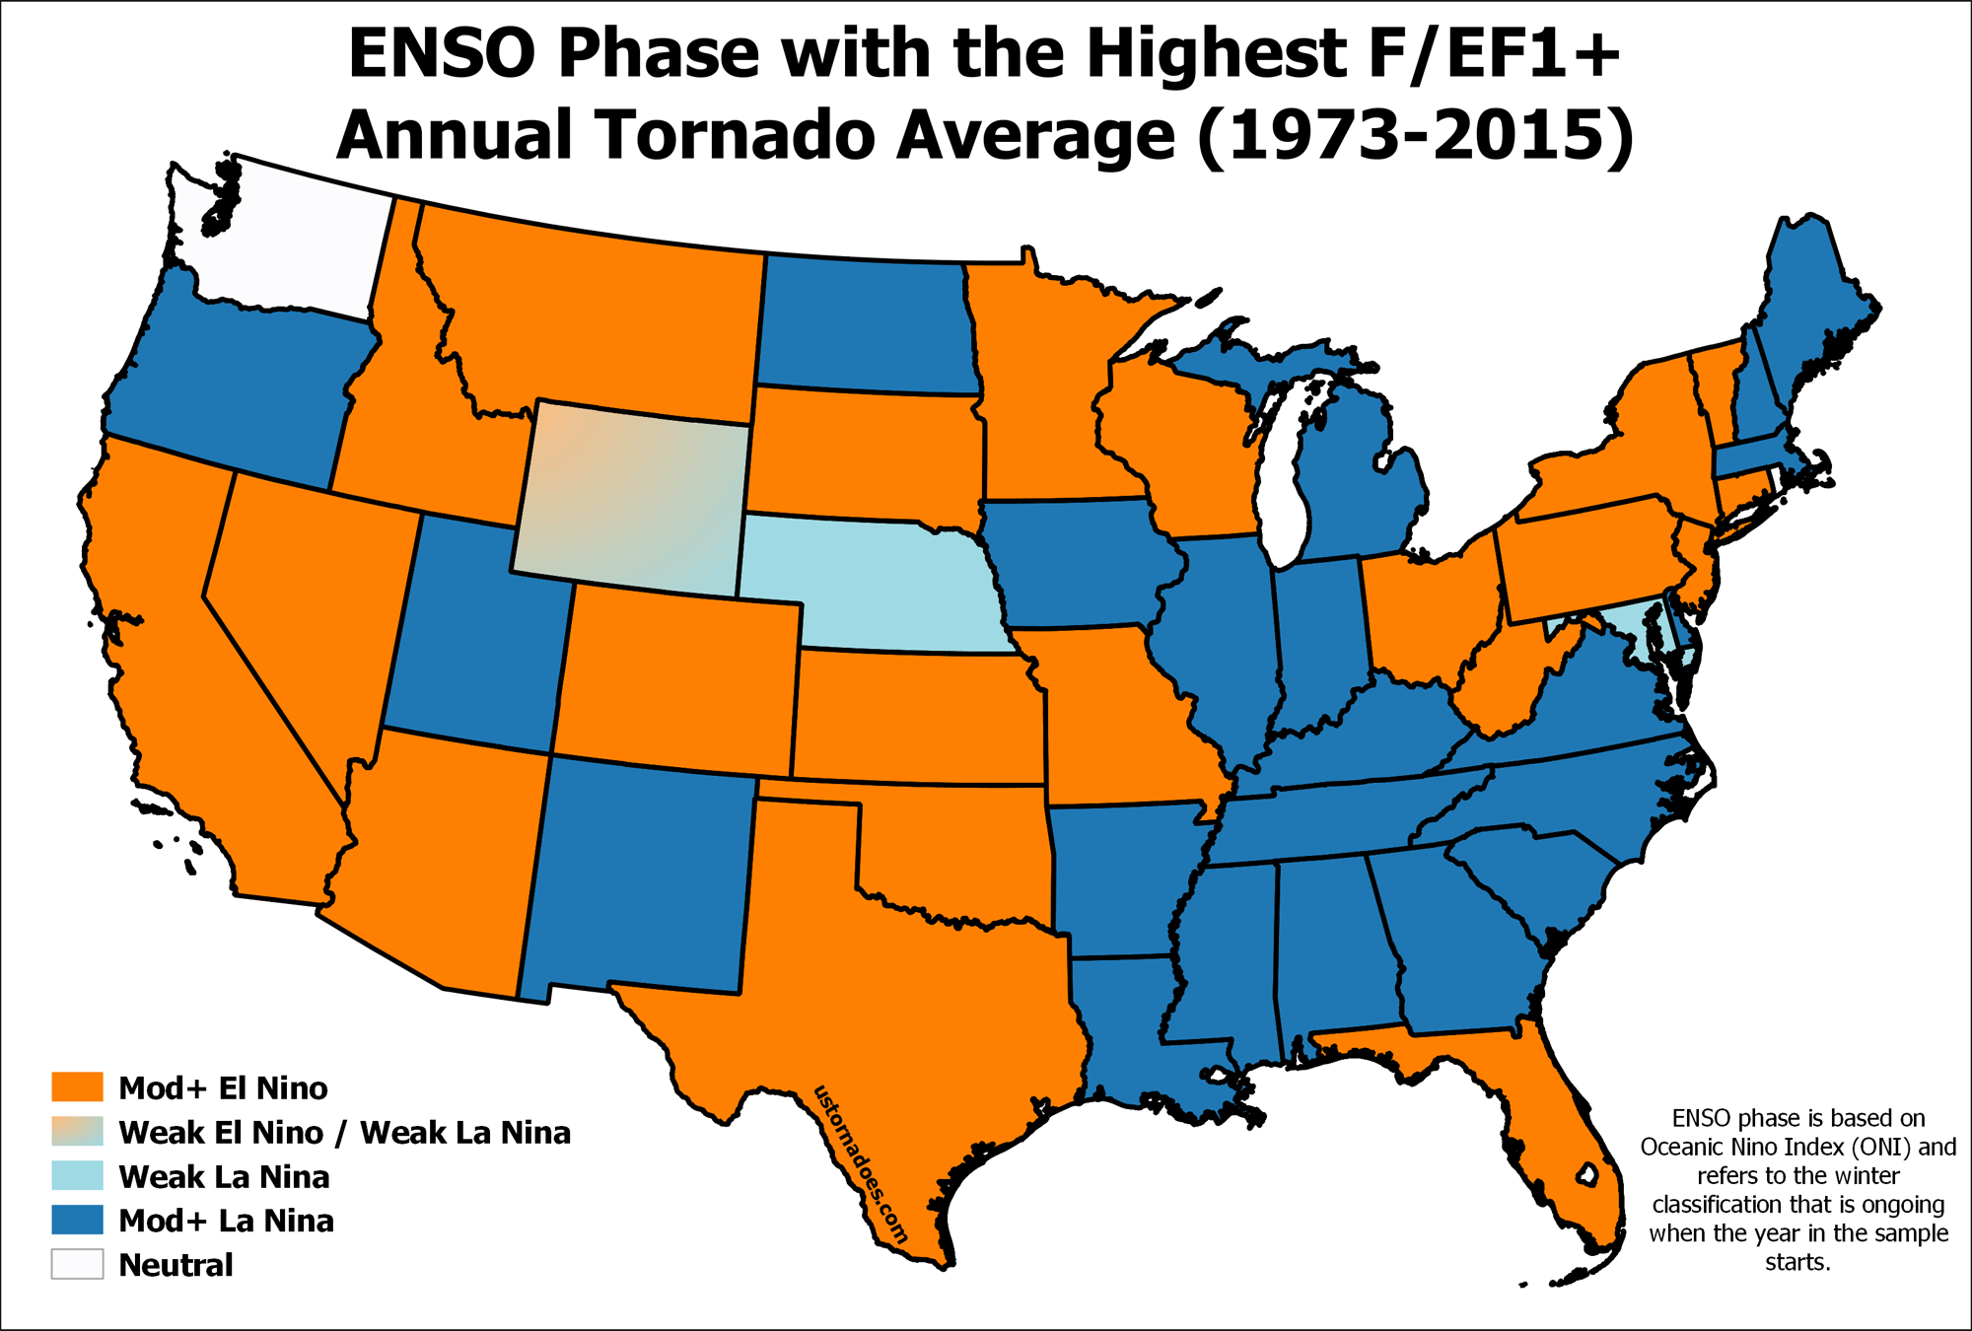
Severe Weather/Tornadoes
Graphs below taken from: http://www.ustornadoes.com/2016/03/30/how-does-el-nino-la-nina-or-la-nada-impact-the-following-tornado-season/

Slide 24
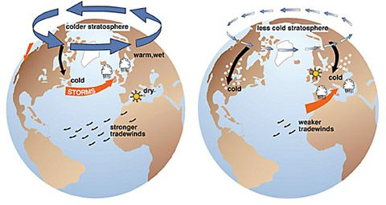
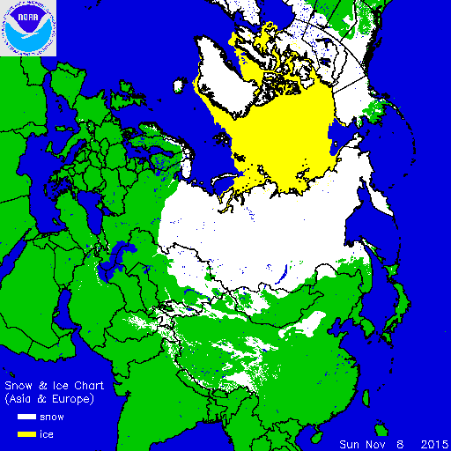
Other Influences
Stronger High
Weaker High
Strength of Polar pressure system (Arctic Oscillation)
*only forecast 2 weeks out
H
H
Siberian snow cover extent
Northeast Pacific SSTs

Slide 25
Summary
La Niña conditions likely through winter, then back to neutral for spring
CPC Outlook – Higher probabilities (%) to see Warmer and Drier than normal – but don’t be fooled by these outlooks!!
Local study indicates closer to normal temps/precip – don’t overlook influence of polar jet stream in eastern US
Recent “La Nina” episodes (last 10+ years) include notable winter & severe weather events

