Slide 1
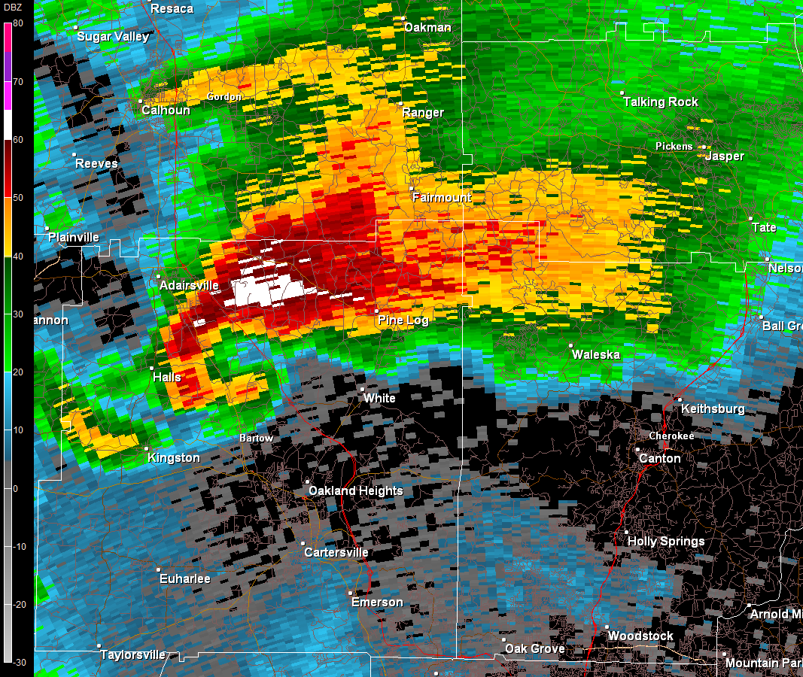
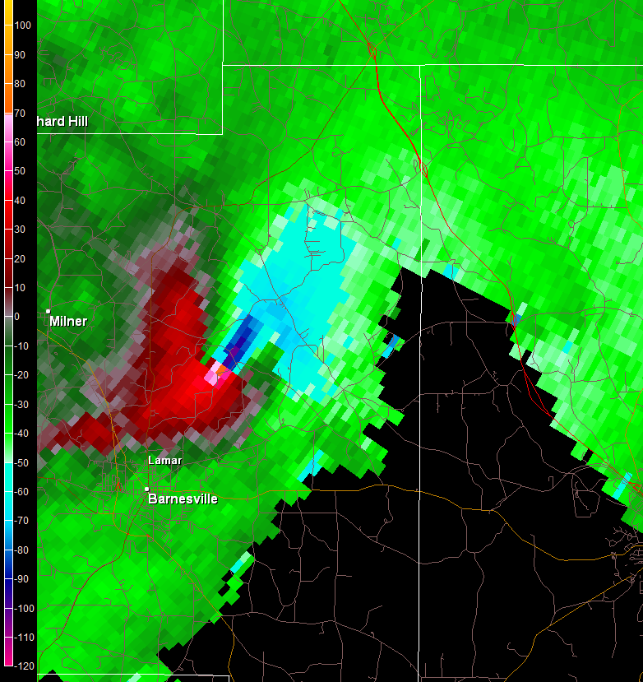

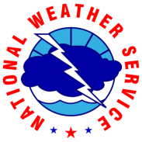
Weather Radar Interpretation and Communication of Severe Storm Threats
Steven Nelson
Science and Operations Officer
National Weather Service, Peachtree City, GA
Integrated Working Team Workshop
December 5, 2017

Slide 2
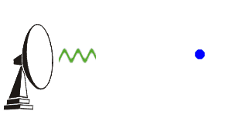
What is Radar?
Radio Detection and Ranging
  Detects the distance to and power returned from a target
Weather radar is designed to detect targets made of water
  It can be fooled!
Raindrop, snowflake, hail, insect, dust, etc.
Many brief microwave pulses per second are transmitted
In between the pulses, the radar is “listening” for a reflected signal, or “echo”
The amount of reflected signal received is called reflectivity

Slide 3
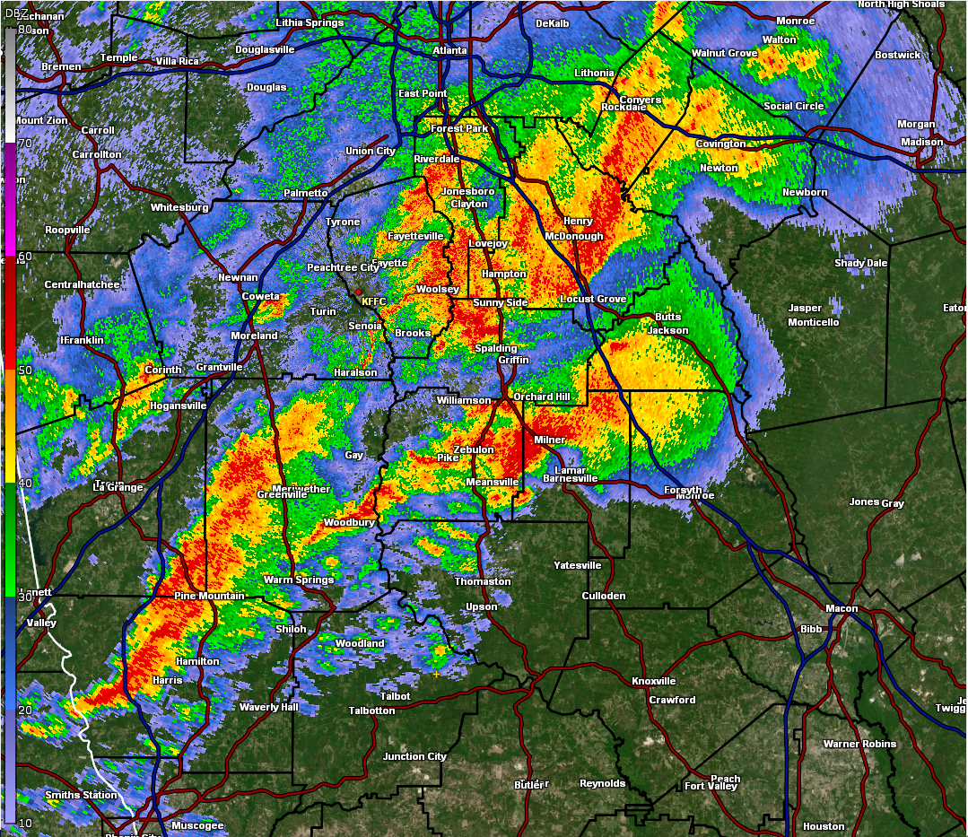
What is Reflectivity?
The higher the reflectivity, the heavier the rainfall
Colors are used to display low and high reflectivity
    warm colors = high
    cool colors = low
    Always use the color legend
Threats seen: heavy rain, hail, snow
Can also see birds, insects, leaves (tornado debris)

Slide 4
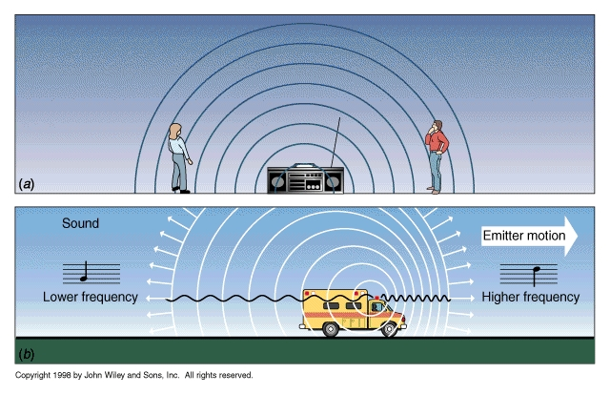
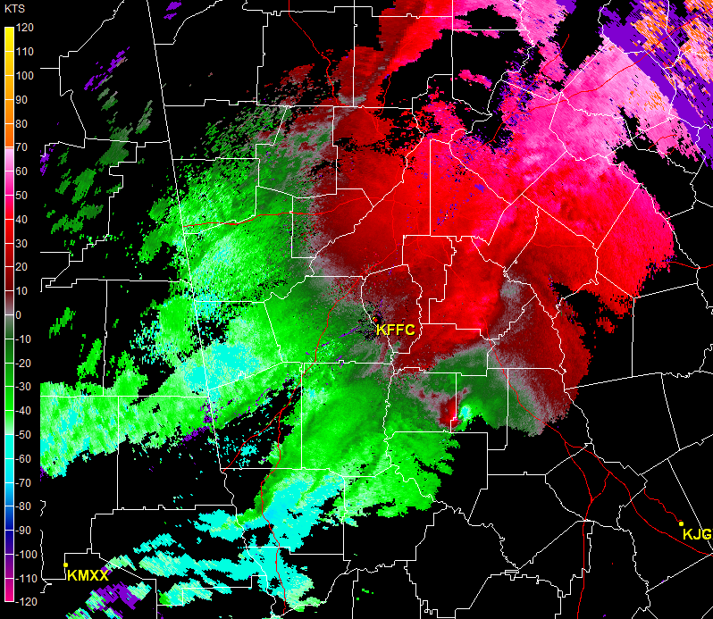
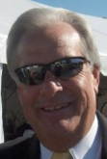
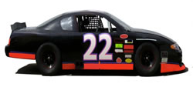
What is Doppler Radar?
Doppler effect is a change in frequency of a moving object
Targets moving toward the radar are colored green
Targets moving away from the radar are colored red
The brighter the color, the stronger the wind
Threats seen: damaging wind, tornadoes

Slide 5
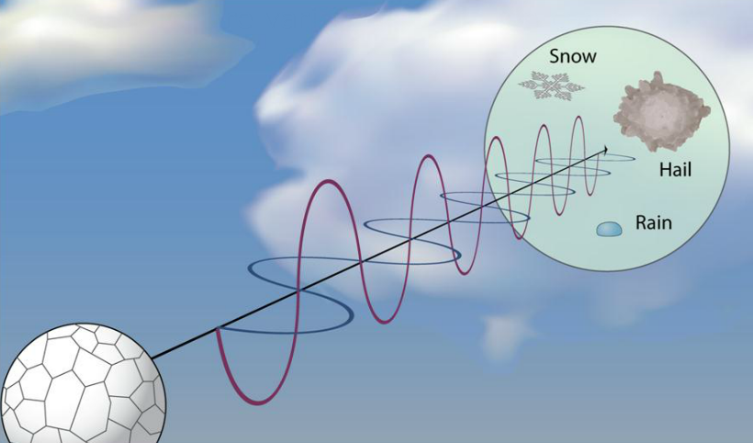
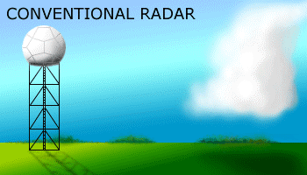

What is Dual-Polarization Radar?
Leaves
Dirt
Radar waves polarized horizontally and vertically
Can see the size and shape of weather and non-weather targets
Threats seen: hail, heavy rainfall, tornado debris

Slide 6
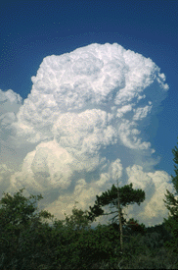

Limitations of Radar
Resolution decreases with distance
Earth curvature
  Need a network of radars
Can’t see this!!
Can’t see this!!
Radar
Earth

Slide 7
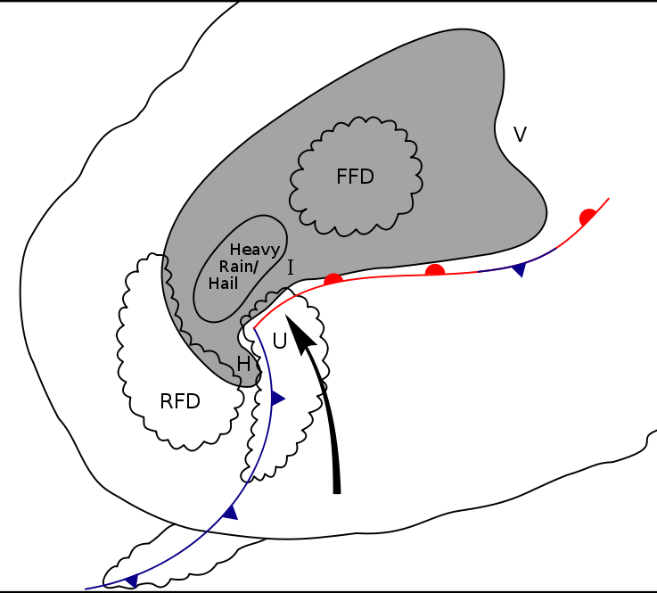
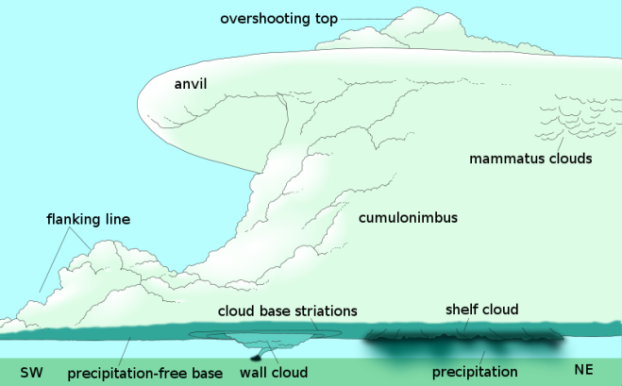
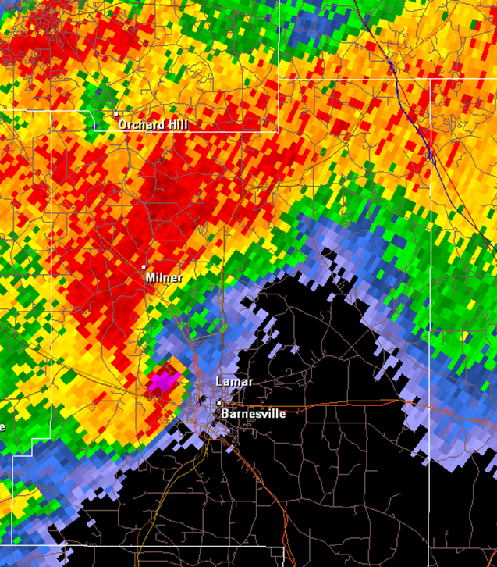
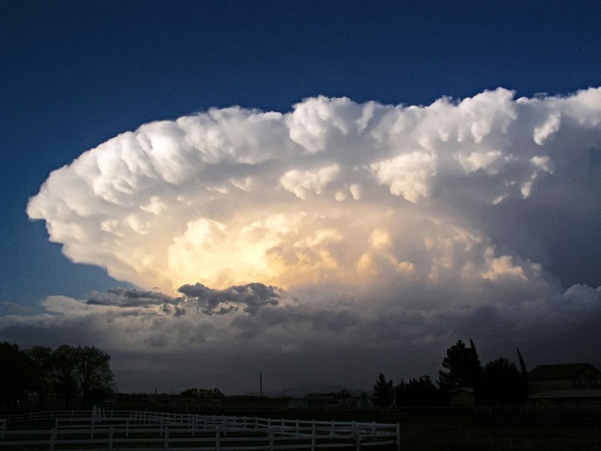
Storm Structure - Reflectivity
Most likely area for damaging wind, large hail and tornadoes
T

Slide 8

Storm Structure - Reflectivity
T

Slide 9
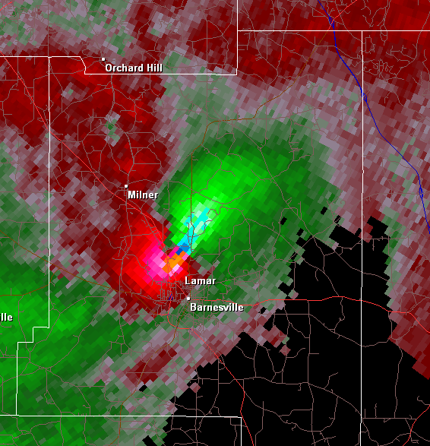
Storm Structure - Velocity
T

Slide 10
Storm Structure - Velocity
T

Slide 11
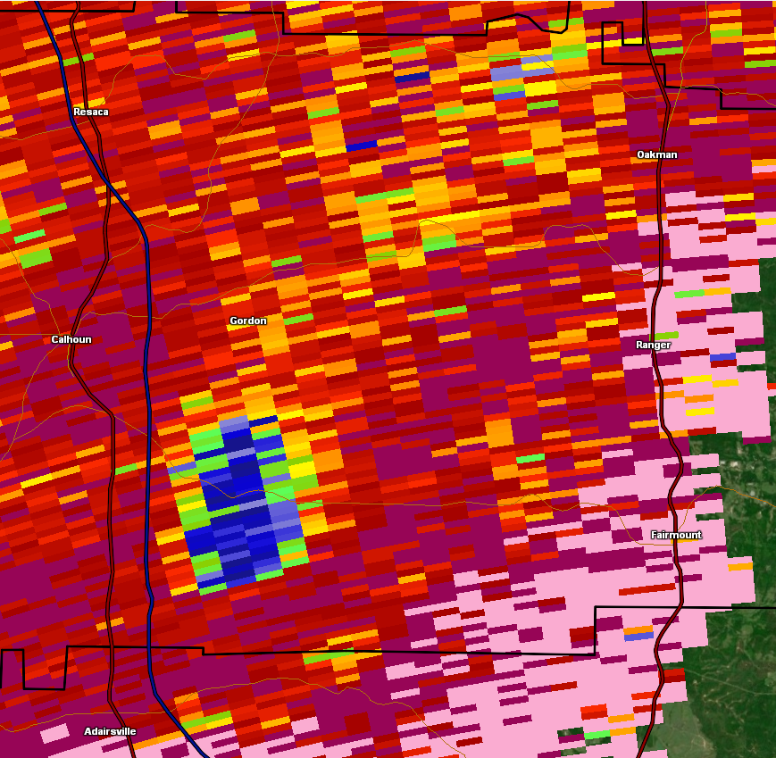
Storm Structure – Dual-polarization
T

Slide 12
Storm Structure – Dual-polarization
T

Slide 13
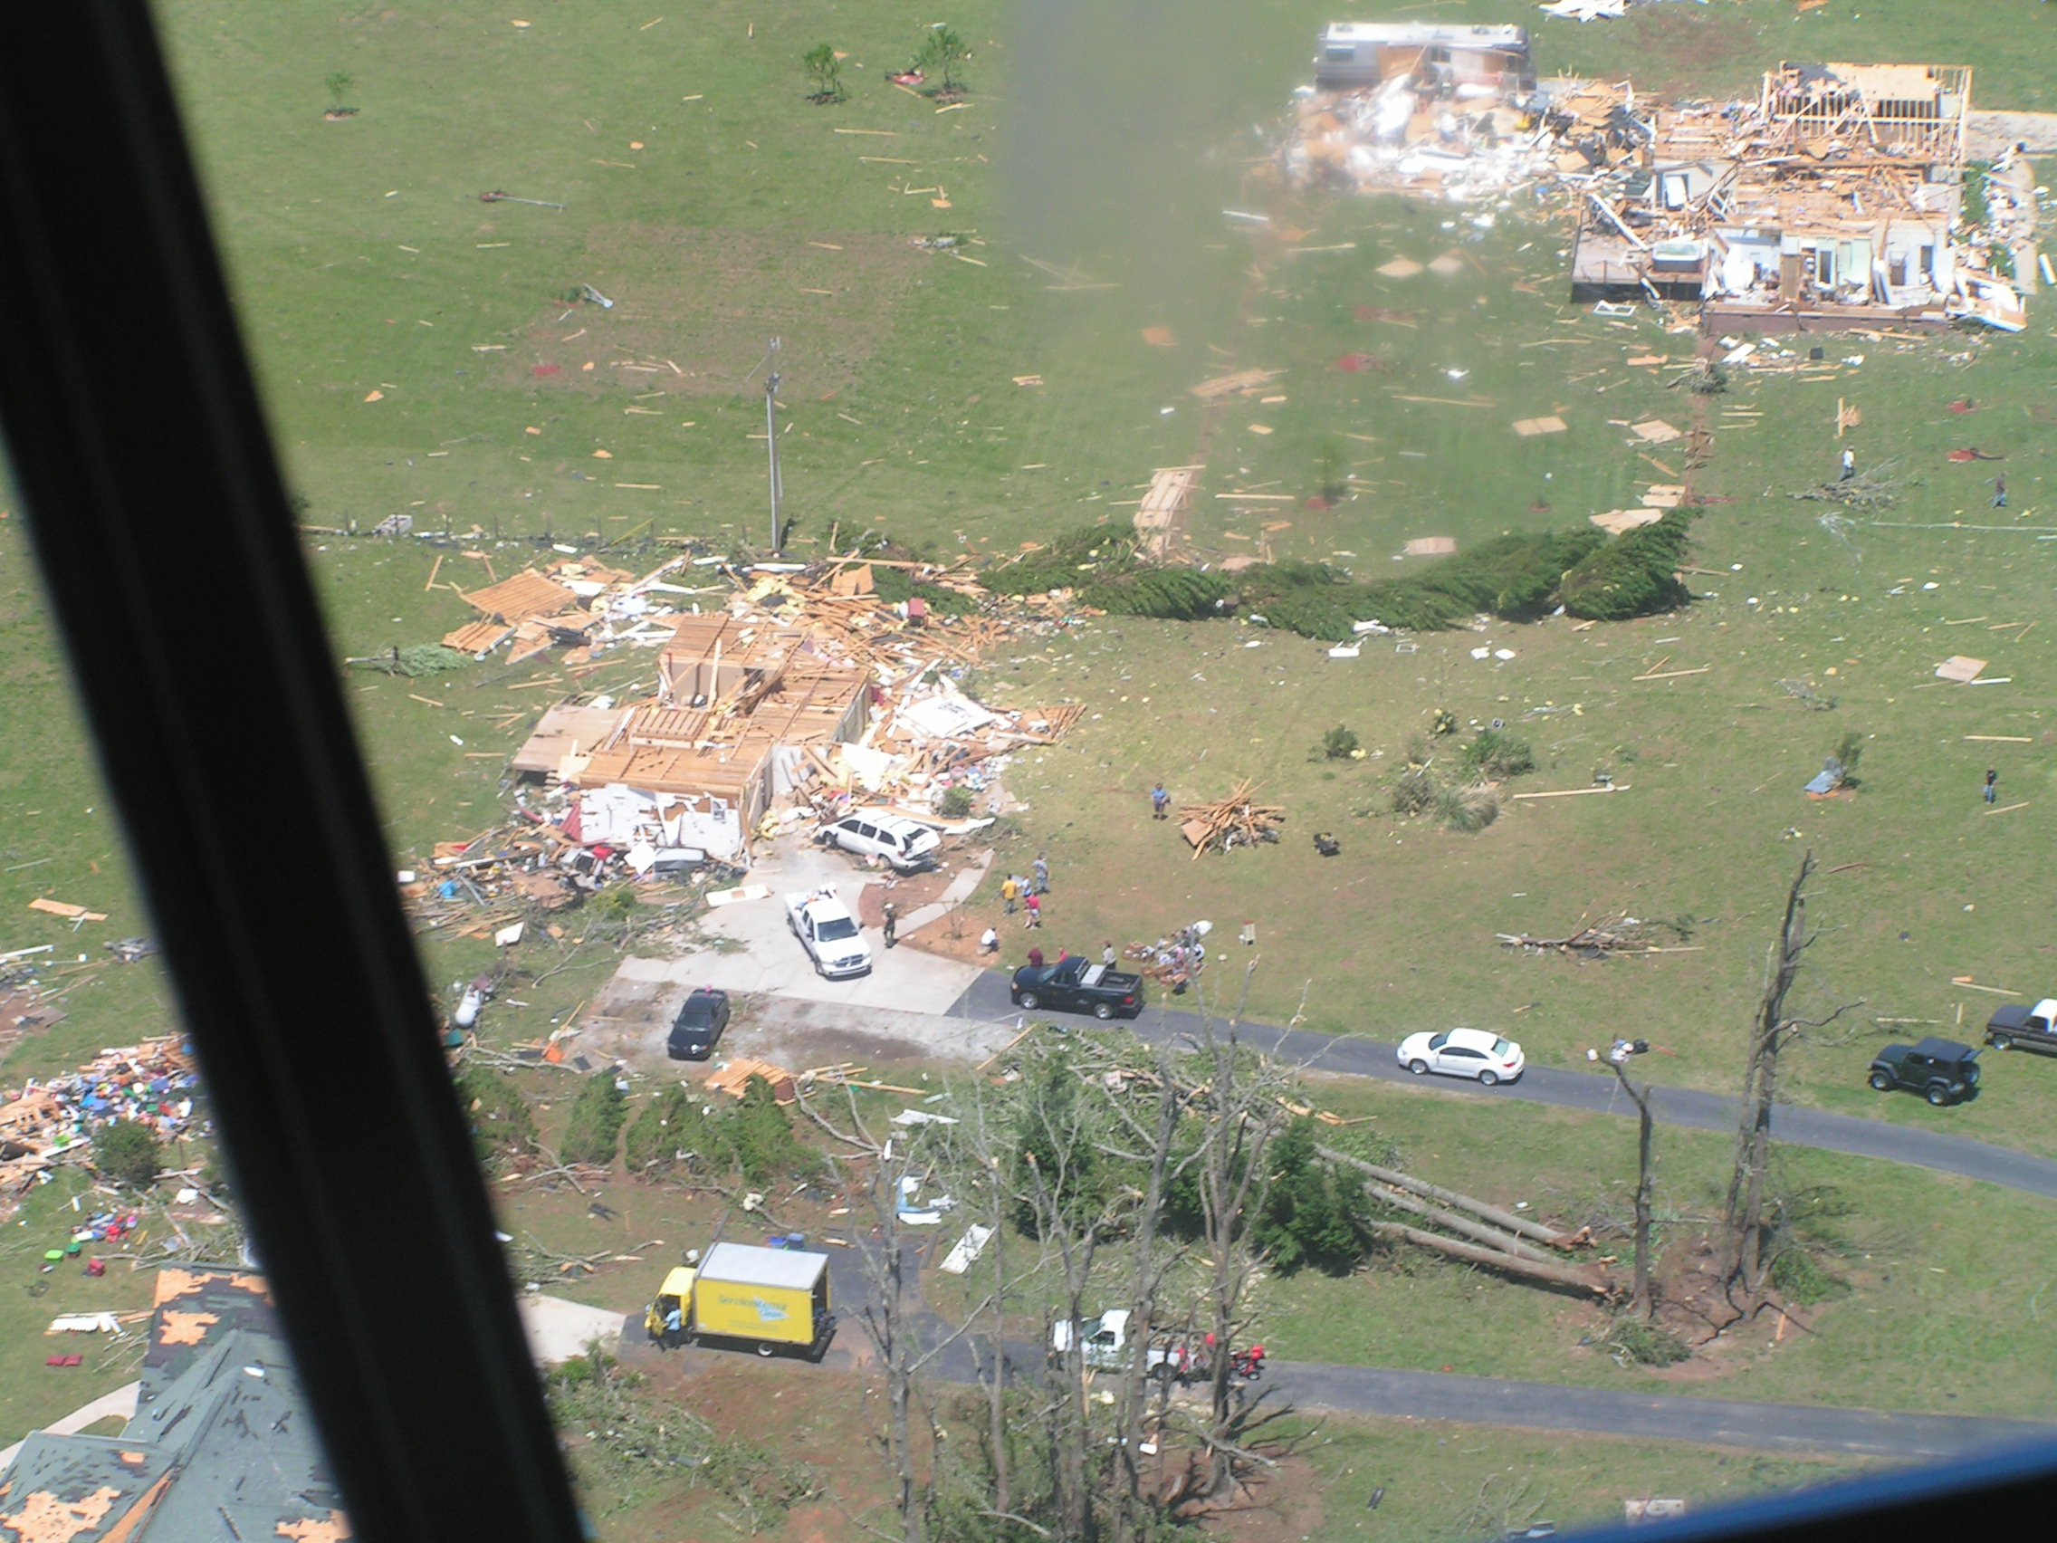

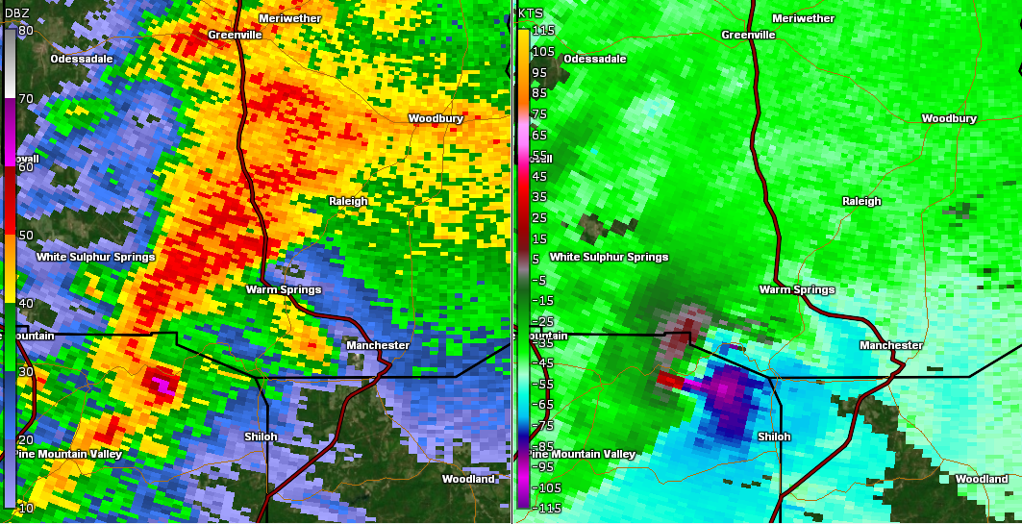
You make the call!
Vote now! goo.gl/Wcpq1X
87% - Tornado Warning

Slide 14
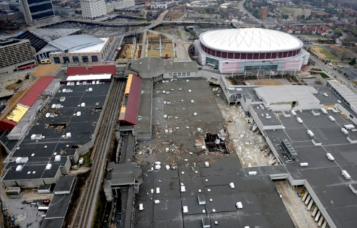
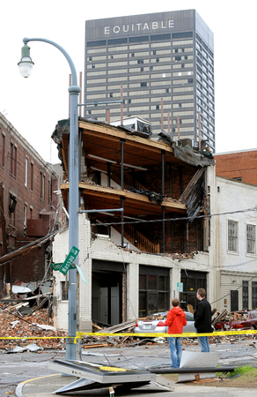
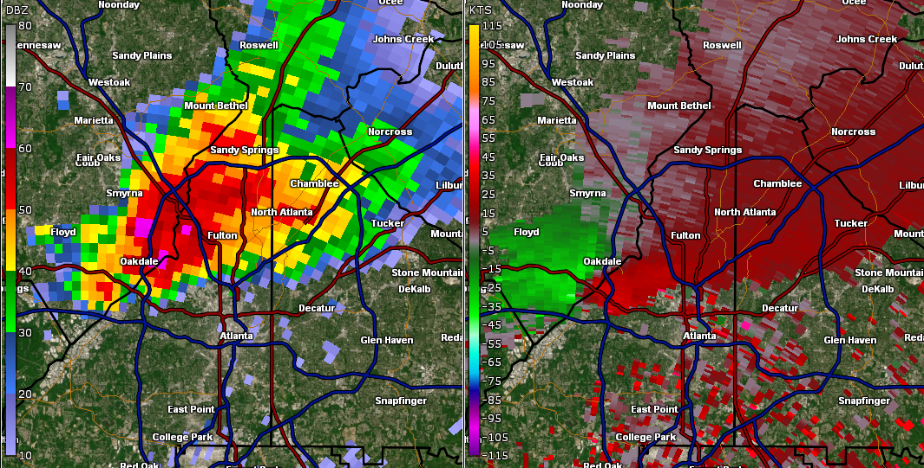

You make the call!
Vote now! goo.gl/Wcpq1X
87% - Tornado Warning

Slide 15
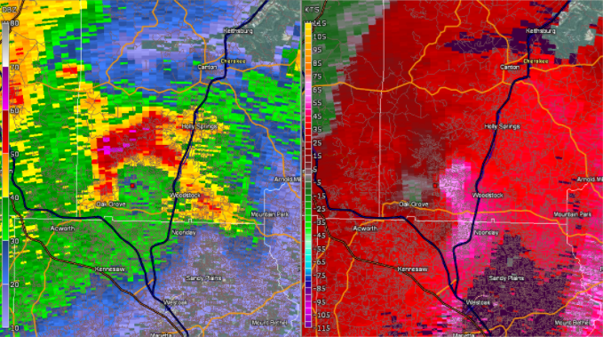
You make the call!

Slide 16
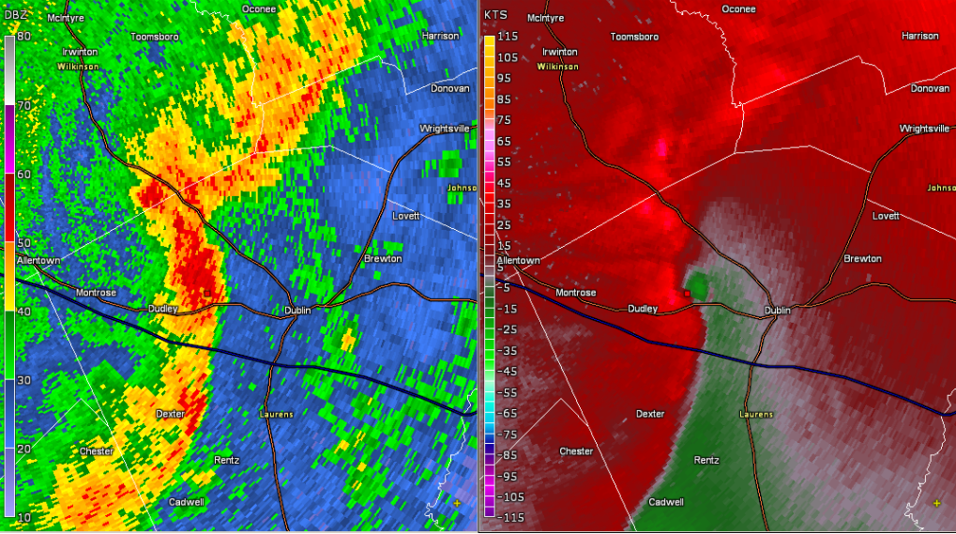
You make the call!

Slide 17
Discussion
Stuff

Slide 18

Questions?
steven.nelson@noaa.gov

