Slide 1
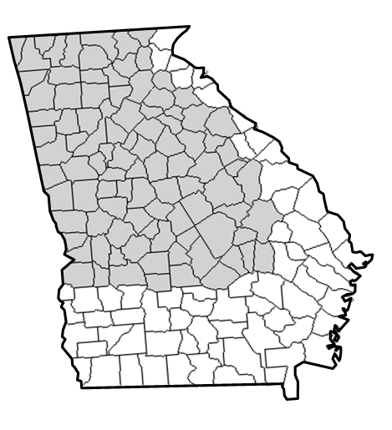
National Weather Service
Disclaimer: The information contained in this briefing is time sensitive which should be taken into consideration while viewing.
Weekly Weather Briefing
NWS Atlanta/Peachtree City
For the week starting November 21st, 2024

Slide 2
Friday
The Week Ahead
November 21, 2024
11:40 AM
Risk Levels:
1
2
3
4
5
Today
Friday
Saturday
Sunday
Monday
Tuesday
Wednesday
1
1
1
1
1
1
1
Snow flurries possible overnight in the mountains
Rain showers possible, mainly north Georgia
Chance of rain showers, mainly north Georgia
Chance of rain showers, mainly north Georgia
Weather
Highlights
Dry, cool, and breezy through Friday.
Gradual warming trend heading into next week.
Next rain-producing system arrives early to middle of next week.
National Weather Service
National Weather Service
Peachtree City, GA

Slide 3
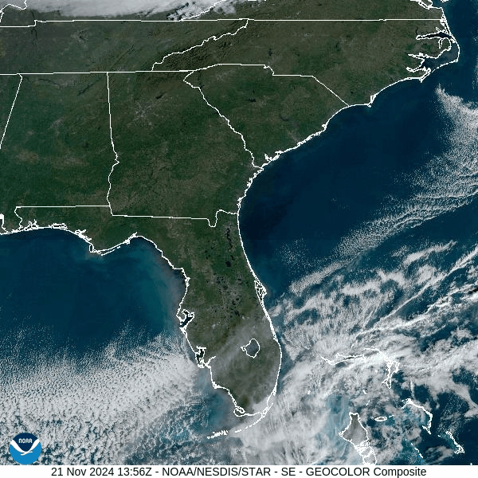
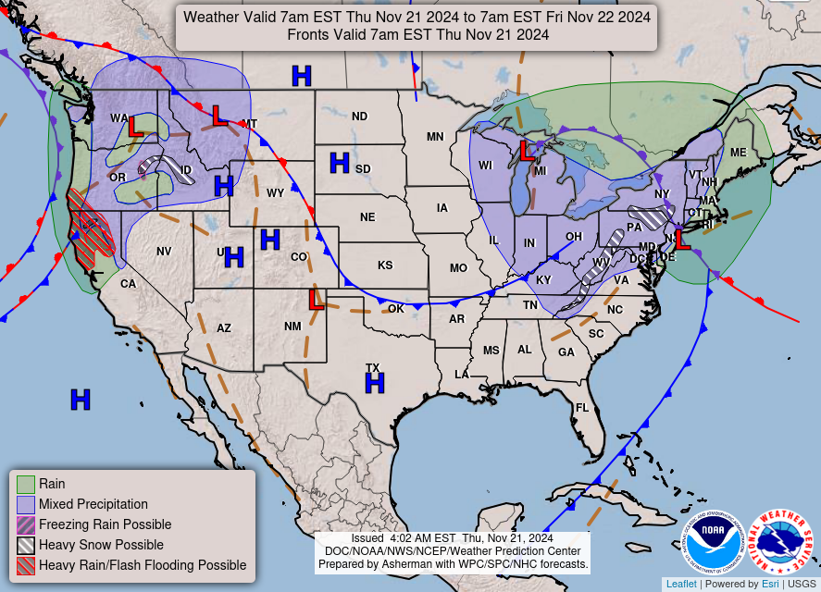
Today and Tonight
Dry, cool, and breezy, with snow flurries possible in the mountains overnight

Slide 4
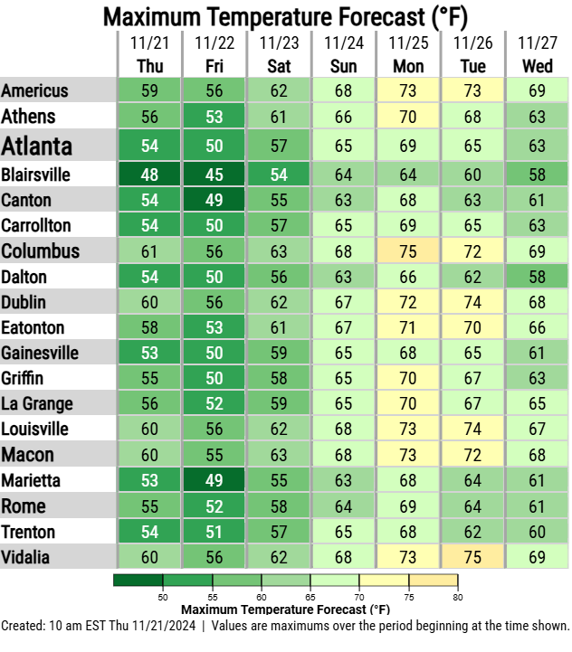
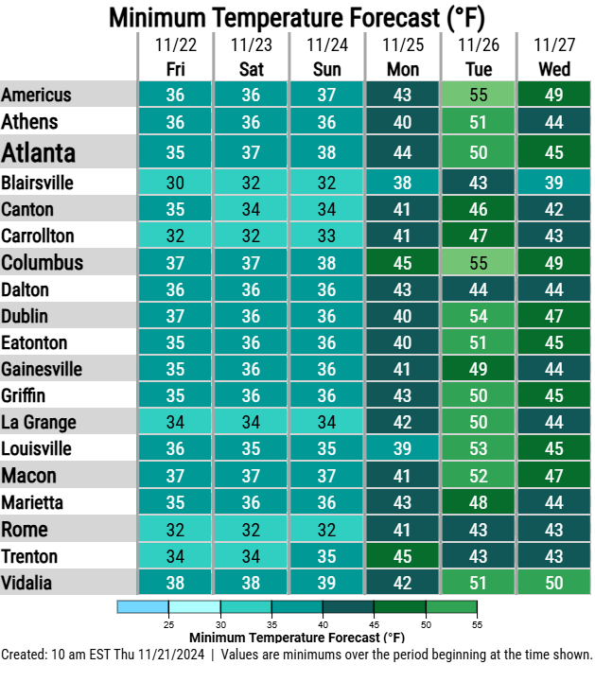
Friday
7 Day Temperature Outlook
November 21, 2024
11:40 AM
Cool for the next few days, then gradual warming heading into next week
Gradual warming
Gradual warming
Potential for widespread freezing temperatures (plus patchy frost)
National Weather Service
National Weather Service
Peachtree City, GA

Slide 5
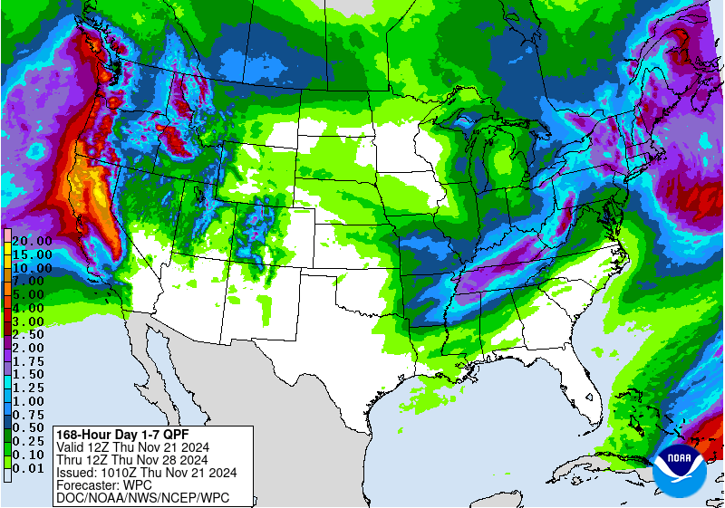
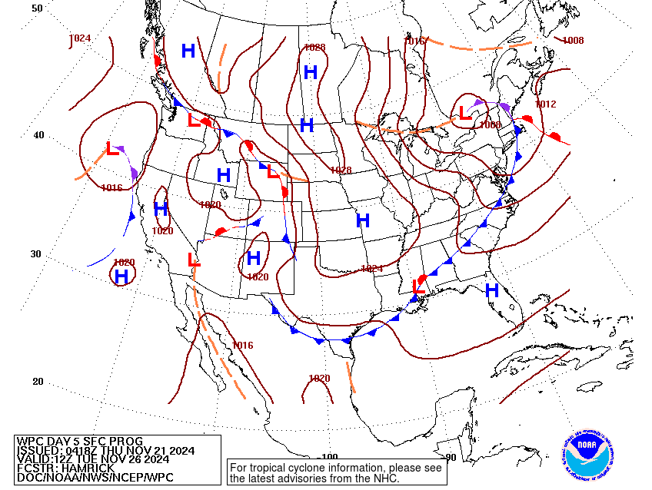
Friday
7 Day Precipitation Outlook
November 21, 2024
11:40 AM
Low pressure system and cold front to impact Georgia early to middle of next week
Day 1-7 Rainfall Forecast
Cold front to arrive on Tuesday
National Weather Service
National Weather Service
Peachtree City, GA

Slide 6
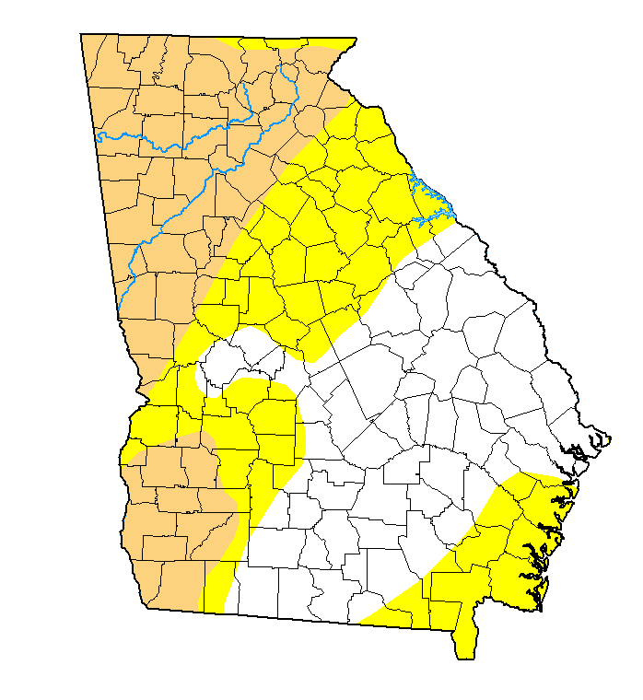
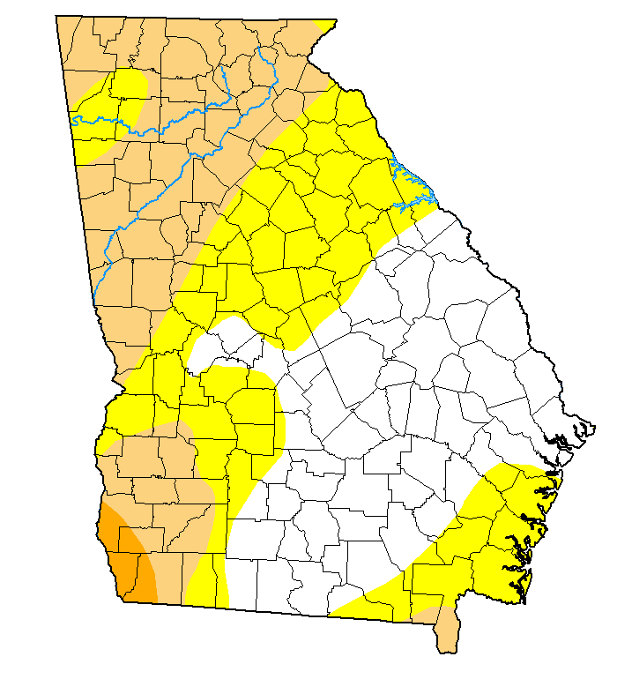
Drought Monitor
Not much change between November 12th and 19th
Previous Outlook
(November 12th)
Current Outlook
(November 19th)
Drought Classification
None
D0 (Abnormally Dry)
D1 (Moderate Drought)
D2 (Severe Drought)
D3 (Extreme Drought)
D4 (Exceptional Drought)

Slide 7
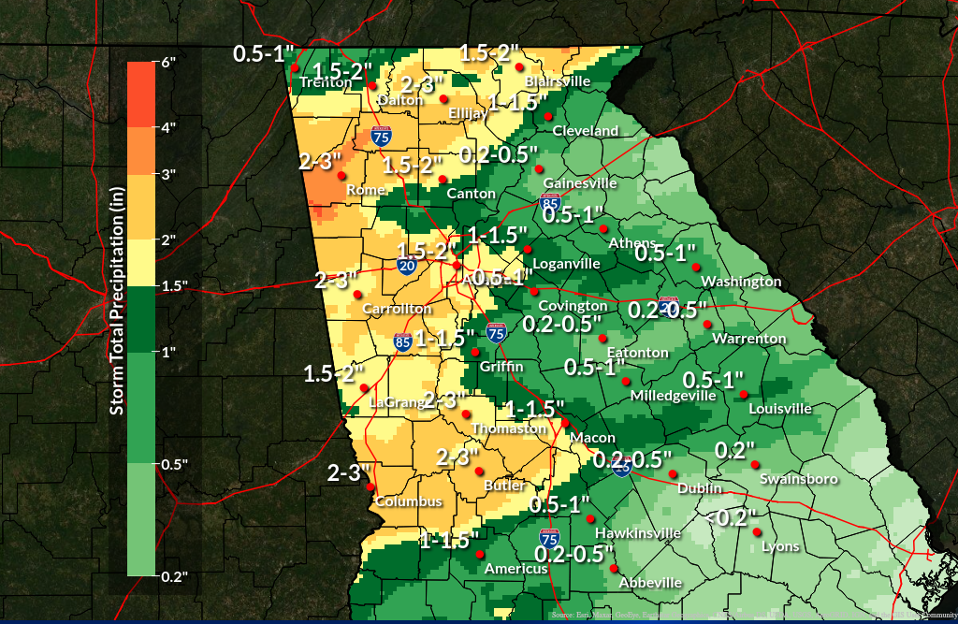
Rainfall Totals
Tuesday morning through Wednesday evening
Same area where there was one category improvement in drought conditions since last week (Moderate Drought to Abnormally Dry)

Slide 8
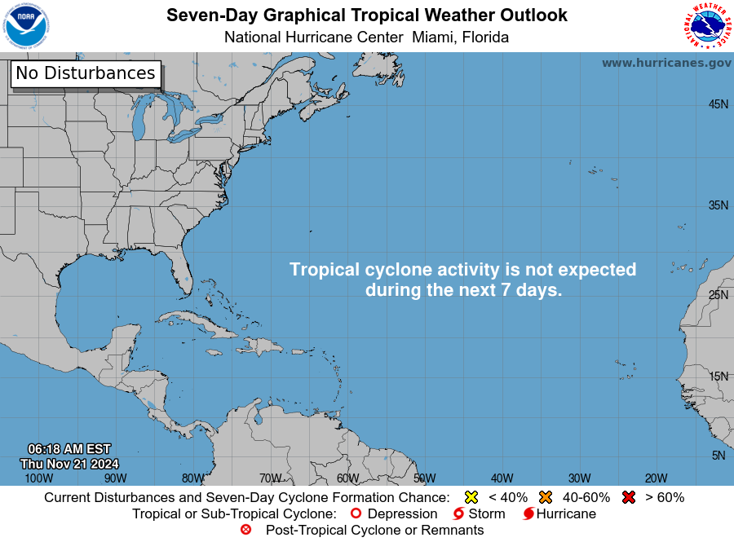
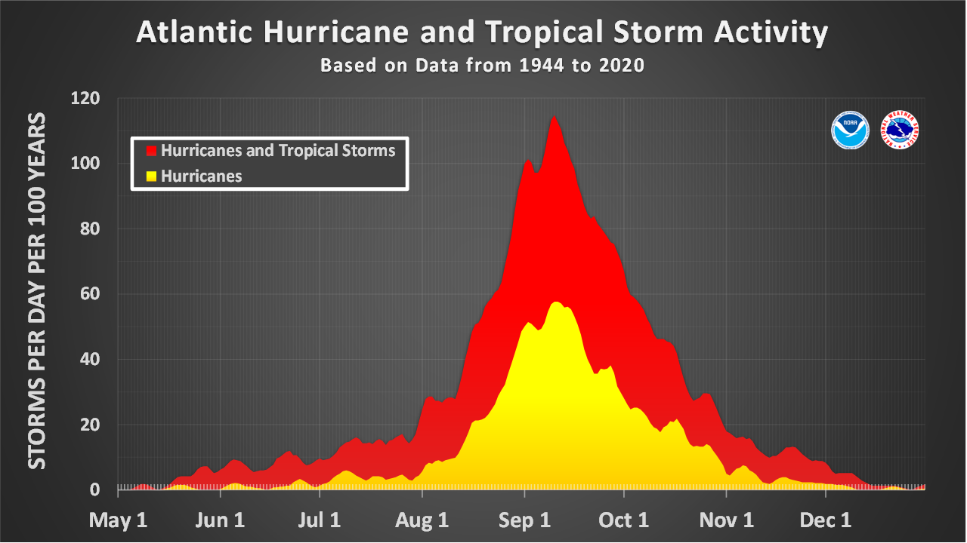
Friday
Tropical Overview
November 21, 2024
11:40 AM
No tropical activity expected in the next week
Atlantic hurricane season coming to a close soon…
We are here
National Weather Service
National Weather Service
Peachtree City, GA

Slide 9
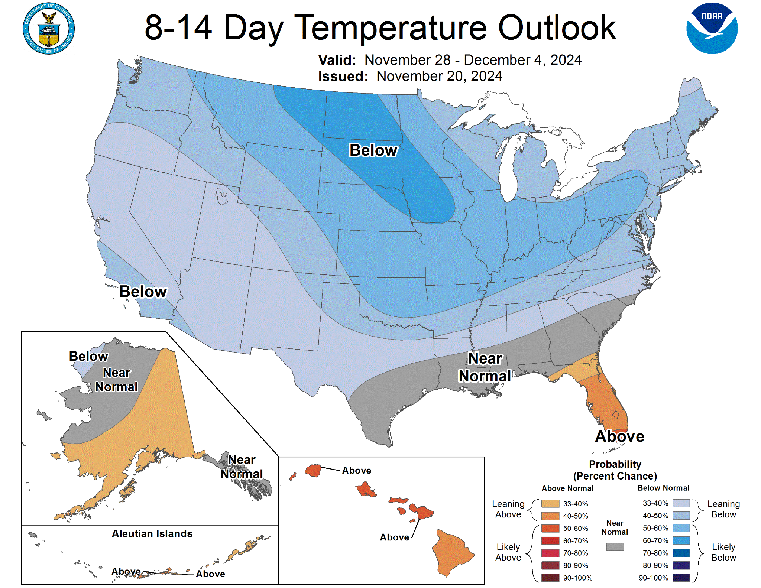
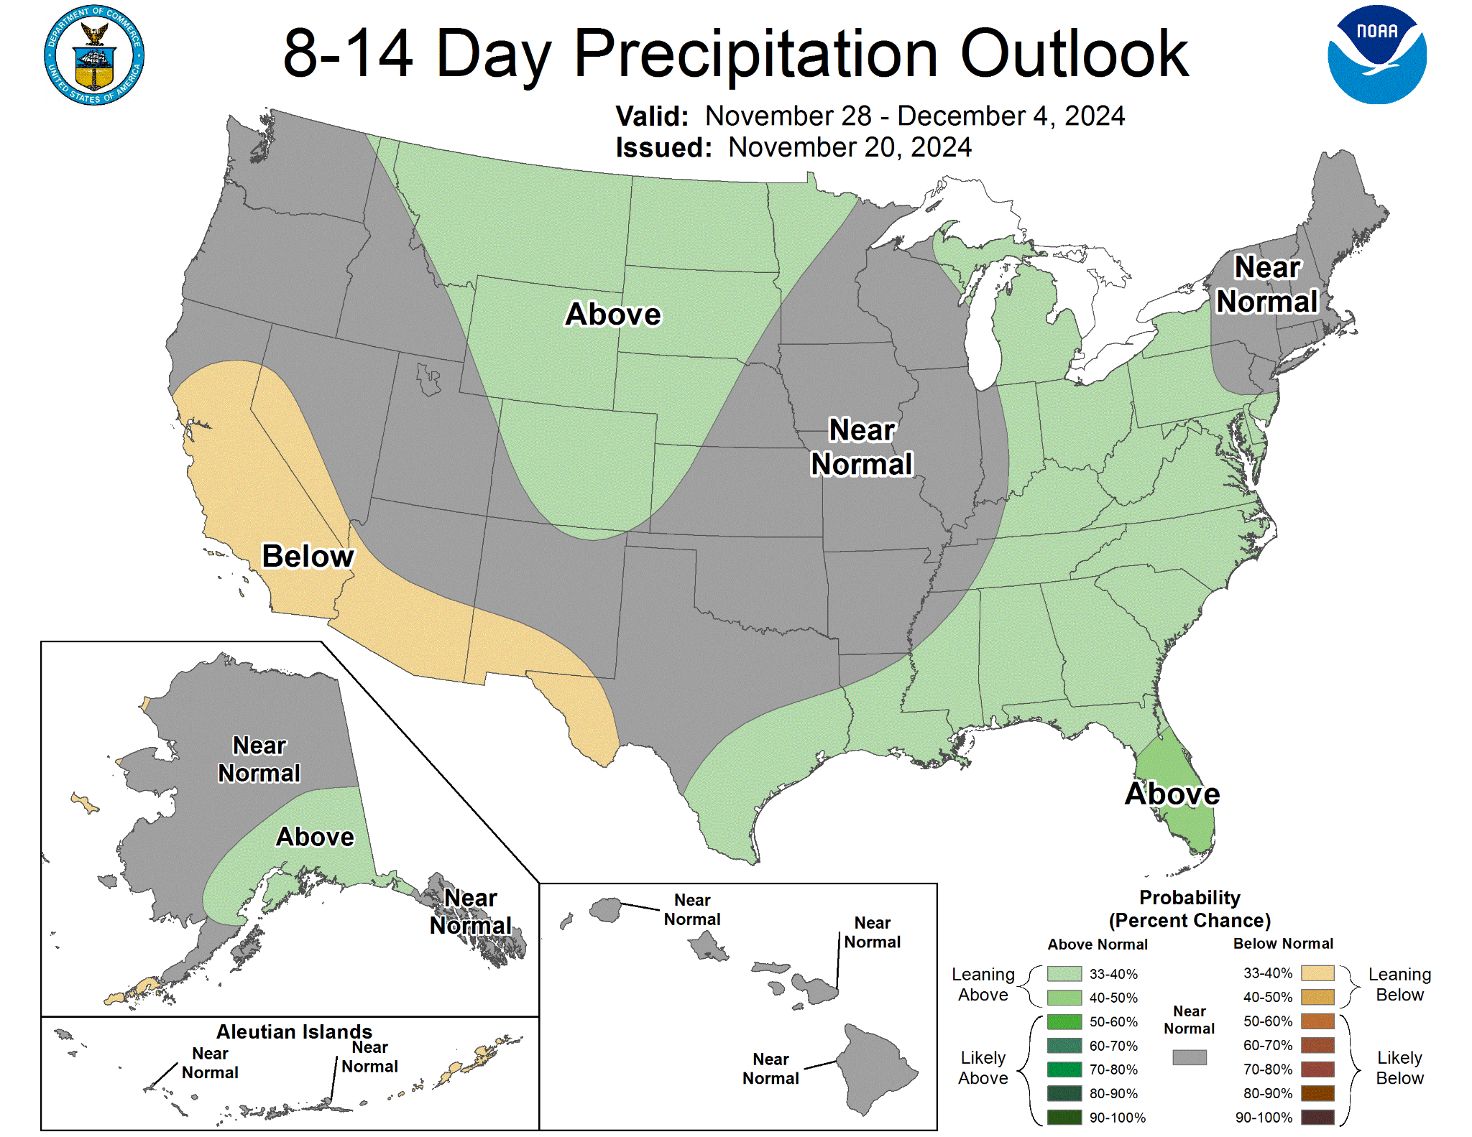
8-14 Day Outlooks
November 21, 2024
11:40 AM
November 28th to December 4th
Temperature: leaning below normal across north Georgia
Precipitation: leaning above normal across all of Georgia
National Weather Service
National Weather Service
Peachtree City, GA

Slide 10
Contact Information
November 21, 2024
11:40 AM
By Phone
770-486-1133
X
@NWSAtlanta
Via Email
sr-ffc.webmaster@noaa.gov
Instagram
nwsatlanta
Online
weather.gov/atlanta
weather.gov/ffc/briefings
Facebook
NWSAtlanta
NWS Chat
EMs, Media, and approved partners
YouTube
@NWSPeachtreeCity
Decision Support
weather.gov/ffc/dss
National Weather Service
National Weather Service
Peachtree City, GA

