Slide 1
WFO DTX Aviation Decision Support
Support for the Detroit Metro Airspace (D21)

Slide 2
For 2017, Detroit Metro Airport (DTW) ranked 18th in the US for total passenger traffic.
Total annual airport operations for DTW (including passenger, cargo and military) generally range between 380,000 and 400,000.
DTW is the second largest hub for Delta Airlines. It is a major gateway to Asia and Europe for Delta Airlines.
Detroit Metro Airport not only services metro Detroit, Flint, Ann Arbor and Lansing (Southeast Michigan), but also Windsor, Ontario and Toledo, Ohio. [A population between 5 and 6 million].
A new traffic pattern was implemented for airflow into and out of Detroit Metro Airport in late 2018. This was developed to improve the efficiency at the airport, with the expectation for air traffic to increase over the coming decade.

Slide 3
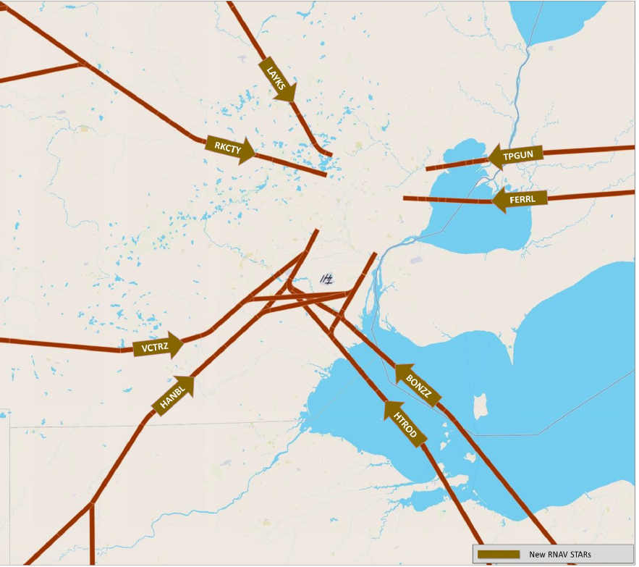
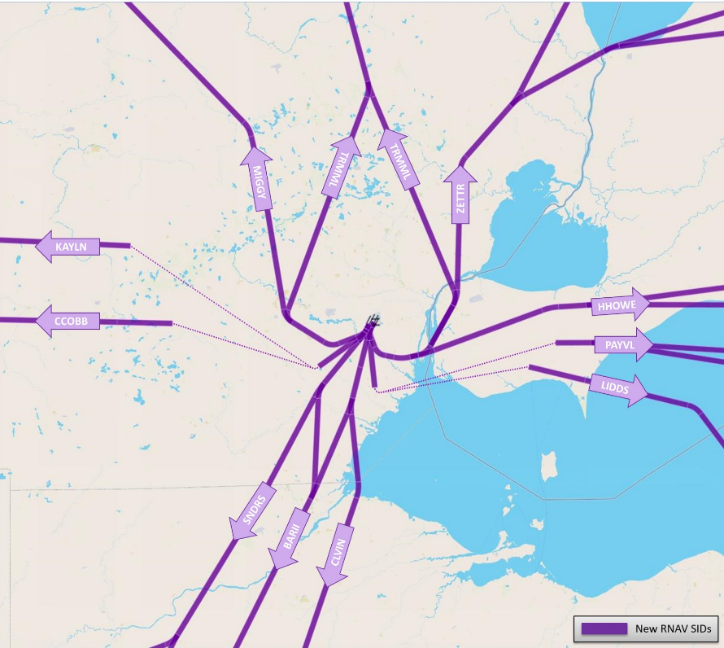
DTW is a Class B airport serviced by the Cleveland Air Route Traffic Control Center. They are the largest airport within the Cleveland ARTCC.
Below is a diagram of the D21 airspace for arrivals (right) and departures (left).
WFO
DTX
Downtown
Detroit
DTW

Slide 4
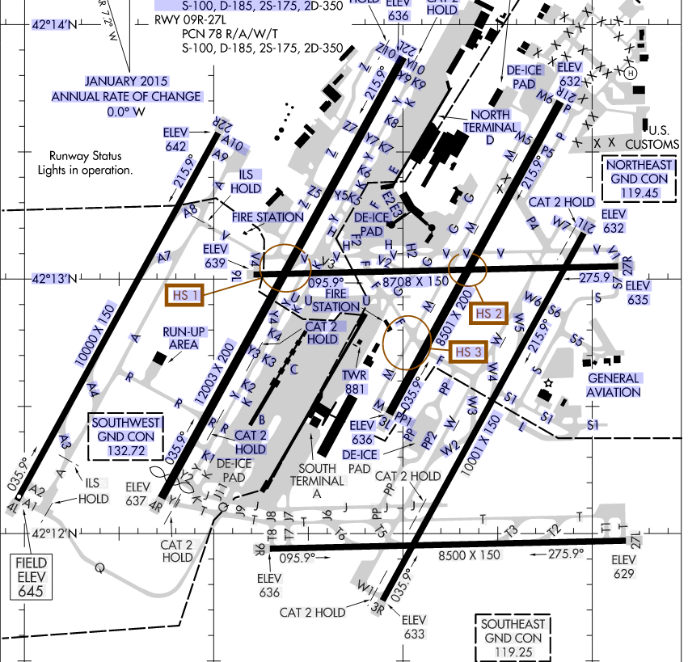
Below is a diagram of Detroit Metro Airport. Note the runway configuration 4 SW-NE oriented runways and 2 E-W oriented runways.

Slide 5
Main Users of DTW TAF
Traffic Management Unit (TMU) and other controllers at CLE ARTCC.
DTW air traffic control tower and TRACON.
Airline dispatchers, especially Delta Airlines and their meteorologist staff.
Forecasters at the CLE CWSU.
They use the DTW TAF extensively for their twice (at a minimum) daily briefings to the TMU and Detroit Metro TRACON.

Slide 6
Weather Conditions Which Have Large Impacts on DTW Operations
Winds
Sustained or frequent gusts exceeding crosswind thresholds on the 4 SW-NE oriented runways. This forces operations to use the two W-E oriented runways, which greatly reduces the capacity of the airport. If southwest flow operations are underway and a sudden and unexpected increase in the cross winds occur, the TRACON must then reconfigure the flow in and out of the airport, causing a ripple effect in the National Airspace and causing some aircraft to be placed in a holding pattern.
Winds at or above 7 knots from 340 to 90 degrees. These may force take offs to the northeast as opposed to the southwest. DTW must follow a court ordered noise abatement program which limits the amount of time per year that they can use northeast flow operations (it is densely populated northeast of the airport). So they prefer to stick to southwest flow operations.
Ceilings
5000 ft, [CAT F] Ceilings at or below this critical threshold will restrict visual approach to the airport. This means that aircraft must be spaced farther apart, which in turn greatly reduces the arrival rates. Almost every warm season, at least one of the SW-NE runways are closed due to construction and/or general maintenance, which then causes a hyper-sensitivity to this threshold.
200 ft, [CAT A] Cigs below 200 ft fall below airport minimums.
Dense Fog – Visibilities below ½ mile fall below airport minimums.
Thunderstorms – As with all major hubs, convection not only at the airport but anywhere within the airspace (especially at the arrival and departure fixes) greatly impact traffic flow in and out of the airspace.
Winter Weather – Intense snowfall rates, sleet and freezing rain/drizzle slow arrival rates due to the time it takes to clear runways and deicing operations.

Slide 7
WFO DTX Aviation Support
Shift duties at WFO DTX include a decision support services (DSS) desk twice a day (day shift and night shift). Short term and long term grids are done on the grid desk (day shift and night shift). The evening shift consists of two forecasters, one of whom is primarily dedicated to aviation services. The DSS desk focusses on near-term high impact weather, scheduled and unscheduled DSS services to local, state, federal partners, and aviation support.
Aviation Support consists of the following:
The standard 30-hour TAF for DTW and 24-hour TAFs for YIP, DET, PTK, FNT, MBS.
Enhancement to the aviation discussion for Detroit Metro specific thresholds.
Direct support to the CLE CWSU, which indirectly supports the TMU at the Cleveland ARTCC and the DTW TRACON.
Direct support to Wayne County Airport Authority (WCAA). They are responsible for clearing and treating runways in the cool season and runway construction projects in the warm season.

Slide 8
DTW Specific Aviation Discussion
AFD FORMAT: One paragraph will give a general overview of the forecast for SE MI TAF sites, with emphasis on the first 6 to 8 hours. The second paragraph will discuss concerns for DTW specifically. The focus being mainly on timing of high impact events forecast to hit DTW and specifics with respect to DTW thresholds. The last section will be a list of potential threshold criteria (which have at least of low probability of occurrence) and their probability of impacting DTW (low, medium or high).
DTW THRESHOLD PROBABILITIES:
Crosswinds with high wind speeds
Thunderstorm potential
Precip type for winter weather (when temps are in a range of 25-45 deg and/or when precip type is a concern).
Potential for ceilings to be at or below 5000 ft
Potential for cigs/vsby to fall below 200ft and/or 1/2SM

Slide 9
Aviation AFD – Examples
//DISCUSSION…
A COLD FRONT WILL TRACK ACROSS SE MI BETWEEN 18Z AND 22Z THIS AFTERNOON. DEEP MIXING HEIGHTS WILL PROMOTE INCREASING WESTERLY WINDS IN ADVANCE OF THIS FRONT…WITH GUSTS EXPECTED TO APPROACH 30 KNOTS. AMPLE DAYTIME INSTABILITY IS EXPECTED TO LEAD TO A SOLID LINE OF THUNDERSTORMS AHEAD OF THE FRONT…SOME OF WHICH MAY PRODUCE VERY STRONG WINDS. WINDS WILL VEER SHARPLY FOLLOWING FRONTAL PASSAGE. RESIDUAL LOW LEVEL MOISTURE MAY LEAD TO SOME MVFR OR IFR FOG AND STRATUS TONIGHT.
FOR DTW…THE FRONT WILL MOVE THROUGH AROUND 21Z…WITH THUNDERSTORMS EXPECTED A GOOD 2 TO 3 HOURS IN ADVANCE OF THE FRONT.
//DTW THRESHOLD PROBABILITIES…
HIGH FOR WIND GUSTS TO REACH 30 KNOTS FROM 260-270 DEG THIS AFTERNOON.
HIGH THAT THUNDERSTORMS WILL OCCUR THIS AFTERNOON.
MEDIUM THAT CEILINGS WILL FALL BELOW 5000 FT AFTER 22Z.
___________________________________________________________________________________________________________________________________________________
//DISCUSSION…
DEEPENING LOW PRESSURE WILL MOVE FROM OHIO INTO SOUTHERN ONTARIO TODAY. THIS SYSTEM WILL PRODUCE A WIDE SWATH OF PRECIPITATION ACROSS THE SE MI TERMINALS. A RAIN SNOW MIX WILL DEVELOP OVER THE REGION BETWEEN 14Z AND 16Z AND CHANGE OVER TO ALL SNOW BY MID AFTERNOON BEFORE ENDING AROUND 02Z THIS EVENING. THE PERIOD OF HIGHEST INTENSITY SNOWFALL WILL BE BETWEEN 20Z AND 00Z.
FOR DTW…A LITTLE WARMER AIR IN METRO DETROIT WILL CAUSE THE PRECIPITATION TO BEGIN AS ALL RAIN BEFORE EVENTUALLY CHANGING OVER TO SNOW. THIS CHANCE OVER SHOULD OCCUR BETWEEN 18Z AND 20Z. AN ACCUMULATIONS OF 3 TO 6 INCHES OF HEAVY WET SNOW IS EXPECTED BY 02Z AS SNOWFALL RATES MAY EXCEED AN INCH PER HOUR AT TIMES.
//DTW THRESHOLD PROBABILITIES…
LOW FOR PRECIP TYPE TO BE SNOW PRIOR TO 18Z. HIGH AFTER 18Z.
HIGH THAT CEILINGS WILL REMAIN BELOW 5000 FT TODAY AND TONIGHT
MEDIUM THAT VISIBILITIES WILL FALL BELOW ½ MILE IN HEAVY SNOW LATE THIS AFTERNOON AND EVENING.

Slide 10
Direct Support to CLE CWSU and DTW TRACON
D21 Dashboard – This is a one stop shop web page with tabs to give useful forecast data to the CLE CWSU forecasters to help them gather information for their briefings to the TMU and DTW TRACON. This page is also available to the DTW TRACON.
Overview Page: one or two page graphic summarizing the main weather concerns for the D21 airspace. Created by the DTX DSS forecaster on duty. [More on this later]
Discussion: Latest aviation discussion from DTX AFD.
TAFs: Latest TAFs within and near the D21 airspace.
Wind and Gust: Probability graphs for sustained winds and wind gusts generated off NDFD and ensemble guidance. Also wind rose data for sustained and gusts based off ensemble guidance.
DTW Flow and DTW Flow (Gust): Detroit Metro flow probabilities based on ensemble winds, updated hourly (hourly forecasts to 18 hours, every three hours to 36 hours). Uses ensemble winds and critical wind thresholds at DTW to determine the most likely runway configuration used for take offs and landings.
Convection: Latest CCFP’s and probability graphs for convection at DTW and the surrounding area.
Snow: 1 and 6 hour probability graphs for snow, expressed as time periods of highest snowfall rates .

Slide 11
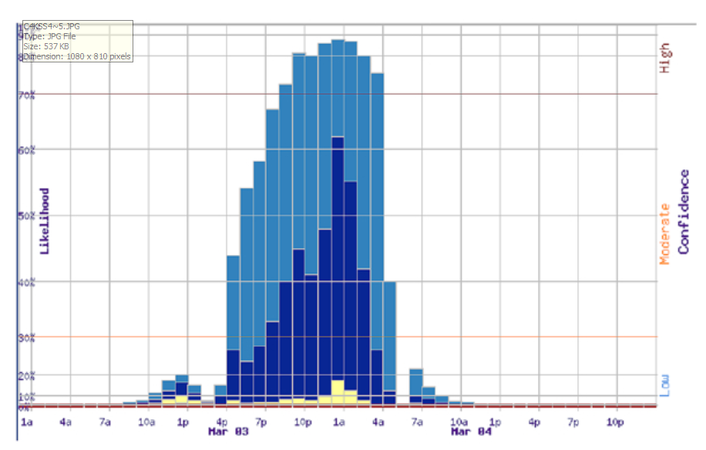
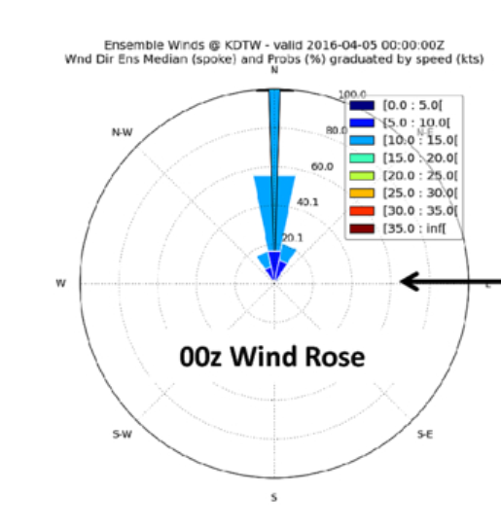
Some Examples From the D21 Dashboard
Ensemble Wind Rose
Probability of Snow Graph

Slide 12
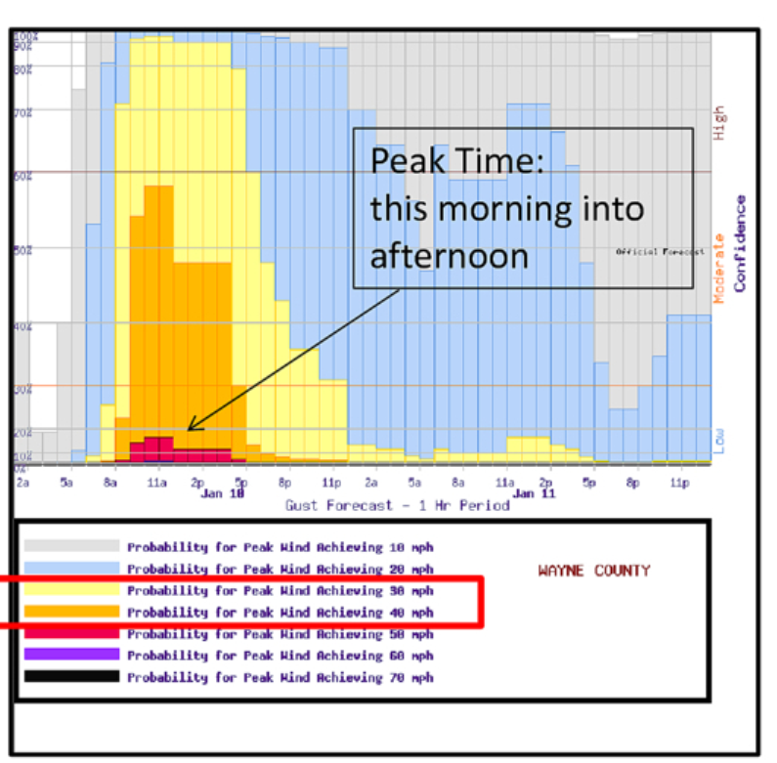
More Examples From the D21 Dashboard
Probability of Wind
Gusts Graphs

Slide 13
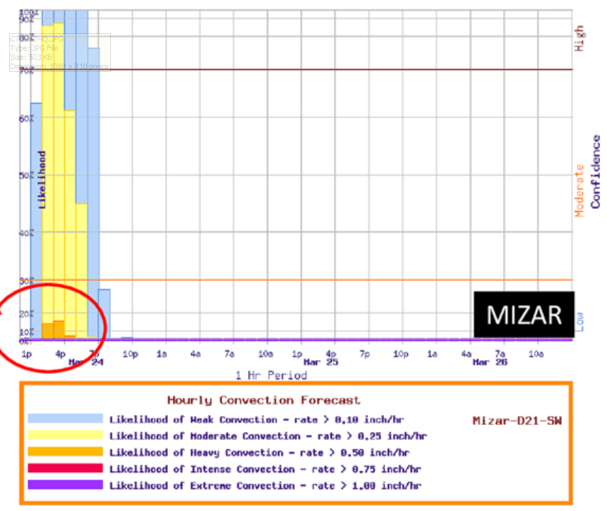
More Examples From the D21 Dashboard
DTW
Probability of convection graph Detroit Metro Airport

Slide 14
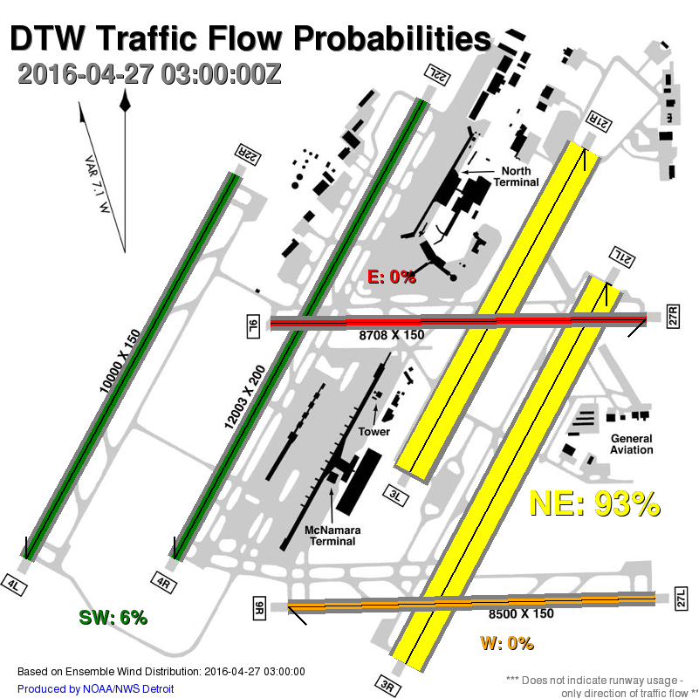
More Examples From the D21 Dashboard
Flow probabilities based
on ensemble winds and
DTW wind thresholds.
In this case, light NE winds
are favoring taking off
to the northeast. (Again
SW is the favored flow
for metro airport).

Slide 15
D21 Support Overview Page
Created by DTX DSS forecaster once a day and posted to the web page by 5 AM local time, one to two hours prior to the morning briefing to the controllers at the Cleveland Center.
Gives the CWSU and DTW TRACON a quick overview of the most important weather concerns to the D21 airspace. The 5 AM page is useful to the CWSU forecaster, who only has a short time between arriving in the morning and briefing the ARTCC controllers and TMU.
Utilizes various graphics from the D21 dashboard and other images to highlight the main weather concerns, like graphical model output.

Slide 16
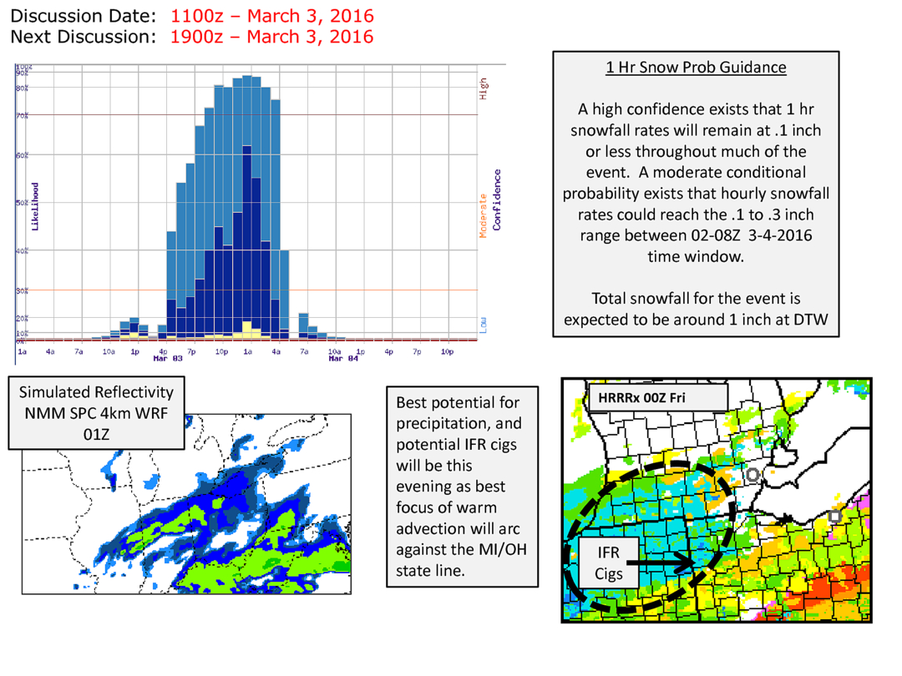
D21 Snowfall Event Example

Slide 17
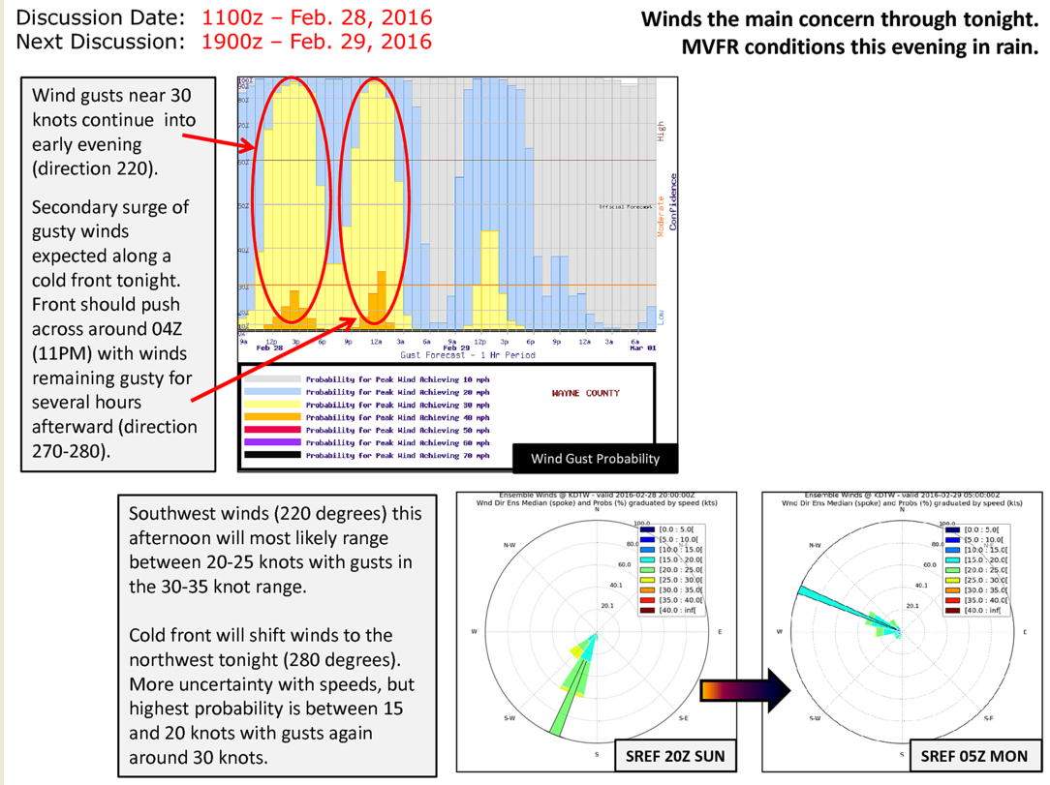
D21 High Wind Event Example

Slide 18
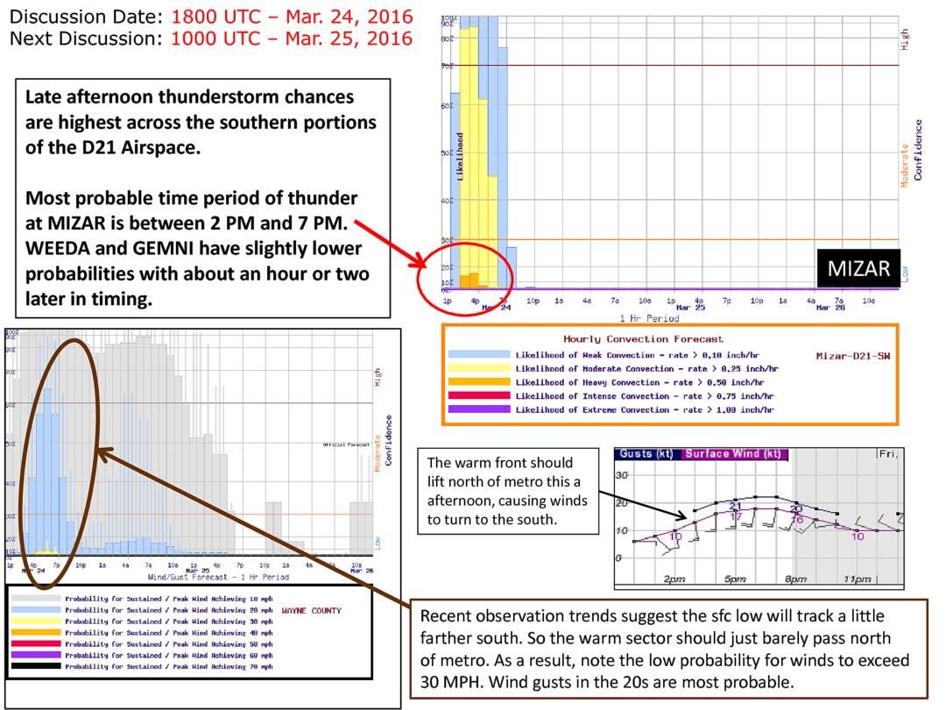
D21 Chance of Thunderstorms Example

Slide 19
D21 Northeast Wind Example

Slide 20
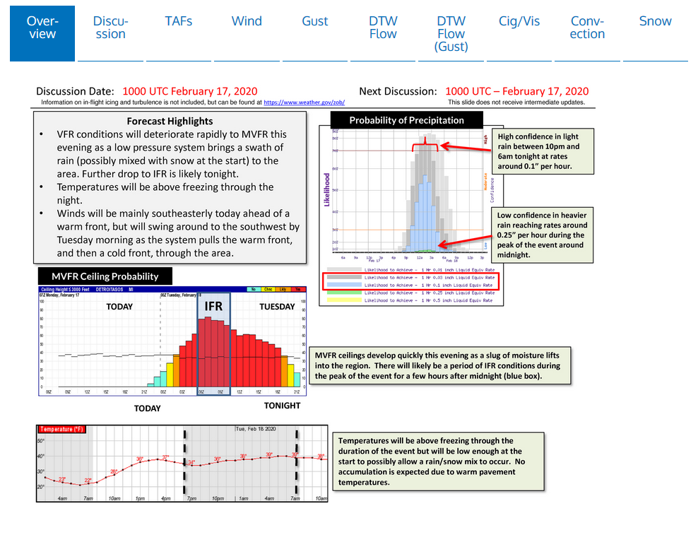
Example – Full D21 Support Web Page

Slide 21
Wayne County Airport Authority (WCAA)
Detroit Metro Airport (DTW) is owned and operated by Wayne County.
WCAA is responsible for removing snow and for the treatment and prevention of ice on the runways and taxiways.
The efficiency with which they can accomplish this has direct impacts on air traffic operations at the airport.
This often places them in high stress situations as they must meet safety standards while at the same time try to mitigate weather related delays at the airport.
During the warm season months, WCAA completes runway and taxiway construction and maintenance projects.

Slide 22
WFO DTX Support to WCAA
During the Cool Season
Maintain a winter weather season forecast page (dashboard).
Send a one to two page forecast slide as needed (when winter precip is forecast within the next couple of days).
Participate in hourly WCAA led conference calls leading into and during a winter precipitation event.
Provide direct communication via either phone calls or in a WCAA chat room with short fuse forecast updates, especially to notify them of approaching intense snowfall or freezing precip.
During the Warm Season
Weather conditions are typically not as impactful as their projects are planned for well in advance and are not as weather sensitive.
A couple of examples of when warm season support was needed (which was given via direct phone communication).
When concrete work or painting was impacted by rain.
When locally heavy rainfall caused holding ponds to overflow and flood a portion of a runway.

Slide 23
The WCAA Dashboard
Like the D21 Dashboard, this is a one stop shop web page that gives valuable forecast information to the WCAA. It consists of:
An overview page which gives forecast info in a graph, regional radar and current observations.
Snow intensity page which gives one hourly, 3 hourly, and 6 hourly snowfall rates in a graphical format. It also gives a probability graph of snowfall character (detailing the water content of the snow).
The snow page gives a forecast of total snowfall in six hourly time periods and an event total.
The precip type page gives probabilities of snow, freezing rain and sleet.
The wind page gives wind speed and direction probabilities.
The gust page gives the speed and direction probabilities for the peak wind gusts.
The outlook page gives a 3 to 7 day forecast outlook for planning purposes.

Slide 24
WCAA Forecast Slides
These are sent directly to the WCAA via email when there is the risk of either accumulating snow or freezing precipitation; usually within the next three days.
These are updated at a minimum of twice a day when new forecast information becomes available.
The WCAA uses these forecasts as tactical decision aids to prepare staffing and equipment needed to deal with forecast winter weather.
The forecast slides are tailored to address the most important forecast elements dependent upon the type of winter weather expected. Some of the items that may be included in these forecast slides are:
Time periods of accumulating snow
Expected snowfall rates
Liquid content of the snow
Total forecast snow accumulations
Probabilities of icing
Hourly temperature forecasts
Hourly wind speeds and directions; important for blowing snow
Expressions of forecaster confidence and/or forecast challenges are also often included.

Slide 25
WCAA Forecast Slide Example - Heavy Snow

Slide 26
WCAA Forecast Slide – Freezing Rain

Slide 27
WCAA Conference Calls
WFO DTX participates in hourly conference calls led by the WCAA operations center.
These are conducted every hour leading into and during a winter weather event.
We provide a brief forecast on these calls. The forecasts are for ongoing conditions and conditions in the very near future. We also answer questions from other participants on the call.
Participants include; WCAA operations and ground crew, FAA personnel, airline representatives (usually dispatchers); Delta Airlines is always on the call as they are DTW’s major airline.

