Slide 1
Overview – NWS Detroit WCAA Forecasts
WCAA Slide Production – Created and sent between 3 to 5 AM and 3 to 5 PM, coinciding with latest forecast information and updated graphics.
Near term forecast update information or clarification will be entered on Passur and/or via a phone call.
To convey any expected change in forecast conditions, usually within the next 6 hours.
To notify of an approaching snow squall, or rapid increase in snowfall intensity.
To notify of approaching freezing rain/drizzle or timing of precip change over.
To provide start and end times to precipitation.
During ongoing events or leading into an event, NWS Detroit will participate in the hourly conference calls.
NWS Detroit will be available for forecast questions, concerns, or clarification 24/7 via phone or Passur.

Slide 2
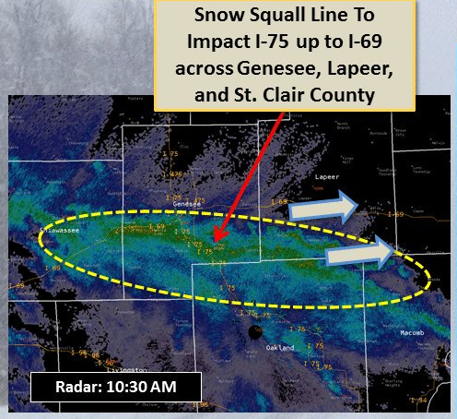
Snow Squalls
Meteorology Definition: Producing ½ to ¼ mile in heavy snow for 15 minutes or more, along with gusty winds.
The potential will be mentioned in the forecast; ie slide deck. However, very hard to predict exact track beyond two hours.
Radar rule of thumb: 30+ dBZ or greater on radar
Flash freeze potential with roads around freezing or below.
Can produce a quick half inch or more in very short time; snowfall rates often exceed 2 inches per hour.
The cause at metro Detroit is often lake effect off Lake Michigan or along the passage of a cold front.
12/25/17 – Snow squalls pushed inland from Lake Michigan
Visibilities dropped to near zero
Snowfall rates were near 2 inches per hour
Snow totaled 1.5 inches on pavement in just 40 minutes

Slide 3
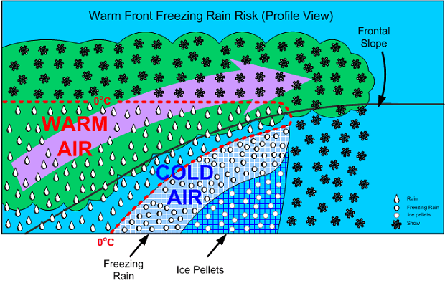
Freezing Rain
Rain falls into a shallow layer of subfreezing air near the surface, and freezes on contact.
Often occurs with multiple precipitation types present across the region.
Precip type transition timing and location can be difficult to predict.

Slide 4
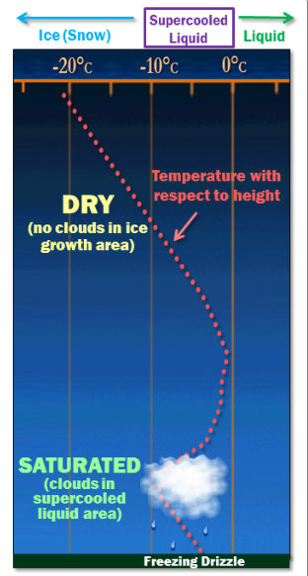
Freezing Drizzle
One of the most challenging precipitation types to forecast because:
Lift is much weaker than with rain or snow.
Requires a specific temperature and moisture profile.
The very small droplets are not always detected on radar.
Meteorology
Forecasters analyze precipitation elements (hydrometeors) from top down in the atmosphere, accounting for what state they start as, change (melt, freeze, or both), and then what state they reach the surface.
Snow forms in the atmosphere were temperatures are colder than -10C.
At 0 to -10C, precipitation forms as supercooled liquid droplets.
Subtle lift will cause these to collide and form drizzle.
Air and pavement temps below freezing lead to freezing drizzle.
It often only takes a small amount of freezing drizzle, sometimes so light one cannot even see it, to cause icing onto paved surface.
Special Case – Rain falls onto subfreezing pavement
Usually occurs when air temperatures rise as the rain moves in.
Typically when warm moist air replaces an arctic air mass.

Slide 5
Example – Jan 22, 2019 Freezing Rain

Slide 6
Example – Feb 4, 2019 Freezing Rain

Slide 7
Example – Feb 26, 2019 Snow Liquid Ratio

