Slide 1
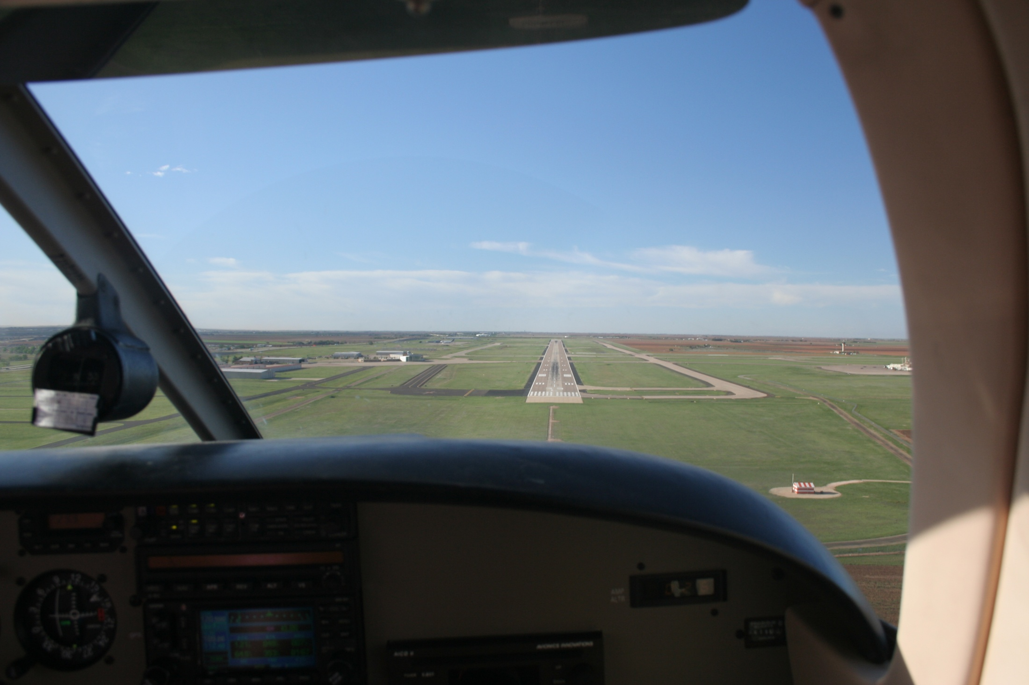

SAWS 2015 KLAS
Flight Hazards Associated
with Thunderstorms &
Weather Radar Interpretation
Joe Jurecka CP ASMEL, IA
National Weather Service
Lubbock, TX

Slide 2
Outline
Thunderstorm Hazards and morphology
Radar limitations
In flight radar
Radar vs. visual
Avoidance tips
Scenarios

Slide 3
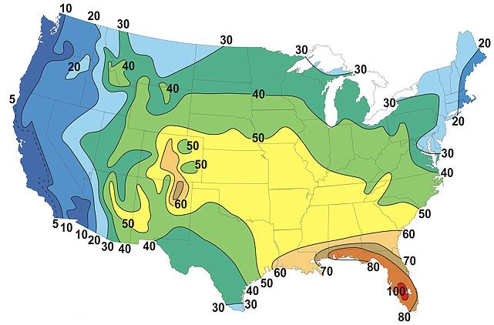
US Thunderstorm Distribution
Average Number of Thunderstorm Days Per Year
noaa.gov
Notes:
The west may look less formidable, but there are traps for both east and west coast pilots who traverse the divide. The storms are often very different beasts. Garden variety storms in the west often have more geospatially diverse hazards.

Slide 4
Thunderstorm attributes
What is a thunderstorm?
Any storm (rain or snow) which produces lightning (IC/CG)
Formed when three ingredients combine
Moisture, instability, and a trigger (lift)
Hazards
Large hail, tornados, severe icing, severe turbulence, downburst winds, lightning
E.g. don’t even think of flying into one!

Slide 5
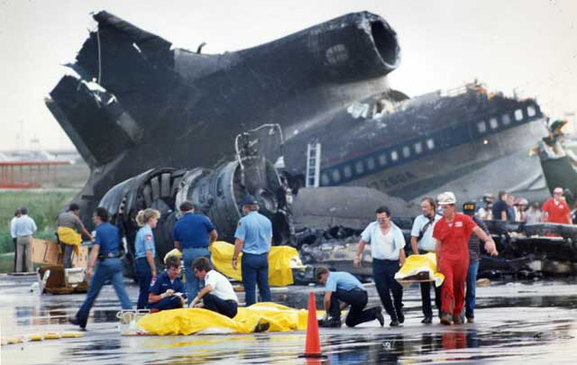
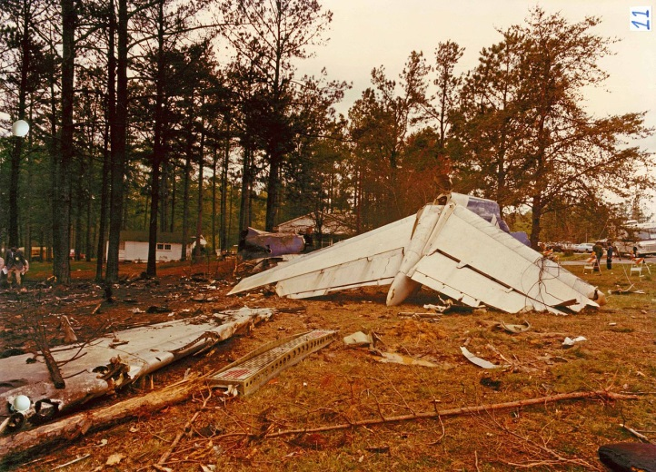
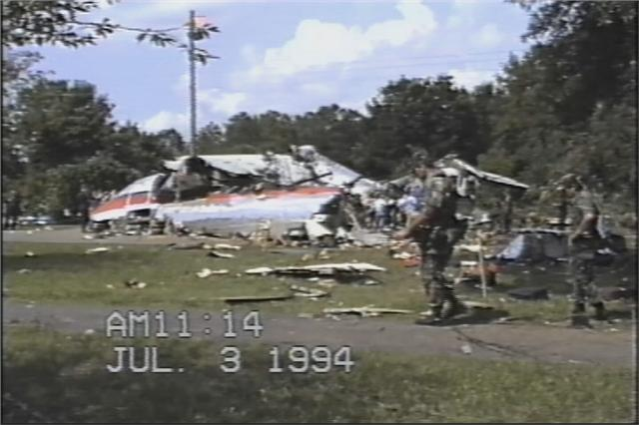
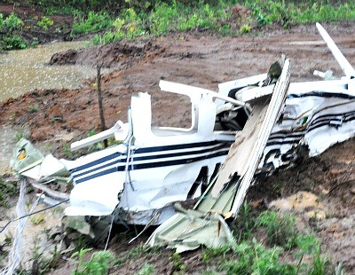

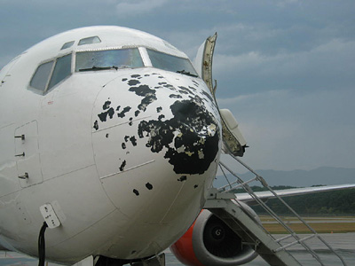
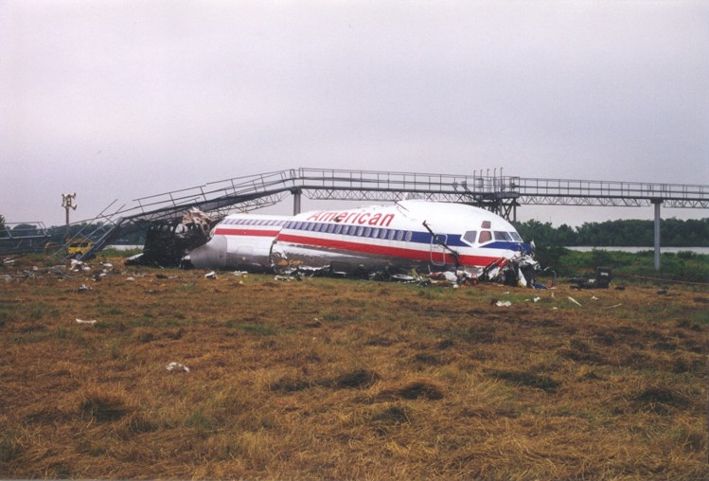
Still thinking of trying?
It just doesn’t often end well!
“The probable cause of this accident was the captain's decision to penetrate rather than avoid an area of severe weather…” Southern Air 242

Slide 6
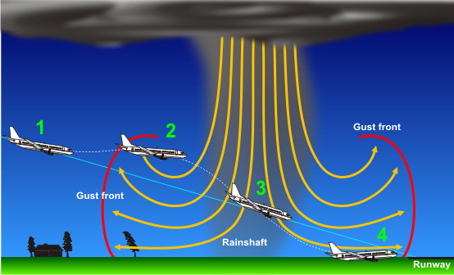
How about near a thunderstorm?

Slide 7
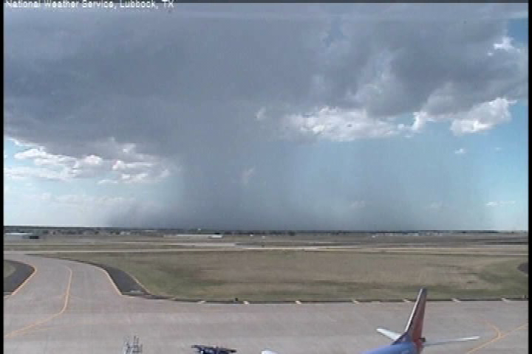
Outflow/Downburst
50+ KT
Winds

Slide 8
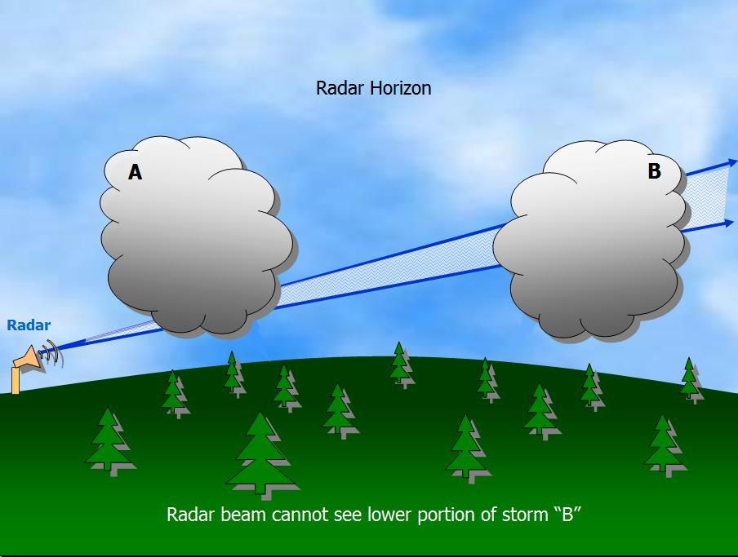
Radar limitations overview

Slide 9
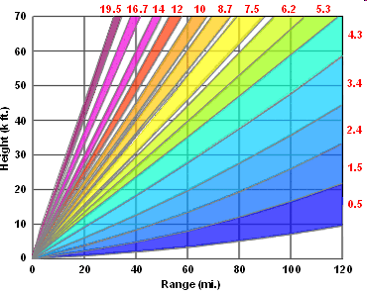
Radar Limitations
Storm above or below radar beam
Severe Weather Mode

Slide 10
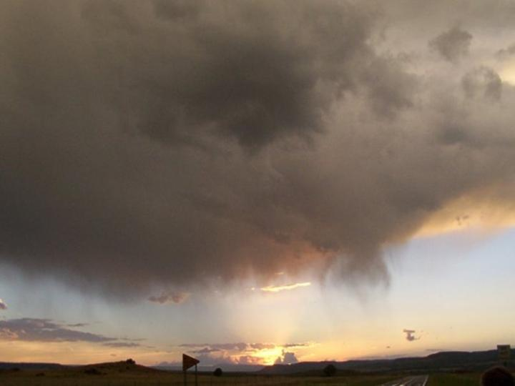
Radar Limitations
Below Beam Effects

Slide 11
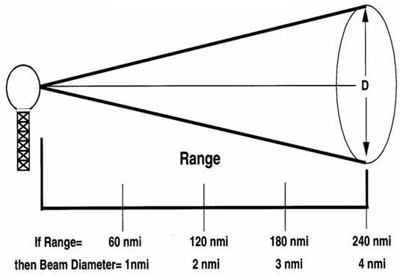
Radar Limitations
Rain too far from radar
(or too weak with beam broadening)
Radar Limitation 1: Rain too Far from Radar Cause 1: Beam Broadening

Slide 12
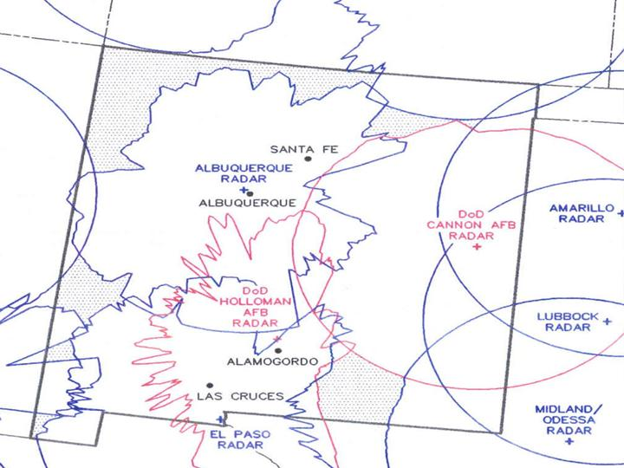
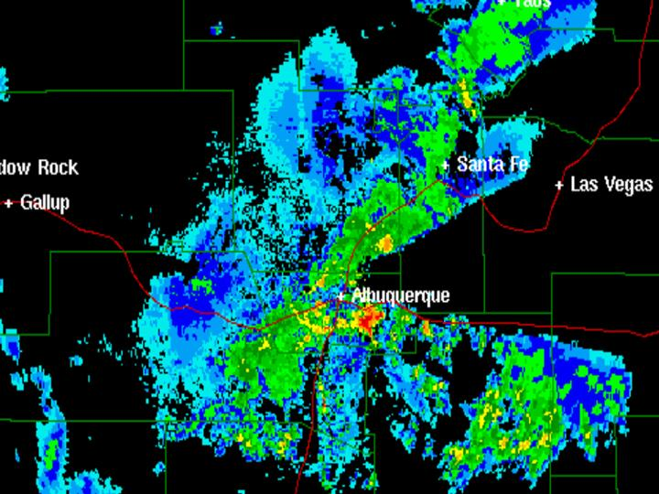
Radar Limitation
Terrain blocking
Rain Blocked from Radar View
Radar Limitation 2: Rain Blocked from Radar View

Slide 13
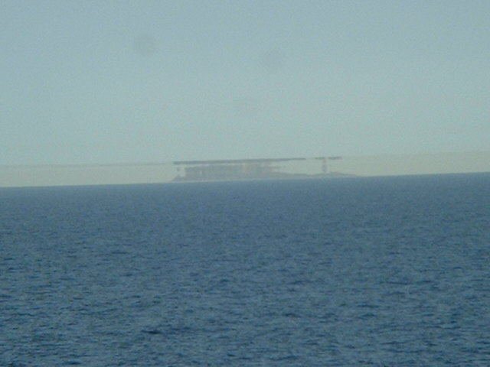
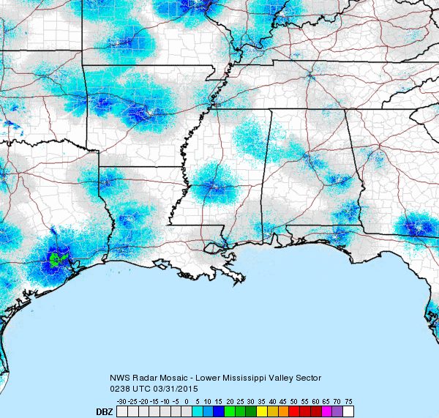
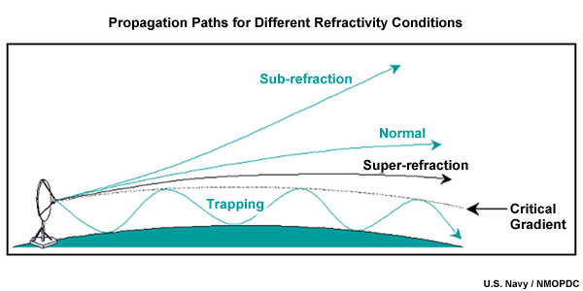
Radar Limitations
Ground Clutter and Super refraction
http://confluence.org/dk/all/n56e011/pic10.jpg
noaa.gov

Slide 14
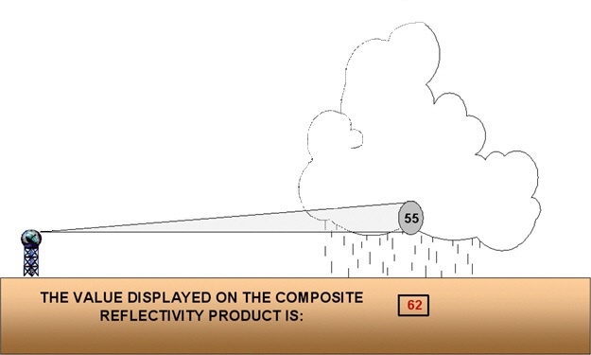
Base Reflectivity (lowest tilt 0.5°)
The intensity displayed is 55 dBZ.

Slide 15
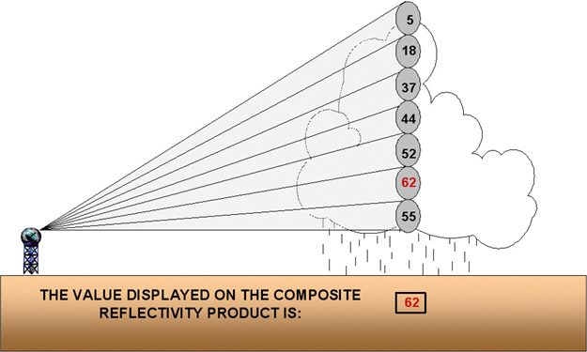
All radar tilts (0.5° to 19.5°)
max intensity

Slide 16
Composite Reflectivity
The intensity displayed is 62 dBZ.

Slide 17
Composite vs. base reflectivity
Composite Reflectivity | Base Reflectivity
Yes | No, unless storm is far from radar.
Most times | Most times
Sometimes | Yes
Yes | No
Shows developing storms?
Shows fronts, wind shifts?
Shows fine details like thunderstorm gust fronts?
Blocky appearance?

Slide 18
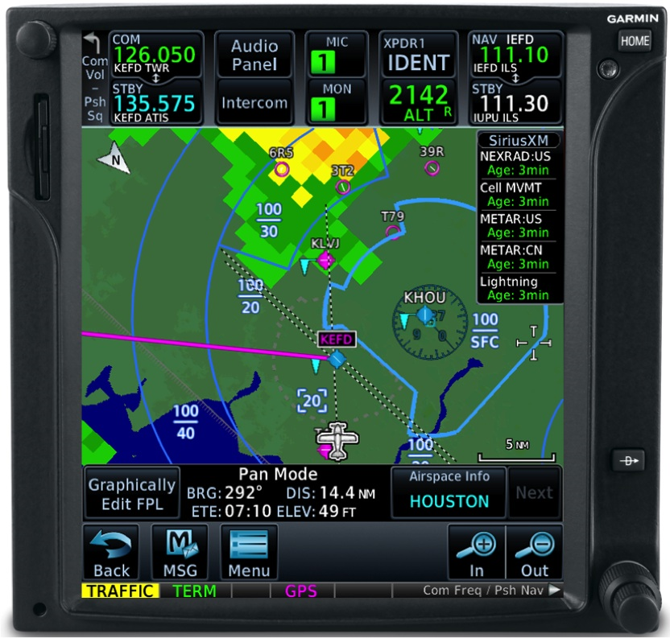
What do you get?
Composite or Base?
Did everything
update 3 mins
ago?
Likely not!
Update frequencies:
METARs 60m (~H+53)
Composite 4-10 min
Base 2-10 min
Cell movement 4-6 min
Lightning update times
often not published!
You don’t know what you don’t know
garmin.com

Slide 19
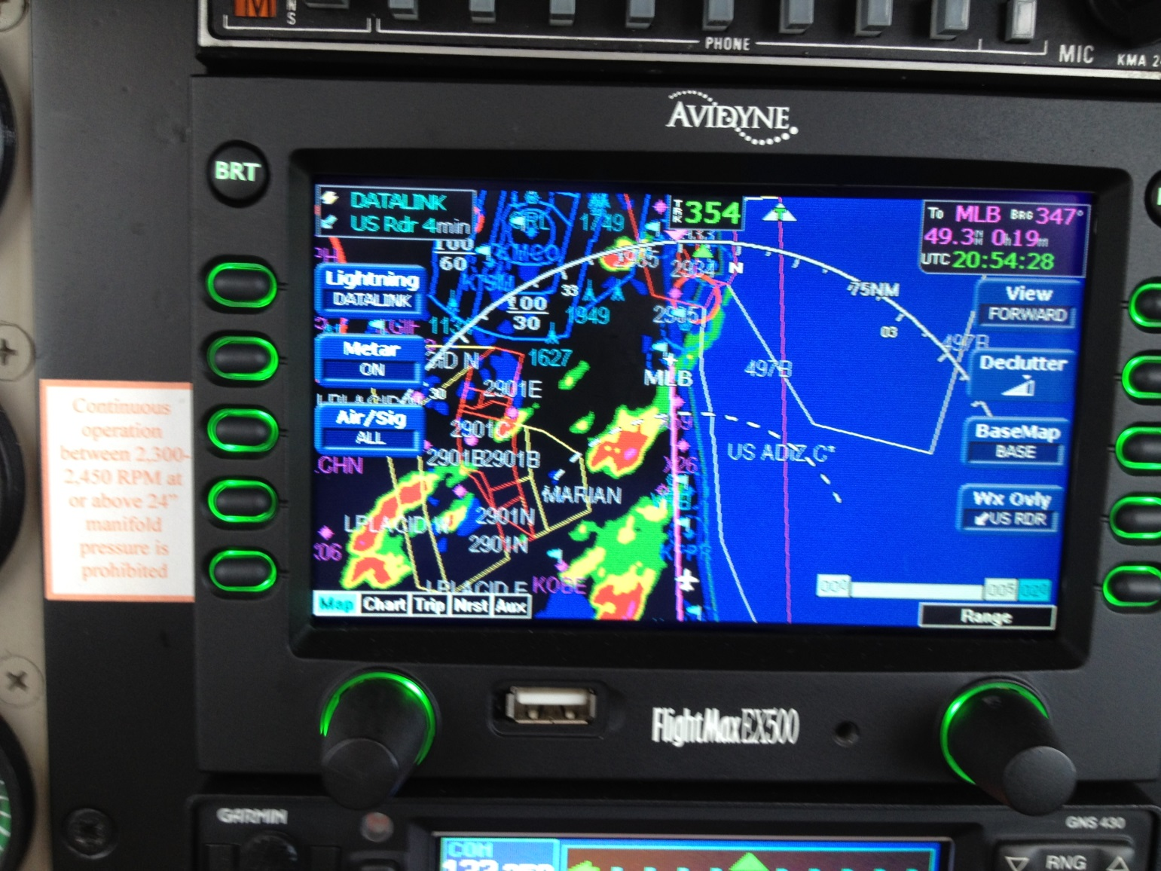
What do you get?
Understand your
timestamps!
4 mins since what?
  Base scan start or
  Base scan finish or
  Mosaic creation or
  When downloaded
Beware of filtering!
Filtering means MISSING DATA
Eliminating ground clutter also eliminates outflow boundaries
https://bonanza36.files.wordpress.com/2012/11/img_0295.jpg

Slide 20

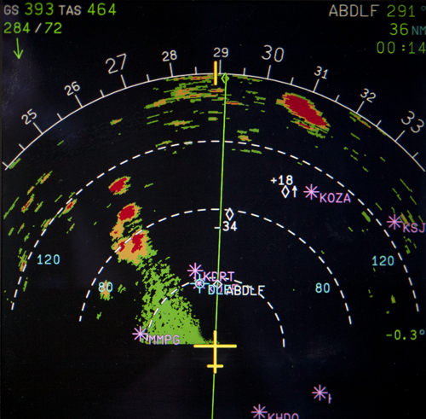
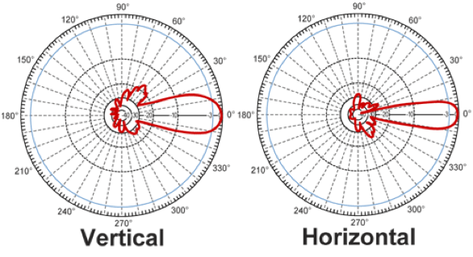
May 23 2011 Ozona, TX
WSR 88D 0.95°
Typical GA radar 7°
Typical airline radar 3°
http://www.photos4u2c.net/2011/05/26/the-atmosphere-is-ripe/

Slide 21
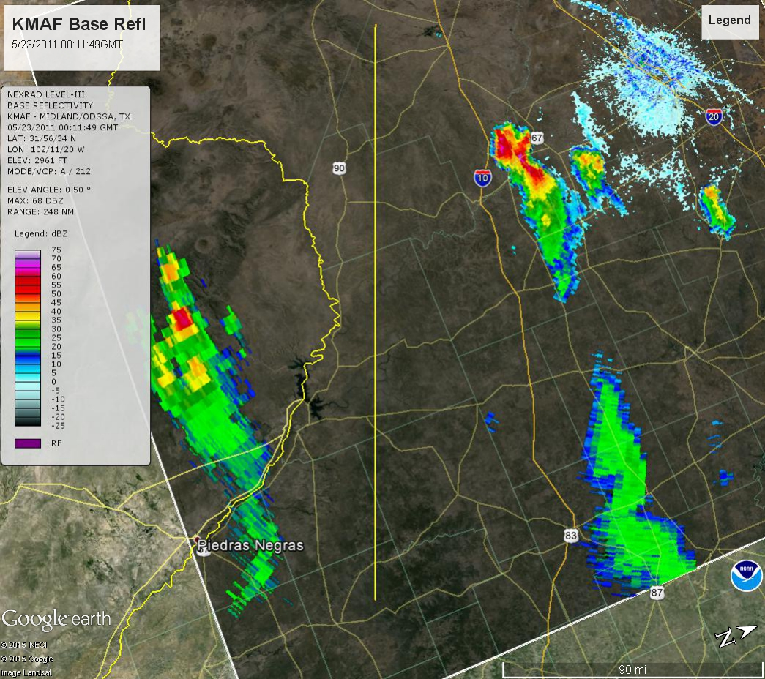

May 23 2011 Ozona, TX

Slide 22
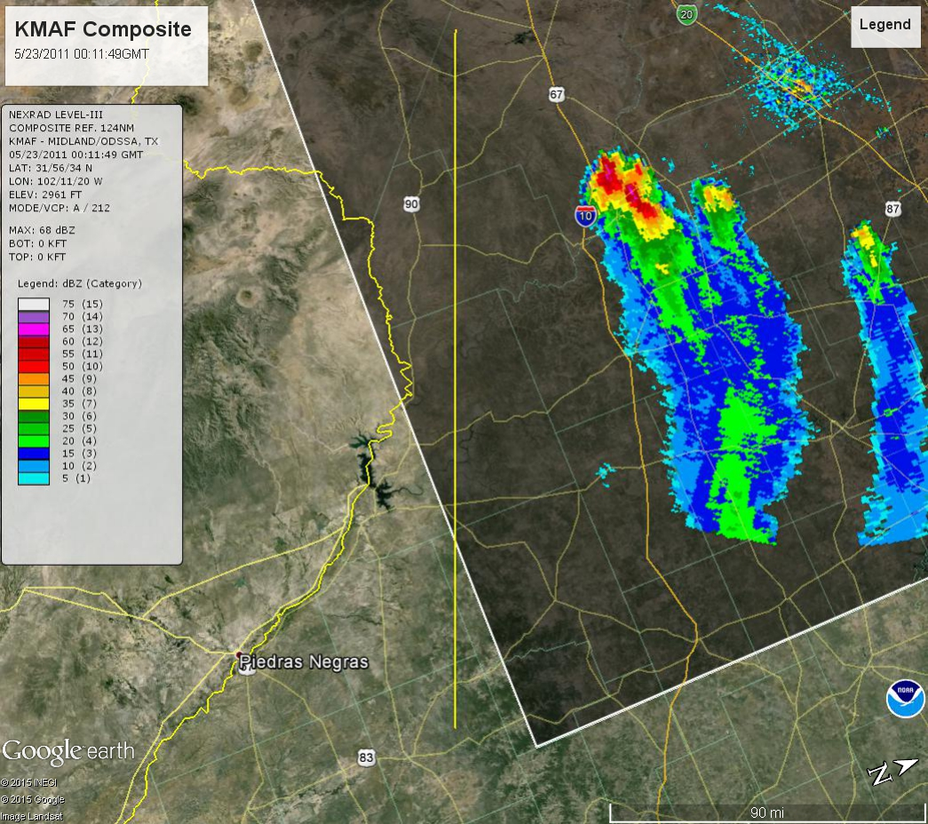
May 23 2011 Ozona, TX
May 27? 2011 DRT

Slide 23
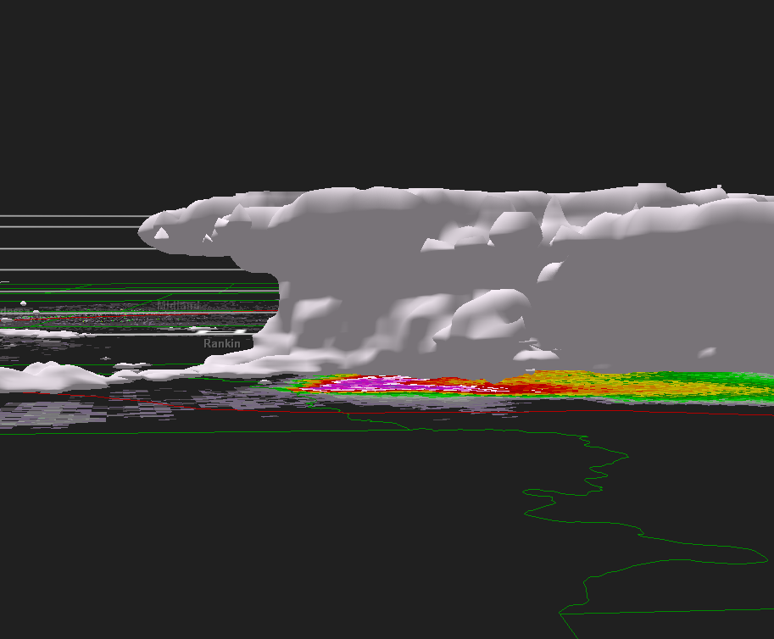
Volumetric Radar

Slide 24
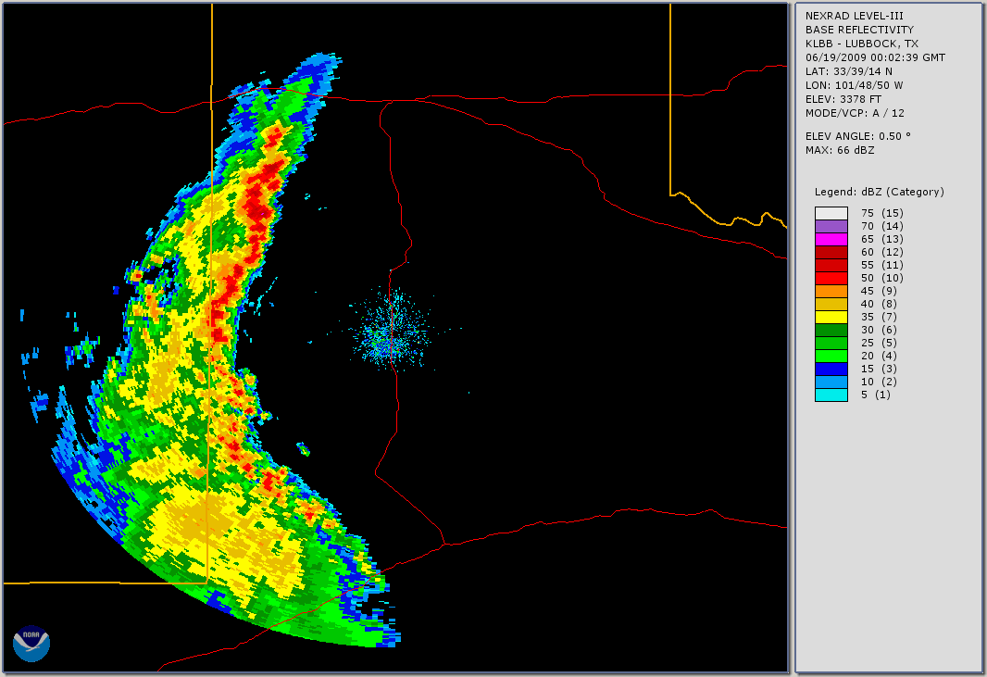
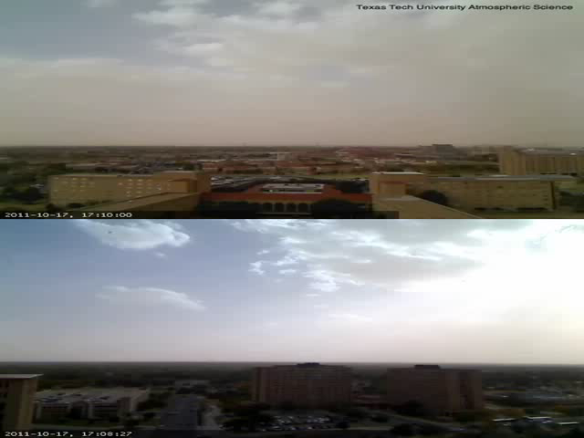
18 Jun 2009

Slide 25
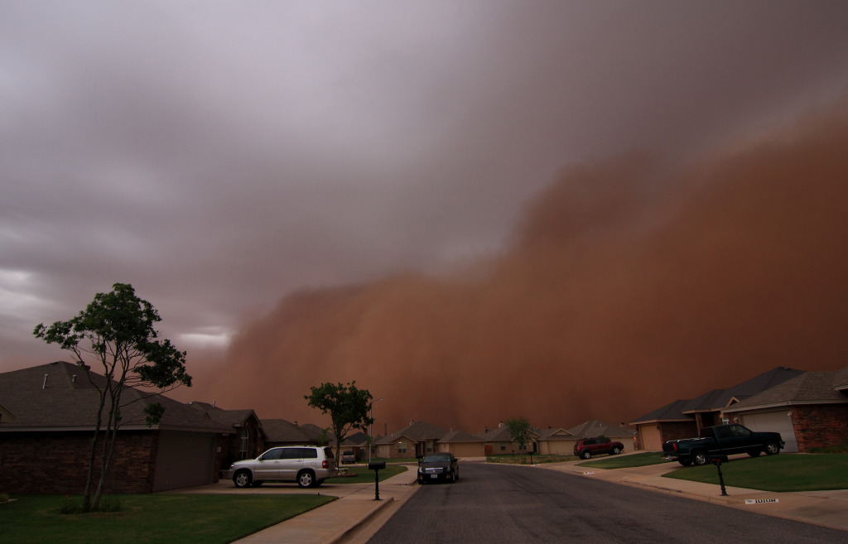
18 Jun 2009 Haboob
Haboob+C182 = 2 dead
Todd Lindley, NWS

Slide 26
18 Jun 2009 Haboob
Texas Tech Atmospheric Sciences

Slide 27
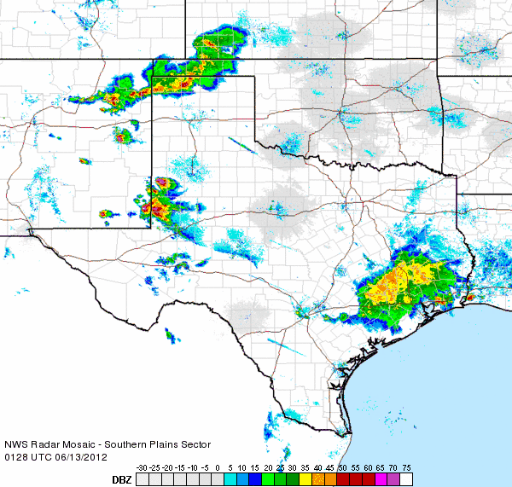
Deviant Motion

Slide 28
Some rough guidelines
Know the mean storm motion before departure. This is typically the average of the 3000’-30000’ winds.
Avoid the vicinit all thunderstorms.
Never go closer than 5 miles to any visible storm cloud with overhanging areas, and strongly consider increasing that distance to 20 miles or more.
You can encounter hail and violent turbulence anywhere within 20 miles of very strong thunderstorms.
Do not attempt flight beneath thunderstorms, even when visibility is good, because of the destructive potential of shear turbulence in these areas.
At the first sign of turbulence, reduce airspeed immediately to the manufacturer's recommended airspeed for turbulent air penetration for a specific gross weight (that is, maneuvering speed, or Va).
https://www.faasafety.gov/files/gslac/library/documents/2011/Aug/56397/FAA%20P-8740-12%20Thunderstorms[hi-res]%20branded.pdf

Slide 29
More rough guidelines
If radar paints "moderate" or "heavy" precipitation (previously Level 2 or Level 3; see box on page 18), maintain at least 20 miles separation from the moderate echoes.
When deviating around storms, maneuver on the upwind side so wind isn't carrying the storm toward you, and to avoid hail that might spew from the anvil top.
Avoid flying under thunderstorm cells themselves, where you may find powerful turbulence and intense rain or hail.
http://www.aviationsafetymagazine.com/airplane/Flying-In-Thunderstorms.html

Slide 30
Final thoughts
Stay away from thunderstorms and all which emanate from them
Hazards exist well beyond the precipitation echo
Look for surface clues if possible
Know your equipment and what it provides and what it hides
Understand data update characteristics

Slide 31
Thank you
joe.jurecka@noaa.gov
Joe Jurečka
National Weather Service
Lubbock, TX

Slide 32
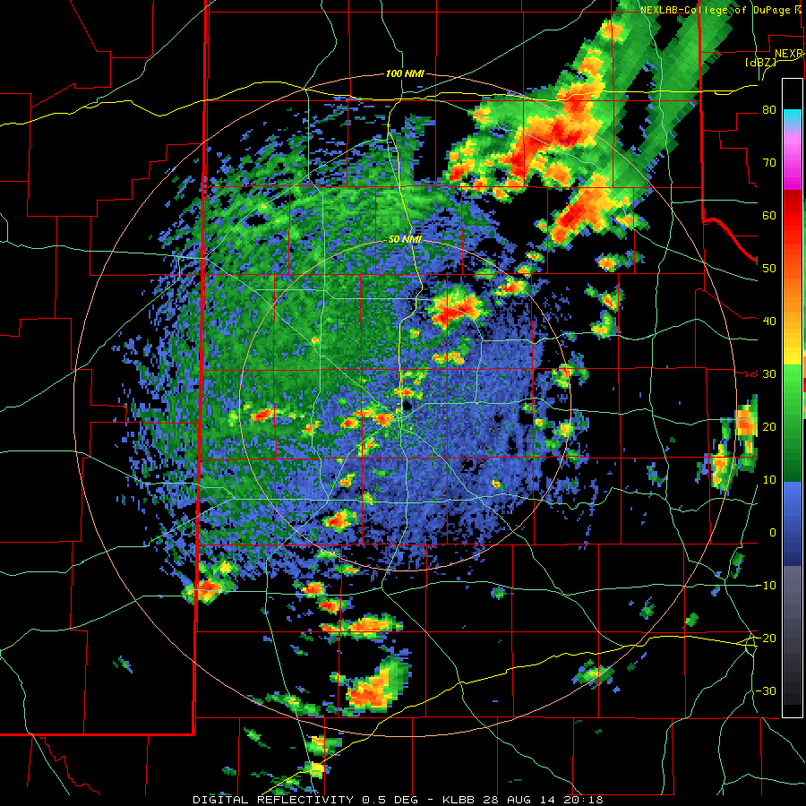
What would you do?
DFW to AMA

Slide 33
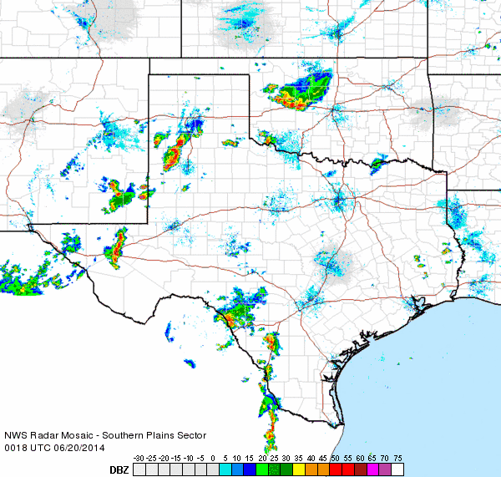
What would you do?
DFW to AMA

Slide 34
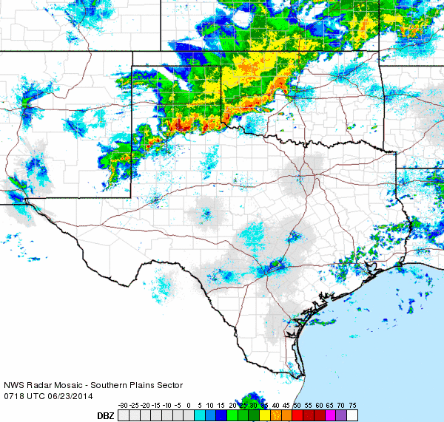
What would you do?
DFW to AMA

